Slide 1

Project Diamond
Digital Due Diligence

Slide 2
DISCLAIMER
In accordance with our agreement on our proposal dates as of June 29th, 2020 (the “Agreement”) between Apax partners (the “Client”) and eleven Strategy Consultants (“eleven”), we attach our report related to the digital strategic buyer due diligence of CG.
This document is confidential. It has been prepared by eleven for the sole use of the parties to whom it is addressed. Eleven will accept no liability or responsibility to any person other than the Client and then only as referred to in the Agreement. Eleven does not provide legal, accounting or tax advice. Client is responsible for obtaining independent advice concerning these matters, which advice may affect the guidance given by eleven.
The analyses and conclusions contained in this report were concluded within three-week period from June 29th, 2020.
The report is based upon information obtained from the Client and from other sources deemed to be reliable. Market analyses and projections represent eleven’s judgment, based upon data sources cited, and are subject to the validity of the assumptions noted herein.
For purposes of the analyses presented in this report, eleven has relied upon, and considered accurate and complete data obtained from the Client and its advisers, publicly available information, interviews with clients, competitors of the Group as well as market experts. Eleven has not independently verified the completeness or accuracy of that data and assumes no responsibility for it. No representation or claim is made that the results projected will actually be achieved.
It is expected that the recipient will conduct its own independent analysis. All estimates and projections contained in this report are based on data obtained from the sources cited and involve significant elements of subjective judgment and analysis, which may or may not be correct.
Eleven has made no undertaking to update these materials after the dates cited in the Agreement.

Slide 3
This document is the result of a one-week engagement, which concentrates on a red flags analysis over 5 main disruptive digital areas and on a review of potential growth opportunities for CG
Start:
29th of June
1.5 week (full-team)
Today
Go /
No Go
0.5 week (full team)
1 week (reduced team)
Pre Apax’ offer proposal to CG management
Follow-up if offer accepted
Red Flags analysis on CGB2C activity (Alpheis)
A
Red flags analysis on CG’s B2B2C digital platform Alpheys business, including:
Mapping of B2B customers journeys and associated pain points
Assessment of platform technological adaptability over time (incl. legacy, IP, scalability issues)
Drafting of the competitive landscape and associated threats
Revenue model assessment
Customers churn rate assessment
Red Flags analysis over 5 main disruptive digital areas identified by elven
Assessment of the risk level (red flag analysis) represented by 5 wealth management industry macro trends on CG’s B2C activities (cf. detailed deliverables)
One-page red flag analysis synthesis (cf. illustration)
1
4
“Asset production” industry (i.e., wealth management underlying market) evolution towards a wider range of products, both in terms of underlying asset (e.g., green or tech assets) and investment vehicle (e.g., ETF)
Complexification of CGPs’ business and operating models, especially around distribution with prescribers’ network evolution (e.g., liberal accountants, lawyers) and alternatives distribution models (e.g., distribution through digital platforms, Multi Level Marketing)
3
Increasing expectations in terms of user experience both for end-users (CGPs’ clients) and CGPs (i.e., Alpheys users) with access to state-of-the-art digital platforms more transparency (both on fees and on assets)
5
2
Increasing Digitalization of back-office operations (e.g., IT systems interconnexion, use of data science, machine learning, RPA) to reduce costs which are put under pressure by growing regulation and compliance constraints, customers’ data protection and fee transparency
Increasing impact of digital and data tools to support “data-augmented advisors”, a right blend between human and digital interactions to improve CGPs efficiency (e.g., professional CGPs platforms supporting CGPs in their daily tasks: customers acquisition, investments, admin, etc.)
B
Review of potential and future growth opportunities for CG
Identification of relevant digital growth avenues regarding both business potential for CG and ease of implementation regarding CG’s actionable tech enablers, including:
B2C upper mass market segment /lower mass affluent USP preliminary formalization (including automatized online diagnosis of customers wealth situation)
Identification of potential digital levers to help CG to extent its prescribers’ network (e.g., sport agents) in order to become a “inter-professionalité” specialist
Macro-prioritization of the identified key initiatives to be launched to secure CG’s growth
Scope to be reviewed during phase 1 in an agile approach and in cooperation with Apax team
Key sources &
interactions
Expert calls
Apax
IM (EY)
IFA market study (Oliver Wyman)
Commercial DD?
Meeting with Olivier Potellet
Management meeting (TBC)
Expert calls
Apax
IM (EY)
Commercial Due Diligence?
Sources: eleven research & analysis
Legend: Added elements compared to version of scope presented during the intermediary meeting

Slide 4
Both external expert interviews and reference materials coming from internal and external sources have been leveraged throughout eleven’s analyses
Expert interviews conducted by eleven*
Industry reports and other data sources
Président at CC&A Finance Patrimoine Formation (10/2004-present), President at Anacofi (1/2004-present)”: Former president of FECIF, former president at CA-FPF and member of CCSF, specialist of the CGPi industry.
CEO at Patrimoffice (01/2018-present) : Former CEO at Gresham (10/2010-12/2016), former Directeur du marché de l’épargne et de la distribution at Axa (1/2008-11/2012) he is a specialist of the CGP industry.
Former Associée – General secretary at Cyrus Conseil Sas: Former HR, Administrative and Financial Director then Secretary General of Cyrus. Now acting as a consultant specialist of the CGP industry, she has over 25 years of experience.
Directeur du Dévelopement de la clientèle privée at Talence Gestion (5/2020-present): Former Private Banking Director at Otea Capital (1/2018-8/2019), Former Directeur de la Gestion Privée at Financière De L'echiquier Oberval Fcp (5/2012-7/2014),
Business Development at Manymore (2019-present): More than 7 years of experience in the CGP industry
Pierre-Laurent FLEURY - President at Manymore (1/2006-présent)
Malte Berresheim - Former Founders' Associate at N26 Gmbh (9/2017-9/2018): Malte Berresheim was one of the early Founders Associate at N26 in 2017, and notably set up operations in the US.
Pierre-Laurent FLEURY - President at Manymore (1/2006-présent) [second interview]
Materials provided by APAX as part of process:
EY - APAX IM
Oliver Wyman – Market Study on the French IFAs’ industry
Other reference materials:
ANACOFI – Observatoire du digital 2019
Argus de l’assurance website
BCG – Global Digital Wealth Management Report 2019-2020
Deloitte – The digital wealth manager of the Future
KPMG – Panorama des néobanques en France 2019
McKinsey – Global Wealth & Asset Management 2018 & North American wealth in 2030 (2020)
Expert interviews conducted by eleven
Chartered Accountant: Chartered accountant and external auditor
Olivier Rabian: CGP at Expertis
Nicolas Blenny: Conseiller en investissements financiers
Bruno N. et Maxime K.: CG
Nicolas Montes Edwards: Managing Director France at Finleap
Guillaume Piard: Fondateur & CRO at Nalo (scheduled on July 21th)
*GLG contacts
Interview done
Interview to be done

Slide 5
Glossary of key terms
ACRONYM
TERM
DESCRIPTION
CPA
Certified Public Accountant
Certified profession consisting in performing accounting
CGP
Cost Per Click
Price to pay for each click on an ad
ETF
Exchange Traded Fund
Investment fund traded on stocks exchanges
E&F
Expert & Finance
HNWI
High Net Worth Individuals
Individuals with patrimony >1M€
KYC
Know Your Customer
Requiring to verify identity, suitability and risks involved in maintaining a relationship
KYP
Know Your Product
Legal obligation to understand products before recommending it to clients
NLP
Natural Language Processing
Analysis through machine learning large amounts of natural language data
SEA
Search Engine Advertising
Method of placing online advertising on web pages that show results from search engine queries
SEO
Search Engine Optimization
Process of increasing the visibility of a website
UHNWI
Ultra High Net Worth Individuals
Individuals with patrimony >5M€
WM
Wealth Management
Management of wealthy clients’ patrimony

Slide 6
Executive summary
1
Page 7
Wealth management ecosystem
Key digital moves and impact for CG
2
Page 20
Wealth management B2C customers’ experience
Assessment of CG’s customer experience
3
Page 47
AGENDA
Digitalizing financial advisors’ day to day operations
Assessment of CG’s operations digitalization level and underlying opportunities
4
Page 71
Digitalizing CGP’s back and middle offices
CGP’s back and middle offices: comparison of CGP’s tools, organizations and models
5
Page 84
Highlights on key digital growth opportunities for CG
Digital moves and customer acquisition opportunities for CG
6
Page 110

Slide 7
Executive summary
One-pager red flag synthesis
Executive summary
1
Wealth management ecosystem
2
AGENDA
Wealth management B2C customers’ experience
3
Digitalizing financial advisors’ day to day operations: CG’s positioning and underlying opportunities
4
Digitalizing CGP’s back and middle offices: comparison of CGP’s organizations and models
5
Highlights on key digital growth opportunities for CG
6

Slide 8




One-pager red flag analysis: the assessment of CG’s ecosystem, operations and customer’s journeys highlights the strength and resilience of its model
KEY QUESTIONS Investigated in the digital Due diligence of CG
Flags
Key takeways
B2C Customer experience
Relevance of CG’s customer journeys depending on the various B2C customer segments (wealth x typologies)
Potential threat (opportunity) represented by automated and online wealth situation profiling / diagnosis
Management of online acquisition (incl. adaptation of online acquisition costs to customer segments) and internal co-optation
CG offers premium and tailor-made services, combining digital and physical touchpoints, meeting mass & core affluent’s demand of personalization and performance
While automation is key to simplify CGP’s back-end operations, digitalized diagnosis of wealth situation for mass & core affluent will reinforce CGPs more than replacing them
Digital reputation, online presence and customer acquisition would help CG target the upper part of the mass market and reinforce its branding
“Data-augmented” wealth management advisors
Level of threat represented by mass market B2C platforms (e.g., online aggregators and robo-advisors), dedicated to the mass market segment
Ability for CG to leverage digital tools in order to augment advisors in tackling their time-consuming tasks and to support them in generating revenue
Risk of intermediation by a software platform (e.g., Harvest, Manymore)
CG’s workforce ability to master the latest / state-of-the-art digital tools
While mass market B2C platforms show the potential of automating CG’s operations, they struggle gaining clients and moving upmarket: CG’s human and tailor-made model should remain robust
Several digital opportunities would help CG increase its customer knowledge for more personalized and proactive advices
While software providers do not represent a direct risk of intermediation, they act as key enablers for alternative CGP models such as networks of self employed CGPs
CG’s workforce already leverage Manymore tools (upcoming for E&F), a standardized but customizable wealth management software
Digitalized back office and value of a corporate structure
Ability to ensure longevity, relevance and renewal of solutions and tools in a constantly evolving constraint framework
Ability to leverage available off the shelf solutions and focus internal IT efforts on developing tools that generate an IP / differentiator
Value of a corporate structure (brand, tools, …) to attract and retain CGP and Disruption risks associated with potential alternative CGPs models
CG’s choice of digitalizing its middle and back offices by leveraging Manymore end-to-end suite, that will help CGPs focus on their most valuable tasks and adapt to evolving regulation
CG currently leverages Manymore modules with few differentiated add-ons ; CG’s IT teams currently staffed on Alpheys. On the longer term, CG should maintain a differentiated tool with personalized add-ons on top of Manymore’s standard offer
While CG’s brand is valuable for CGPs launching their activity, some alternative models relying on multi-level marketing of self employed CGPs have emerged. CG should monitor this market trend to identify potential growth opportunities.
“Asset production” industry
Ability to meet new customer expectations (underlying assets, investment vehicles) with its product inventory
Risk of commoditization due to a potentially low perceived value for money compared to passive investment solutions such as ETFs
CG leverages a wide range of products meeting customers expectations. Reducing its range of products for an alternative standardized and digital journey would help CG target the upper part of the mass market
ETFs, leveraged by some CGPs such as CG, constitute an alternative passive investment and should not substitute to CGP’s value of personalized advice for the mass & core affluent who also need tax engineering and high value services
Ecosystem and prescribers’ network
Major changes expected to impact the accounting industry that might put CG model at risk
Relevance of the current compensation model between CG and its prescribers. CG ability to leverage its prescribers’ network with a tailored co-optation policy
Ability to enlarge the network of its prescribers beyond liberal accountants in order to become a “inter-professionalité” specialist
While accountants are also digitalizing their activity and slightly moving towards more advice services, they rely on professional advisors to perform these activities
CG’s prescriber network of accountants is valuable for customer acquisition (39% of 2019’s E&F collect), recommendation from current clients also remains a key acquisition lever
Creating a neobank would be eased by banking-as-a-service tools, but the sustainability and synergies with CG’s core activity of such model are still to be proven compared to underlying development costs
Neo-bank
Level of threat:
low, medium, high
Underlying opportunities for CG
Key element to keep monitoring

Slide 9
Executive summary
One-pager red flag synthesis
Executive summary
1
Wealth management ecosystem
2
AGENDA
Wealth management B2C customers’ experience
3
Digitalizing financial advisors’ day to day operations: CG’s positioning and underlying opportunities
4
Digitalizing CGP’s back and middle offices: comparison of CGP’s organizations and models
5
Highlights on key digital growth opportunities for CG
6

Slide 10















While the number of digital intermediaries and services providers has increased competitive pressure on traditional CGPs, human-based wealth management advices keep holding the largest business value within the ecosystem
Various players are positioned along the wealth management value chain, with an increasing porosity between them due to open banking
Wealth management industry has been deeply impacted by Open Banking obligations (i.e., the use of open APIs that enable third-party developers to build applications and services around the financial institutions)
This has increased the number of digital intermediaries (e.g., products brokerage platforms) between providers and end-customers
If data flows have been simplified, the inherent complexity of the financial industry’s regulation and the multiplicity of suppliers are the reasons to be of CGPs’ professional software that keep on developing advanced features to support CGPs in both:
their administrative, regulatory and process tasks (e.g., electronic signature, automated generation of documents, remote meeting, portfolio aggregation)
their core business which is advisory (e.g., automated tool to build wealth diagnosis) and associated strategic recommendations (e.g., Big Expert)
These software enable CGPs to focus in their value-added task which is client relationship, requiring a subtle understanding of its needs and objectives
Producers and IFAs holding the largest share of value creation: human-based wealth management advices keeps holding the largest business value within the ecosystem
Commercialization
1
Products fabrication
Products aggregation
Advisory
Back and middle office
End-customers reporting
1
Product conception
Fund holding
Brokerage
Application
Arbitrage
Buyback
Administrative changes
Electronic signature
KYC
KYC
Wealth strategy simulation
Wealth strategy definition
Payments
RTO
Consultation of contracts
Financial allocation
Preparation for arbitrage
CRM
Aggregation of clients' accounts
Aggregation of clients’ investments
Customer reporting
2
3
Different level of digitalization among suppliers (e.g., electronic signature)
Suppliers
CGPs
2
Products
Brokerage platforms
Increased partnerships between CGPs software editors and bank accounts aggregators to provide state of the art UX to end-customers
3
CGPs
software editors
Contracts aggregations through suppliers’ APIs
Development of sophisticated wealth management diagnosis tools to support CGPs in their recommendations
Neo-banks/ banks accounts aggregators
Core activity
Non-core activity
Sources: eleven research and analysis

Slide 11





Digital levers act as catalyzers of enhanced human-based wealth management advices, and will be increasingly important as customers’ expectations regarding digital services shift between existing and new generations
Human-based wealth management advices keep the major value in the ecosystem compared to software providers and new digital entrants…
Digital tools are paving the way for alternative models such as networks of self employed CGPs, gaining over banks and insurance companies
Robo-advisors bet on a totally digitalized customer journey but struggle gaining clients
Software providers offers CGPs to digitalize their customer journey but hold a low share of the ecosystem value creation
Being employed by a CGP brand eases customer acquisition (prescribers’ network, brand, …) and provides the necessary IT tools
Brands also give their employees access to wealth management expertise (e.g., wealth engineering, tax specialist)
Advisors are also connected to their company for “psychological reasons” (team spirit, job safety, etc.) and are retained as their customers belong to the company
Nevertheless, digital tools facilitate the development of self-employed CGPs (access to product brokerage platforms, aggregation software, regulatory information platforms …)
CGP and employee
These players have developed easy-to-use and fully automated solutions in order to guarantee that their offers and services are accessible to all wealth and patrimonial profiles
The entire customer journey is designed with self-care solutions so that customers are as autonomous as possible in subscribing to the offer and in monitoring their wealth strategy
These players struggle gaining clients and moving upmarket: CG’s human and tailor-made model should remain robust
Traditional CGPs are leveraging digital tools from wealth management software providers (e.g., electronic signature, mobile application, customer extranet)
While these software providers are key to digitalize CGP’s operations, they hold a limited value of the ecosystem as value remains in human-based wealth management advices, especially for wealthier customers who also need wealth management and tax engineering services
Structural independency
(employee vs self-employed)
CGP and self-employed
… nevertheless customers’ expectations regarding wealth management services evolve towards digital
With its “agence à distance” initiative, combining digital and human touchpoints, CG could take the best of both sides to address the upper part of the mass market
Today's robo-advisor customers are a fraction of CGPs' customer base of tomorrow
CG could set up an alternative digital journey:
Including a self care process with online conversion and reporting
While keeping human advisors remotely available
Contact
Conversion
Management
Proportion of clients
Robo-advisors’ clients
CGPs’ clients
Multi-channel customer acquisition (e.g., SEA, SEO, social media,…)
Remote contact with advisor
…
Self-care document deposit platform
Electronic signature
Remote access to human advisors if needed
…
Online reporting and recommendations
Investment choices shared by the customers either on digital channels or by remote contact
Remote access to human advisors if needed
…
30-40 y.o
50-60 y.o
Robo-advisors have reached a clientele sensitive to a smooth and convenient digital experience.
Key purchasing criteria and service expectations from the next generation of clients is shifting towards digital, which will affect CGPs’ older customers base within 5-10+ years
Such journey would target clients with high savings but lower wealth assets than CG’s average customer base. It would contribute to fuel CG’s customer base when those client’s wealth assets increase
Updated

Slide 12


















CG’s choice to leverage Manymore’s cloud-based wealth management software will help save resources maintaining IT up to date to meet evolving regulation
While some peers have chosen to develop solutions internally, CG benefits from software providers’ wealth management tools to automatize its operations and adapt to evolving regulation
By its recent collaboration with Manymore, CG reaches peers’ digital maturity even if some opportunities remain in term of online visibility
While digital tools for CGPs are expanding…
CG is progressively building a unified “all-in-one” solution through its partnership with Manymore …
Providers’ extranets
Use of internal software
4D tools developed internally to support advisors’ operations
High level of personalization but lot of resources to maintain systems up to date
Migration of E&F under Manymore
Transition to Manymore in order to unify tools among CG
Delay in the migration (end 2019 to end 2020) as DSI resources were mobilized on B2B business
Settling and managing contracts
Managing CGP operations
Product platforms
Set of digital tools
for CGPs
2017
2019
2021
Time
Interacting with customers
Managing regulations
Transition to Manymore
Benefits:
Streamline CG’s processes
Interface better with suppliers
Comply easily with many regulation changes
Exception: Harvest’s Big Expert software for wealth management simulation
Customization ads-on of Manymore
On-demand development of additional features to differentiate CG’s offer:
Module for expatriates?
Tools for accountants?
Module for VIP customers?
… players leverage different levers to digitalize their core operations
Quality of digital tools
…but opportunities remain in terms of digital presence, as illustrated by SEO referencing ranking:
High
Internal development
Digital native with adapted processes
Selected keywords
CG
Gestion patrimoine expatrié
0
1
2
3
4
0
1
2
3
4
0
1
2
3
4
0
1
2
3
4
Leveraging Manymore
Gestion patrimoine
Standard
Leveraging Harvest
CGP
PEA
Small less-digitalized CGPs
Assurance vie
Optimisation fiscale
Low
Stratégie patrimoniale
Cost (implementation & updates)
Conseil en gestion de patrimoine
High
Affordable
Gestion privée
Transmission patrimoine
Google ranking
0
1
2
3
4
Updated
Does not appear
Appear end of 2nd page
Appear top of 2nd page
Appear end of 1st page
Appear top of 1st page
Notes:
Note : Astoria et Asteria sont deux CGP. Astoria finance est le plus grand, ici l’illustration porte sur Asteria, plus petit et moins digitalisé.

Slide 13












While CG’s premium and tailor-made services are already being digitalized, selected digital opportunities such as an enhanced customer knowledge would help CG go beyond competition
To meet mass & core affluent clients’ expectations, CG’s journey combines both digital and physical touchpoints while emerging B2C platforms target the mass market with full digital experiences
Mass & core affluent’s expectations
Contact
Conversion
Management
Accessibility and reactivity, transparency and clarity
Trustworthiness, precise understanding, tailor-made: from advice to tax engineering
Performance, quality of service, responsiveness and simplicity
Service journey
Information query
First contact and sharing of patrimonial project
Second contact
Contract and investment
Asset management follow-up
Arbitration of the patrimonial strategy
End of the relationship with the CGP
Presentation of the patrimonial assessment
Registration and investment by the CGP on platforms or providers’ extranets
On-demand arbitration or yearly patrimonial review
Human contact, personalized
Information request document
Specification of wealth resources, sharing of underlying documents
Portfolio simulation management and aggregation by the CGP
GDPR consent letter
Offer acceptance and (electronic) signatures
Digital, standardized
Real-time reporting and alerts for the client
CG & peers
Emerging B2C platforms
As for peers, CG’s operations are progressively being digitalized to simplify back and middle office tasks and give more time to CGPs to focus on their core activity
CG’s operations
Prospecting & Marketing
Strategic Advisory
Contract Settlement
Managing contracts
Digitalization level
Compared to peers
Potential*
Digitalization level
Compared to peers
Potential*
Digitalization level
Compared to peers
Potential*
Digitalization level
Compared to peers
Potential*
Mature
Online customer acquisition with SEO, SEA and presence on social networks
E-training for CGPs
Mgt of regulatory steps, creation and exchange of official documents
Electronic signature of contracts and digitalized document exchange
CRM tools and structured customers databases
Visualization of portfolio for end customers
Digital enablers impacting CG’s operations
Products recommendation leveraging C2C peers’ choices
Proactive advices with captures of moments of life from bank accounts
APIs and seamless interconnection with platforms and product providers
Customers’ whole patrimony aggregation
Emerging
* Potential to go beyond competition with digital use cases
Sources: eleven research and analysis

Slide 14








Focus on digital acquisition: Acquisition based on recommendations from customers or prescribers being the most effective, CG can further reinforce these channels by strengthening its digital reputation and online communication
Acquisition channels based on the recommendation of trusted individuals appears as the most effective for CGPs
To further reinforce acquisition channels, CG can leverage digital levers aiming at strengthening digital reputation and at reinforcing its online communication with prescribers
Acquisition channels
Digital marketing
Prospection (phone calls)
Recommendation from customers
Prescription from professionals
Strengthen CG’s online reputation with SEO, SEA and presence on social networks
Digital acquisition is mainly leveraged by platforms targeting the mass market, but at a high cost
Prospection is mainly conducted through phone calls. The more senior the CGP, the less he is prospecting
« Recommendations supply 50% of new customers in volume»
Expert, former associate at Cyrus Conseil
« Prescription brings in the higher assets under management »
Expert, former associate at Cyrus Conseil
CG’s website natural referencing (SEO):
Website and UX performance
Articles and backlinks related to CG’s products and business
Paid acquisition (SEA):
Purchased keywords related to CG’s products and business and related to specific customers’ segments
Social networks
Presence on professional (LinkedIn) and vertical networks (expatriates)
CG today
Growth
potential
Regarding indirect acquisitions, CG leverages a network of different professions whose missions are changing towards more consulting services
Enhance existing relationships with CPAs through digital tools to become an “inter-professionnalité” specialist
Leverage digital communication tools:
Systematize webinars, e-trainings
Develop specialized podcasts dedicated to the industry (e.g., Webinars Equance)
Involve CPAs in major CGPs professional events (e.g., Patrimonia)
Improve existing dedicated portal to communicate with accountants about CG’s offers and provide hem high-value services (e.g., aggregated view of their commissions)
Support CPAs in the first steps of a wealth management service:
Provide CPAs with a cloud software to carry out the first steps of the wealth management service (e.g., a module to declare his/her patrimonial objectives and a self-care interface to upload key documents) before a CG’s advisor takes over
Further extend CG’s prescriber network
Leverage public data on athletes’ agents in order to use them as prescribers for ProtecSport
CG leverages 3 types of prescribers: CPAs, notaries and tax lawyers
These professionals are very sensitive to their reputation (due to their “intuitu personae” with end-customers) and won’t recommend any partner (e.g., CGP) without a strong trust-based relationship
CPAs’ operations are digitalizing and evolving towards more consulting services:
Produce accountability at a competitive price thanks to automation
Support SMEs in the digitalization of their accounting tasks (e.g., expenses)
Digitalize the Financial Director function
Provide ultra personalized advice to CEOs
Diversify towards other activities (e.g., Wealth management)
Production
Support
Consulting
Low value-added services
Strong value-added services
Updated
Sources: eleven research and analysis

Slide 15









Focus on digital product operations: Due to its high-end positioning, CG will only be able to achieve partial digitalization of its operations but could develop a 100% digital journey on a selected product range
To gain the capacity to offer more tailored packages to customers (or increase the perception of quality of service), CGPs can increase the numbers of product providers …
The lower the product sophistication, the less challenging it becomes to set up a full digital user experience…
Segmentation of investors depending on their wealth:
the wealthier, the more personalized
Range of offered products:
The wealthier, the larger the range of products
Product sophistication
Large range
Family office
Improving the perceived value of the offer with more products, but risks on UX
HNWI
>1m€
Tailor-made and exclusive products requiring a high level of engineering
Club deal
…
Private equity
Retail bank
Structured products
<20 products
CGP
Mass & Core affluent
[100k€ - 1m€]
Hybrid offer combining standardized products and personalized investment advice
Real estate
OPCVM
Digital CGP
Need to simplify the product offer in order to digitize the UX
…
Life insurance
<5 products
Robo advisors
Crowd-lending
+
Digital UX
+++
Mass market
<100k€
Standardized products with low-cost and accessible passive management offer
Stocks
…
ETF
Reducing the range of products paves the way for digitalized operations to target either the upper part of the mass market or wealthier customers
… which requires digital tools to be able to manage the underlying complexification of internal operations in terms of data and product provider information management
HNWI
Strategic move 1:
Towards more personalized services with digital tools
Providers share product data either on their extranet or through aggregators
CGP’s operations are performed either on aggregators platforms or on each providers’ extranet
Digital tools are helping managing larger range of products
1
Mass & Core affluent
CG’s core positioning
Providers are unequally digitalized on their extranet
Providers are also using common language (Penelop) to share product data through aggregators
However, as providers consider them both as partners and competitors, data shared through aggregators often lacks quality
Some operations can be mutualized on aggregators’ platforms, such as: activity monitoring, customer and prospect relationship management, performing simulations
Other operations have to be conducted on each product provider’s extranet: subscription, operations on contracts, search for product information
Digital tools can help manage larger range of products:
E-trainings and product aggregation and recommendation tools to help CGP’s maintain knowledge regarding their products
APIs and IT interconnections to help automatize product data flows among the ecosystem stakeholders
Strategic move 2:
Towards a positioning on the upper part of the mass market with an alternative digital customer journeys including self care and fewer offered products
“Agence à distance” project
Mass market
2
Sources: eleven research and analysis

Slide 16







Three levels of digital ambitions can be envisioned to enhance CG’s existing distribution channels and pre-empt the acquisition of digital native customers in the coming years
CG has already digitalized its operations (e.g., with the Manymore partnership), to reach direct competitors’ level (level 1 of digitalization)
The strategical question is whether to focus on level 2 (exceed competition to meet customers’ demand) or/and on level 3 (prepare to the expectations of tomorrow’s customers)
Digital ambition: level 1
Reach the market standard in terms of digitalization
Digital ambition: level 2
Exceed direct competitors’ digital performance and meet evolving expectations of todays’ customers
Digital ambition: level 3
Prepare the company to the expectations of tomorrow’s customers
Three levels of digital ambitions for CG
Underlying opportunities in terms of customer acquisition through prescribers
Underlying opportunities in terms of direct
customer acquisition
1
4
Digital reputation and communication
Enhance digital communication channels to enhance CG’s reputation and get closer to CPAs (e.g., webinars, e-trainings, specialized podcasts, advanced high-value-added functionalities in the existing dedicated portal)
Data-augmented advisors
Streamline back and middle office operations with smart use of digital off-the-shelf solutions to give more time to CGPs to focus on their core high value-added activity (i.e., advisory)
Digitalized CPAs and other prescribers (athletes’ agents)
Digital-native core affluent and HNWI customers
Maximize customer acquisition and satisfaction in an era where digital will be “the new normal”
2
5
Digital platform/software for prescribers
Develop (make or buy) and promote software solutions dedicated to CPAs (i.e., Alpheys, 360+1) to support them in their diversification towards wealth management activities
“Agence à distance”
Offer a state-of-the-art, full and seamless digital experience journeys leveraging digital-native customers self care usages while keeping an advisor remotely accessible
HNWI
2
4
Mass & Core affluent
1
6
Non-salaried CGPs
Mass market
3
5
Digital-native expatriates
3
6
White label MLM network of
independent CGPs
Launch a white label MLM-based network of self employed CGPs to target the low mass affluent segment
Neo-bank for expatriates
Benefit from the Open Banking new paradigm that has let emerged banking-as-a-service solutions and launch a neo-bank dedicated to expatriates offering highly personalized services
Digital Opportunity for CG
Level of digital ambition

Slide 17

Opportunity - Network of independent CGPs: CG could leverage a white-label network of self employed CGPs to target the upper part of the mass market
Multi-Level-Marketing models are performant revenue models for networks of self employed professionals
CG could launch a white label MLM-based network of self employed CGPs to target the mass market segment
Mutualized costs between independent advisors
CG would benefit from different synergies if it launched a white label MLM-based network on independent / self employed CGPs:
Additional Stable and recurring revenues despite light structural costs
An acquisition lever to target mass-market customers, too costly for today’s CG organization
A way to drain premium customers that could be treated by CG current tools and personalization capacities
A preserved high-end brand image because this network would be white label
An advisor acquisition lever to drain competent advisors in his/her organization wishing to work as non-salaried for personal reasons
A way to pre-empt market changes (i.e., increasing number of self employed CGPs groupings) while remaining a solid group with renowned brand name
Access to expert networks
Access to professional software
Access to selected providers with dealt prices
Access to network’s professionals
STAKES
Strong additional compensation over time
Independent advisors, or “down line distributors” with two revenue streams
0,5%
1,5%
From day one, CG could rapidly launch such a network with the following key success factors:
Define an appropriate revenue model (i.e., commissions fees of the two revenues streams) that preserves CG salaried-based current model
Ensure quality of the service delivered by advisors through:
Remote training sessions (e.g., regulation, sales)
Externalized experts’ network (e.g., Fidroit providing tax and law experts)
Guidelines with step by step wealth management service recommendations
Market documentation
Give access to mutualized tools and processes (already existing at CG) to ensure scalability of the model, including (i.e., access to professional software Manymore)
Maintain a sense of belonging to the network through annual conferences, internal resources and communication
Adapt revenue and organization model following a “test and learn” methodology
0,5%
1,5%
…
CGPs’ Multi-Level-Marketing (MLM) distribution and organizational model derives its revenues from a non-salaried workforce selling one CGP’ services, while the earnings of the participants (i.e., independent/ self employed CGPs) are derived from a pyramid-shaped commission system
In such a model, independents advisors get two revenues streams:
Commissions of sales made by the advisor directly to their own customers (upfront fees and commissions on AuM)
Commissions based on the sales made by “managed distributors”, who may become manager themselves over time
KEY SUCCESS FACTORS
Sources: eleven research and analysis

Slide 18
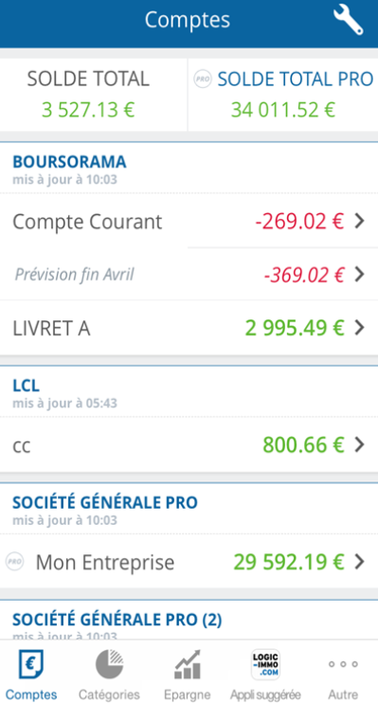
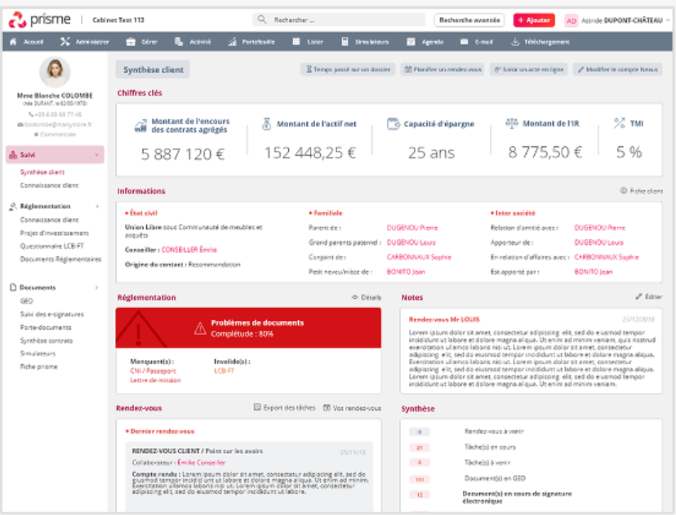
Opportunity - Data augmented advisor: CG could increase its level of offer personalization and switch to proactive advices by knowing its customers better, through three digital levers
Aggregating customers bank account, including non-intermediated accounts
CG’s advisors could widen their offer with an account aggregator to provide a more unified customer experience
CG’s advisors will get their client's banking information up to date and will be able to fine-tune their advice
Access to the customer's banking situation in real time represents an up-sell opportunity for CG by detecting unusual movements or particular moments in life
Offer an aggregator that goes beyond bank accounts by conglomerating all investments, even those on which the CGP is not the intermediary
1
Create an end-to-end "one-stop shop" experience so that the client can access all their asset and wealth information easily and at a glance
Giving advices based on customer profiling and C2C recommendations
CG’s advisors could offer products and advice to their customers according to recommendations based on similar customer profiles
Personalized recommendations may be given to advisors or directly pushed to the clients directly on its dashboard
A
2
For advisors: access to client categories by typology (e.g., level of risk, profession, level of wealth, complexity of assets)
C
Recommendations to clients: “80% of clients similar to your profile have chosen this product and have expressed their satisfaction”
A
B
C
REINFORCEMENT OF CUSTOMER KNOWLEDGE
Steering tool for CGPs
Investment opportunity identification through clustering of client profiles
Sale support tool for CGPs
Identification of sales opportunity and recommendation to CGPs based on the clients’ clusters
Recommendations to clients
Tailor-made offers proposed to the client according to the investment history of the cluster to which he belongs
B
Alerts to advisors when an investment opportunity is identified based on customers segments
Detecting customers’ moments of life through their bank accounts, social networks and online data (e.g., Infogreffe)
An access to customers’ banking account information makes it possible to detect “big life changes” through application of machine learning algorithm and thus to push proactively highly personalized recommendations
Similarly, other online data sources may help increase customer knowledge (e.g., such as social medias, or specialized websites Infogreffe)
For instance, exceptional balances may be detected by advisors and triggers personalized recommendations
3
Exceptional incomes can be linked to life events
Balance evolution €
“Normal” balance
“Exceptional” balance: proactive advices from the CGP to the customer
Date
Sources: eleven research and analysis

Slide 19






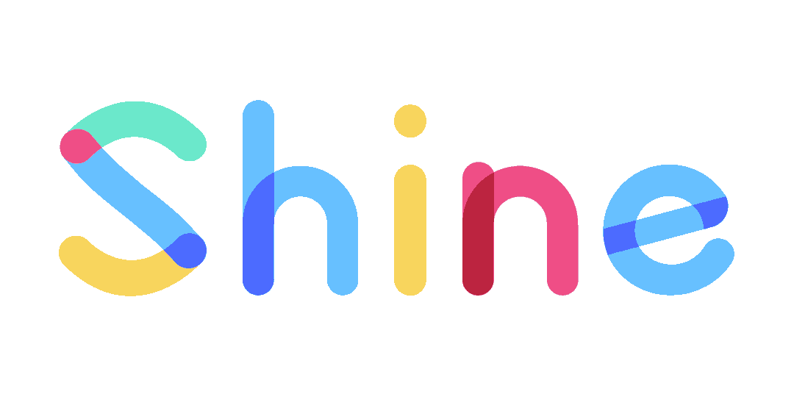


Opportunity - Neo-bank for expatriates: Given the liberalization of banking and the emergence of banking-as-a-service, the launch of a neo-bank targeting expatriates could be a way to fuel customer acquisition and service personalization
CG could benefit from banking-as-a-service solutions to create a verticalized neo-bank
CG would need to leverage synergies between its neo-bank and its core activity to compensate the investment
4 front-end engineer
2 back-end engineer
3 business & partnership developer
400K €
200K €
150K €
+ 3 customers service
90K €
DSP2 regulation has opened access to banking data and facilitate the creation of bank with the possibility of performing banking core services with a light status of EME or externalizing with a provider that have that status
That regulation change has induced the emergence of new players that offer white-label core banking solutions and thus facilitate the creation of many neo-banks
CG’s neo-banks will target expatriates' community weakly addressed by classical banks due to the complexity of their profile.
To acquire a strong customer base CG could leverage on expatriates’ meeting place:
Big firm
Administrative place
Specialized site and social networks
1st year
« Normal running »
Cost
1st year :
750K € wages cost
150K € set-up fees
Normal running:
840K € wages cost
10K € running fees
Revenues
5 000 customers
x
120 € per year
=
600K €
+
Card revenues
Synergies to leverage
To compensate cost CG should earn ≈100 € per year per client on upsell
Key
figures
7 new
neo-banks created in 2019
32
Existing neo-banks in France
x2,5
Number of active accounts between 2017 and 2019
To reach those synergy benefits, CG could leverage its neo-bank service to acquire more customers and develop more personalized services by knowing them better
Digital reputation
Build a digital native reputation for CG and thus rejuvenate an ageing brand
Customer acquisition
That neo-bank would allow CG to increase their customer base by doing cross-selling between wealth management and banking activities
Increased customer knowledge
With both more customers and more precise data, especially about their bank account CG could build very powerful and valuable database
Service personalization
CG could use that data in order to train model to detect “life events” thanks to bank account and thus provide personalized and time adapted recommendations
Sources: eleven research and analysis

Slide 20
Executive summary
CG’s wealth management ecosystem and macro-digital trends
CG’s ecosystem of prescribers: overview of CG’s prescription models and ongoing trends within those prescribers’ industries
Wealth management products: customers’ expectations related to underlying assets and investment vehicle
1
Wealth management ecosystem
2
AGENDA
Wealth management B2C customers’ experience
3
Digitalizing financial advisors’ day to day operations: CG’s positioning and underlying opportunities
4
Digitalizing CGP’s back and middle offices: comparison of CGP’s organizations and models
5
Highlights on key digital growth opportunities for CG
6

Slide 21
















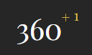
















CG’s ecosystem is increasingly complex with an increasing number digital intermediaries and services providers between the end-clients and the asset producers
Crystal group’s ecosystem
Asset Management Value Chain
Producers
B2B intermediaries
Distributors
B2C end-customers
Asset producers
Product savings referencing platforms
IFAs
Investors
Retail Banks
CGP/
CGPi
Multi supplier platforms/ aggregators
Other players:
Brokers, Family offices
HNWI
Insurers
Retail banks
and insurers
Single supplier platforms (i.e., extranets)
Private
banks
Core Affluent
Investment funds
Prescribers:
CPAs, Notaries, Tax lawyers
Software editors
Asset managers
Portfolio management¹
Administrative tasks support²
Information/ marketing support³
Mass affluent
Financial
CGPs
focused
CPAs
focused
B2C mass market
platforms
Neo banks
(generalist
and vertical)
Financial
advisory
Real Estate
Robo
advisors
Mass market
Regulators
Traditional
Reg-tech
Source: Crystal group IM, eleven research & analysis; 1. e.g., Automatized transactions; 2. e.g., TO, inflow commission management; 3. e.g., Sales support
Tech Players
Trad. players

Slide 22

The value chain of the wealth management industry is broken into several bricks that do not capture the same value, producers and IFAs holding the lion share of value creation
Wealth management industry detailed value chain
Products fabrication
Commercialization
Products aggregation
Advisory
Back and middle office
Restitution du end-customers
Product conception
Fund holding
Brokerage
Compliance
Application
Arbitrage
Buyback
Administrative changes
Electronic signature
KYC
Wealth strategy simulation
Wealth strategy definition
Payments
KYC
Consultation of contracts
Financial allocation
Preparation for arbitrage
CRM
Aggregation of clients' accounts
Aggregation of clients’ investments
Customer reporting
IFAs and producers hold the lion share in terms of value creation among the value chain, resp. 45% and 36% while brokerage platforms and CGPs’ software editors only capture a poor value of the industry (can be seen as “commoditization”)
Source: Oliver Wyman study on the IFAs’ industry

Slide 23


Various players are positioned along this value chain, with an increasing porosity between them due to open banking
Wealth management industry detailed value chain
Products fabrication
Commercialization
Products aggregation
Advisory
Back and middle office
Restitution du end-customers
Product conception
Fund holding
Brokerage
Compliance
Application
Arbitrage
Buyback
Administrative changes
Electronic signature
KYC
Wealth strategy simulation
Wealth strategy definition
Payments
KYC
Consultation of contracts
Financial allocation
Preparation for arbitrage
CRM
Aggregation of clients' accounts
Aggregation of clients’ investments
Customer reporting
For their products only
Concentration trend among CGPs market (e.g., major players and groupings/ network of independent CGPs)
Suppliers
CGPs
Different level of digitalization depending on the level of collaboration between CGPs and software editors
Different level of digitalization among suppliers (e.g., electronic signature)
Products
Platforms/ brokers
Incl. multi and single suppliers' platforms
CGPs
software editors
Contracts aggregations through suppliers’ APIs
Development of sophisticated wealth management diagnosis tools to support CGPs in their recommendations (e.g., Big Expert - Harvest)
Neo-banks/ banks accounts aggregators
Bank account aggreged view only
Core activity
Non-core activity

Slide 24



Financial and data flows have largely increased between these players , particularly due to the exchanges’ rising standardization (i.e., through Penelop standard)
Financial flows simplified scheme in CG’s environment
Products fabrication
Commercialization
Products aggregation
Advisory
Back and middle office
Restitution du end-customers
APIs
CGPs
CGPs’ extranets for end customer
Supplier A
Extranet
for CGPs
(single supplier
platform)
Extranet for
End-
customers
Product brokers (multi suppliers’ platforms)
B2C end-customers
APIs
Products brokerage
Banking accounts aggregators
…
Extranet
for CGPs
(single supplier
platform)
Extranet for
End-
customers
CGP software editors
IT flows only from Suppliers back offices (products aggregation only, no brokerage contrary to products platforms)
…
…
Financial flows

Slide 25


CG benefits from a large range of products due to its multi-supplier approach, contrary to Yomoni-like mass-market wealth management solutions that deal with few suppliers in white label only
Large
Illustration of two distinct supply models in the wealth management industry
CG’s supply chain model
A large range of products
A large range of suppliers
CG
Different needs in terms of product supply depending on CG brands’ customers specificities
Ability to serve a large range of customers from mass market to core affluent with specific needs depending on their wealth (from life insurance to club deals)
Direct supply
SCPI
Comptes-titres
Generalli Patrimoine
Software editors offering products aggregation
Indirect supply
Crédit immobilier
Immobilier
Celestia
CGEFI
Asteria
APICIL
Premalys
Oradea Vie
Brand 1
Auralys
Brand 2
B2C end-customers
Primavator
Natixis WM
Extend AM
Product brokerage platforms
Indirect supply
Brand 3
HNWI
Life insurance
Club deal
…
…
…
Product inventory
Mass & Core Affluent
Yomoni-like players’ supply chain model
A small range of products
A small range of suppliers (<5)
Yomoni-like B2C mass market solution
Mass market
Life insurance
Standardized offer
ETFs
Mostly direct supply
Ability to serve small range of customers with standardized needs in terms of products (e.g., life insurance, PEA)
..
Limited
Source: Crystal group IM, eleven research & analysis; Expert calls
+ est ce que selon le fournisseur on peut mapper les "atouts", ex : gestion pilotée, gestion sous mandat, outils internets performants, souscription dématérialisée...

Slide 26




Illustration 1: Investment products aggregation platforms compete with GCPs professional software editors to be positioned in the middle of wealth management’s value chain
Investment product aggregation platforms vs. GPs professional software
Key players
Products
Services
Key market insights
Give access to investment products that are not accessible by CGPis alone (four types of products: (1) Banking credit, (2) Insurance, (3) Financial product and (4) Real Estate)
Are currently shifting from products’ distribution (i.e., aggregation and bundling of investment products), to services’ distribution (e.g., compliance services, trainings)
Increasing number of professional software editors dedicated to CGPs (~130 players) dominated by three players (i.e., Harvest, Manymore, Upsideo)
Harvest covers 1/3 of the CGPs market
Existing solutions’ functionalities cover basic tasks operated by CGPs (e.g., Wealth diagnostic and client profiling; automatized calculation of recommendations depending on profile; customers accounts’ consolidation
40 out of 130 players (incl. Manymore, Harvest) are built on a common data-exchange standard “Penelop”
Key challenges at stake
Increasing difficulty to manage suppliers (e.g., AXA, BNP) multiplication causing proliferation of processes
Lack of advanced features (e.g., customers with taxable households in different geographies)
Difficulty to consolidate customers accounts in real time
Data management and protection issues
Customers data “hijacking”, creating mistrust from CGPs (e.g., Patrimoffice)
Difficult to repatriate data from international customers
IT complexity (i.e., difficulty be interfaced with other tools of the ecosystem despite existing standards (i.e., Penelop))
Complexity due to constantly evolving regulation
Impact
for CGPs
As no solutions covers end-to-end CGPs’ needs, CGPs face strategical decision in choosing the tools to support them in their daily task, depending on their size, with 3 options:
Use off-the-shelf platform and software covering 80% of its needs, with possibility to internally develop specific modules covering its specific needs
Develop from scratch a fully personalized solution
Only use products referencing platforms and not use professional software (increasing middle-office costs)
Source: Crystal group IM, eleven research & analysis; Expert calls
Notes:
to strengthen other players’ dependency on their solutions to increase their bargaining power on fees

Slide 27

Illustration 2: Alpheys is a fully digitalized B2B platform that have sat between products platform and B2B2C software
Alpheys’ key data points
Alpheys’ offer
Alpheys activities are split between two main offers:
Products
Services
Description: 1st independent opened platform of both products and services
Number of clients: 1,000+ liberals CGP
Outstanding AUM: 5Mds+ € in 2019
EBITDA: 4,8M € in 2019
Investment timeline: Alpheys is the result of the fusion between of Finavéo & CD Partenaires in 2019
Alpheys offer a large range of products:
Life insurance in France (15 contracts) and Luxembourg (15 contracts)
30 SCPI
9000 OPCV
PEAs
Pension fund
Real estate offers
Alpheys also provides its users with a range of services:
2 digital services:
Naveo that digitalize opening of PEA and trading accounts
SO SCPI that allows digitalized SCPI subscription
An extranet to check clients’ patrimony and collect all documents needed
Trainings
Tools to calculate fees
Source: Crystal group IM, eleven research & analysis; Expert calls

Slide 28



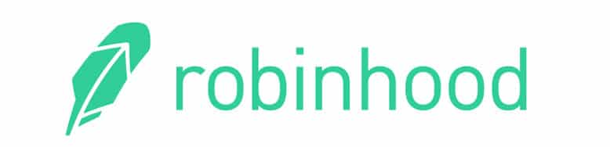



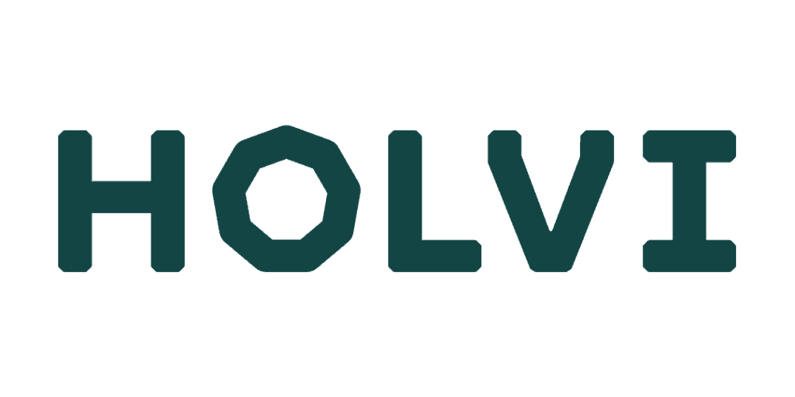
Illustration 3: Suffering from very high B2C customers acquisitions costs, B2C mass market platforms are shifting from pure B2C model to B2B model and targets CGPs
B2C mass market platforms
Robo-advisors
Bank accounts/ neo-banks aggregators
Key players
1
General neo-banks
Vertical neo-banks
Key market insights
Robo-advisors provide high-quality ultra-personalized solutions with great UX-experience allowing clients to:
Adapt their investments according to their mid-term and long-term objectives (e.g., children scholarships, retirement plans, ...)
Monitor financial accounts in one place
Take back control on their investments with increased real-time decision-making solutions
Bank account aggregators/ neo-banks offer a wide new customer-centric experience including:
Visual and interactive categorization of spending coupled with an end-of-the-month balance prevision
Money transfers in a few clicks
Easy-to-understand investment opportunities
Savings monitoring
Key challenges at stake
Mass market B2C platforms model (i.e. robo-advisors) has not demonstrated its effectiveness, particularly due to high customers’ acquisitions costs
Beyond customers acquisitions’ costs, these platforms struggle to meet customers’ need for human contact, particularly during life “big moments” (e.g., wedding, relative death, house/ apartment acquisition) requiring high level of trust with one’s advisor
As a result, some platforms (e.g., Yomoni) are in the process to recruit human advisors to complete their value proposition and some now directly targets CGP, eager to enhance their operations and advisor with digital
Impact
for CGPs
The B2C mass-market platforms have set new customers interface standards (e.g., great UX, transparency, aggregated vision of portfolio) to which traditional CGPs must adapt themselves (e.g., All’In by Patrimonial, mobile application designed to offer customers an aggregated view of their portfolio and personalized advisory)
As they have access to a large amount end- customers data (e.g., transactions, risk profile), these platforms could extent their offer to asset management activity and thus represent a competitive threat for CGPs
Source: eleven research & analysis, Expert calls
Country of incorporation (outside France)

Slide 29

Opportunity - Neo-bank for expatriates: Given the liberalization of banking and the emergence of banking-as-a-service, the launch of a neo-bank targeting expatriates could be a way to fuel customer acquisition and service personalization
CG could benefit from banking-as-a-service solutions to create a verticalized neo-bank
CG could monetize its neo-bank within 5 years
4 front-end engineer
2 back-end engineer
3 business & partnership developer
400K €
200K €
150K €
+ 3 customers service
90K €
DSP2 regulation has opened access to banking data and facilitate the creation of bank with the possibility of performing banking core services with a light status of EME or externalizing with a provider that have that status
That regulation change has induced the emergence of new players that offer white-label core banking solutions and thus facilitate the creation of many neo-banks
CG’s neo-banks will target expatriates community weakly addressed by classical banks due to the complexity of their profile.
To acquire a strong customer base CG could leverage on expatriates’ meeting place:
Big firm
Administrative place
Specialized site and social networks
1st year
« Normal running »
Cost
1st year :
750K € wages cost
150K € set-up fees
Normal running:
840K € wages cost
10K € running fees
Revenues
5 000 customers
x
120 € per year
=
600K €
+
Card revenues
Synergies to leverage
To compensate cost CG should earn ≈100 € per year per client on upsell
Key
figures
7 new
neo-banks created in 2019
32
Existing neo-banks in France
x2,5
Number of active accounts between 2017 and 2019
CG could leverage its neo-bank to acquire more customer and know them better
Exceptional incomes can be mapped to life events
Digital reputation
Build a digital native reputation for CG and thus rejuvenate an ageing brand
Customer acquisition
That neo-bank would allow CG to increase their customer base by doing cross-selling between wealth management and banking activities
Data accumulation
With both more customers and more precise data, especially about their bank account CG could build very powerful and valuable database
“Exceptional” balance
Personalization
CG could use that data in order to train model to detect “life events” thanks to bank account and thus provide personalized and time adapted recommendations
Balance evolution €
“Normal” balance
Legacy
Date
More details of underlying digital opportunities for CG on part 6 of this document

Slide 30
Executive summary
CG’s wealth management ecosystem and macro-digital trends
CG’s ecosystem of prescribers: overview of CG’s prescription models and ongoing trends within those prescribers’ industries
Wealth management products: customers’ expectations related to underlying assets and investment vehicle
1
Wealth management ecosystem
2
AGENDA
Wealth management B2C customers’ experience
3
Digitalizing financial advisors’ day to day operations: CG’s positioning and underlying opportunities
4
Digitalizing CGP’s back and middle offices: comparison of CGP’s organizations and models
5
Highlights on key opportunities for CG
6

Slide 31


As trust remains a main KPC for clients, prescribers keep playing a key role for CGP companies in the acquisition process
Ecosystem of CG targeted customer prescribers
…
Other expatriates
Clubs & organization (e.g., Rotary International, Lions Club,…)
Personal network
Opinion leader (e.g., blogs,…)
Friends
Family
Residents, non-residents & expatriates
Business executives
Independents
Top-level athletes
Professional association
Union
Professional network
Bank
Lawyer
Chartered accountant
Opinion leader (e.g., other professional,…)
Agent and other athlete
…
Key take-aways
CGPs can leverage different prescribers to attract new prospects through both their personal and professional networks and accordingly to their segment (e.g., expatriates, athletes)
Source: eleven research & analysis, Expert calls

Slide 32






Among CG’s six brands, both Crystal Finance and Expert & Finance leverage indirect distribution channels through networks of CPAs (600+), notaries or tax lawyers to sell wealth management services to B2C customers including expatriates, business executives
Key distribution channels leveraged by each CG’s brands
B2C
B2B
Brands
B2C end-clients
HNWI, residents, non-residents, expatriates
Liberal professions
Business executives (shareholder)
Non-residents and expatriates
Business executives (shareholder)
Professional athletes
HNW individuals, though B2B CGPs
Offers
WM¹, international Health and Life Insurance
Global WM¹ solutions
Health and Life Insurance
WM
WM
Career support
Personalized Luxembourg life insurance
Direct
“Interprofessionalité” model
Leveraging adjacent activities as prescribers (or “business getters”):
Network of 600+ CPAs (amounting for ~39% of collected savings by Expert & Finance)
Notaries
Tax lawyers
Distribution channels
Indirect
Source: CG’s website; 1. WM: wealth management; 2. CPA: Certified Professional accountants
CG’s brands leveraging indirect distribution channels

Slide 33

CG’s indirect distribution model is based on the sharing of fees paid by end-customers with their “business getters”
Illustration of E&F¹ prescription by CPAs
A win-win model
Manages company’s accounts and has build a trust-based relationship
Beyond the sharing of fees, CG’s has built over the years a prescription model based on a win-win situation between prescribers in one side and CG on the other side
Global scheme
Company
CPA
Prescription of E&F for private wealth management
CPAs ➔ CG
CG ➔ CPAs
Business executive client
Gives services and content to the CPA
Cheaper and ultra qualified customer acquisition (compared with onine acquisition’ costs)
Revenue sharing (sharing of fees paid by the end-customers)
High value-added services to increase customer retention
Personnal wealth
Exemple of prescription
Business executive wanting to sell his company
Helps for the sale preparation from a company point of view
CG’s network
CPA
CPAs
Recommendation
Notary
Helps for the sale preparation from a owner point of view:
fiscal optimization …
Wealth management for the client
Tax lawyer
Sale of the company
1. E&F: Expert & Finance

Slide 34
If CPAs’ roles and responsibilities haven’t changed, the services proposed by CPAs have been profoundly impacted by the emergence of new technologies
CPAs’ missions of tomorrow
1
2
3
4
5
Produce accountability at a competitive price thanks to automation
Support SMEs in the digitalization of their accounting tasks (e.g., expenses)
Digitalize the Financial Director function
Provide ultra personalized advises to CEOs
Diversification to other activities (e.g., wealth management)
Production
Support
Consulting
Low value-added services
Strong value-added services
Key take-aways
If these offers already exist today and are sometimes proposed by CPAs, they will be exercised differently tomorrow under the impact of digital (e.g., new customers, new customer relationships, new business models, new skills, ...)
CPAs willing to launch CGP services do not switch directly to such businesses at it requires heavy expertise and tools. They recruit CGP adisors and create a dedicated business unit
Source: Crystal group IM, eleven research & analysis, Expert calls
Notes:
Les roles ne changent pas, les missions sont bouleversées. O

Slide 35
These new services and missions could lead to the emergence of several types of accounting firms, with different levels of specialization and positioning
Illustration of a possible typology of the accounting firms of the future: strategic objective and positioning
Types of firms
Strategic objectives
Strategic positioning
Generalists
The FONCIA-like (e.g., accounting industry)
Develop through external acquisitions, and harmonize digital solutions in all acquired firms
Propose a wide range of services thanks to a critical size that makes possible to have a service-based organization
“One-stop shop” CPA
Bring together within the same firm complementary professions: chartered accountant, lawyer, CGP...
Propose all offers potentially useful along companies’ lifecycle: accounting, payroll and social, HR organization, taxation, wealth management...
Agile CPA
Using accounting and social production as an entry door to move up to higher value-added offers
Deliver an enhanced customer experience and improve margins by leveraging digital tools
Specialists
Industrial CPA
Make profitable the large investments required to automatize accounting and social production in large volume
Propose a fully Digitalized basic offer, affordable for clients with basic needs (no personalization)
Full-service Financial Director agency
Become the SMEs “partner of choice” regarding all administrative and financial issues
Offer a “virtual interim CFO” service to several SMEs at the same time, taking advantage of digital tools to offer these services remotely
CEOs-advisor CPA
Diversify its activity beyond accounting production towards high-value added services (e.g., wealth management advisory)
Propose specialized consulting missions, on specific subjects for which the CPA will be able to provide expertise
…
?
?
Source: Crystal group IM, eleven research & analysis; Expert calls

Slide 36
Indeed, CPAs are increasingly seeking to address the consulting market in addition to their traditional activities
Accounting firms already have, or plan to develop, consulting activities...
…which make it possible to aspire to a legitimate and substantial market
Share of accounting firms that have created or are in the process of developing the following activities:
Selected examples of business services
Estimated market size (France)
Support in dashboard
Creation, transmission, sale, acquisition, valuation
2 €Bn
Business & strategy consulting
Social
Strategy ad business performance consulting
1.5 €Bn
Wealth management
Wealth management
1 €Bn
Creation, transmission, sale, acquisition, valuation
Recruitment
IT consulting
0.6 €Bn
Process Consulting
Risk management consulting
IT/ digital transformation consulting
0.4 €Bn
Management coaching (incl. trading)
Ongoing projects
Total
5.5 €Bn
Full services
Funding
Completed project
There is an undeniable need for accountants to diversify towards consulting services. The good new is that we are probably the most legitimate in the environment to do so
Director of an accounting firm (France)
Message clé
Key take-aways
Diversification towards higher value-added services, which has already begun within the firms, is a major contributor to future CPAS industry revenues
Firms are conscious of their need to evolve towards these services to fight the erosion of their traditional activities
Source: Les Moulins study, eleven research & analysis; Expert calls

Slide 37


To further reinforce acquisition channels, CG can leverage digital levers aiming at strengthening its digital reputation and at reinforcing its online communication with prescribers
Strengthen CG’s online reputation with SEO, SEA and presence on social networks
Enhance existing relationships with CPAs
Leverage digital communication tools:
Systematize webinars, e-trainings
Develop specialized podcasts dedicated to the industry (e.g., Webinars Equance)
Involve CPAs in major CGPs professional events (e.g., Patrimonia)
Improve existing dedicated portal to communicate with accountants about CG’s offers and provide hem high-value services (e.g., aggregated view of their commissions)
Support CPAs in the first steps of a wealth management service:
Provide CPAs with a cloud software to carry out the first steps of the wealth management service (e.g., a module to declare his/her patrimonial objectives and a self-care interface to upload key documents) before a CG’s advisor takes over
CG’s website natural referencing (SEO):
Website and UX performance
Articles and backlinks related to CG’s products and business
Paid acquisition (SEA):
Purchased keywords related to CG’s products and business and related to specific customers’ segments
More detail next page
Social networks
Presence on professional (LinkedIn) and vertical networks (expatriates)
Further extend CG’s prescriber network to become an “inter-professionnalité” specialist
Leverage public data on athletes’ agents in order to use them as prescribers for ProtecSport
Updated
Source: Crystal group IM, eleven research & analysis; Expert calls

Slide 38
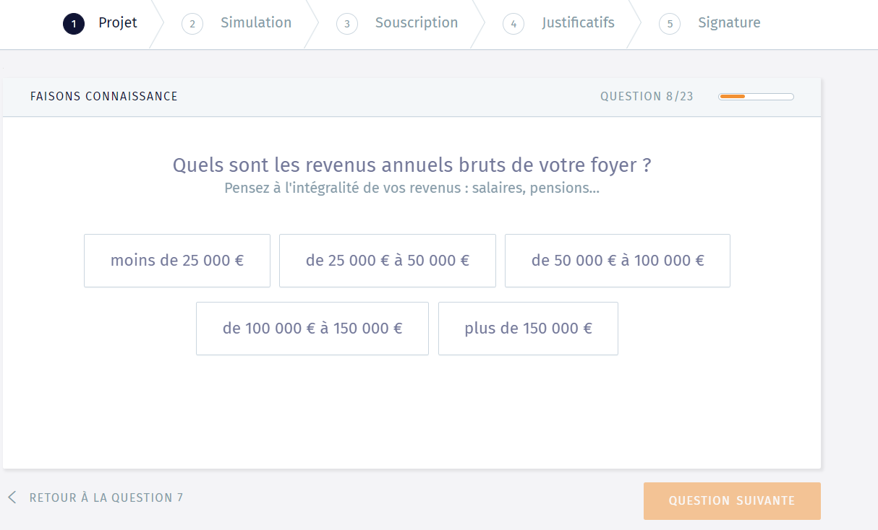
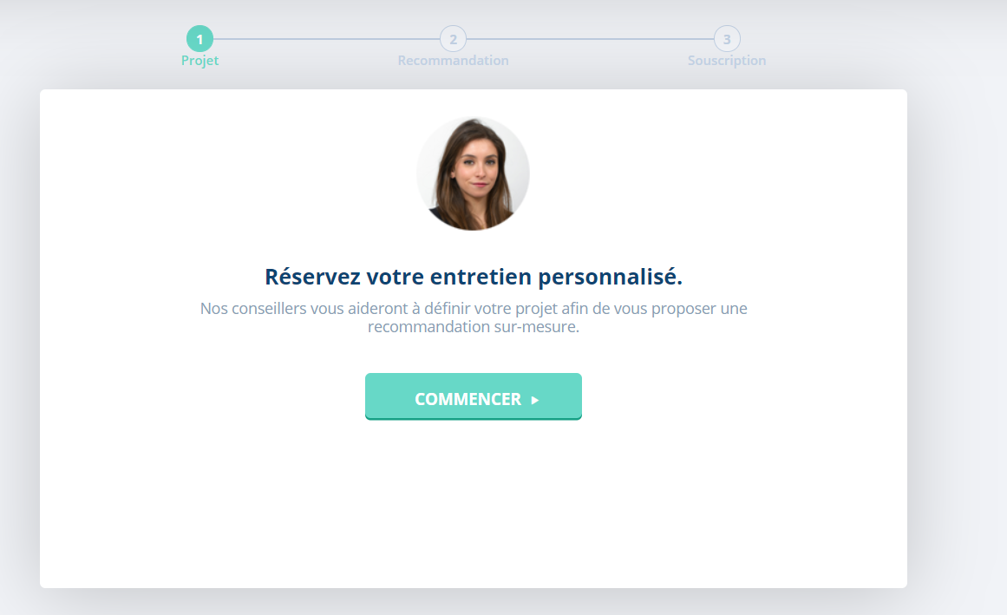

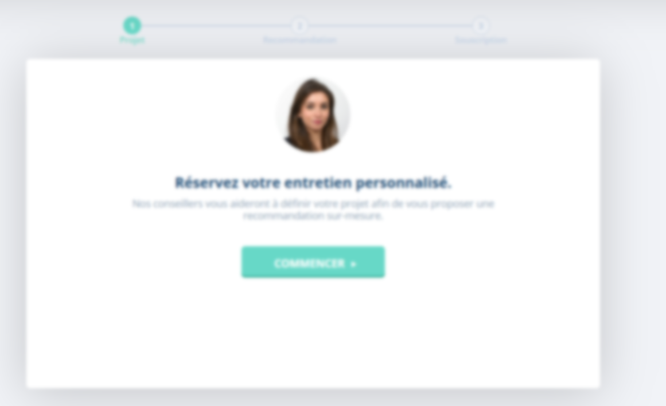
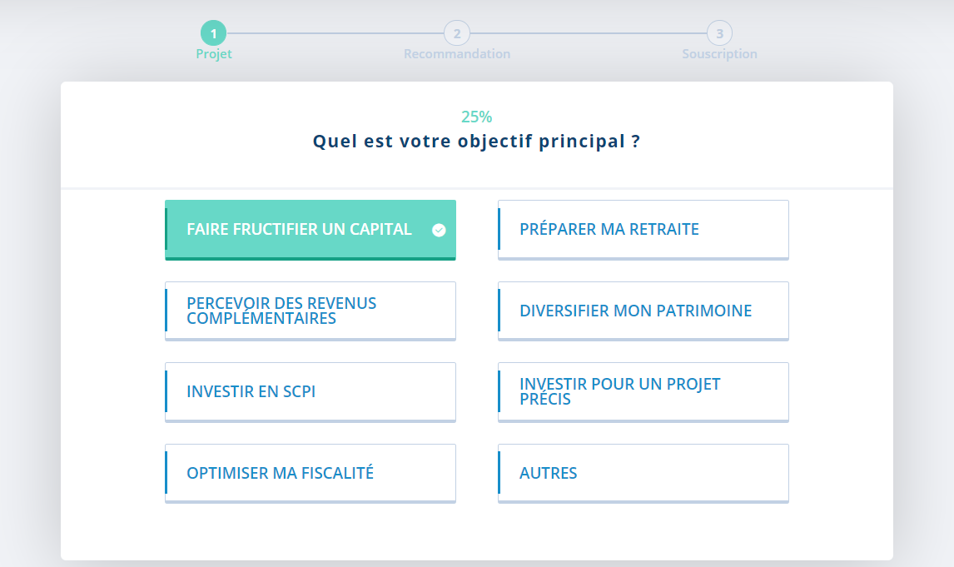

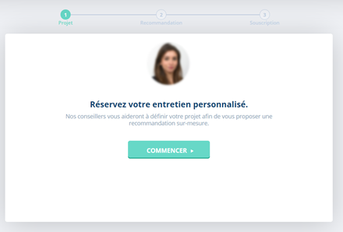
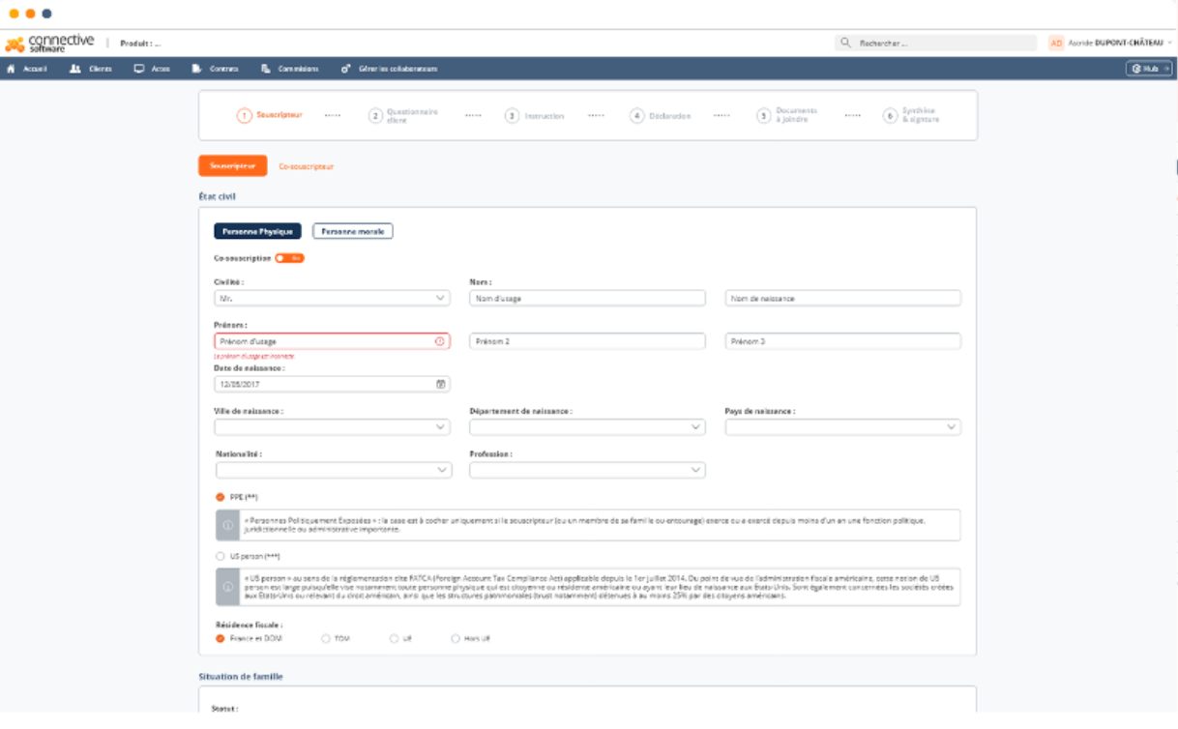
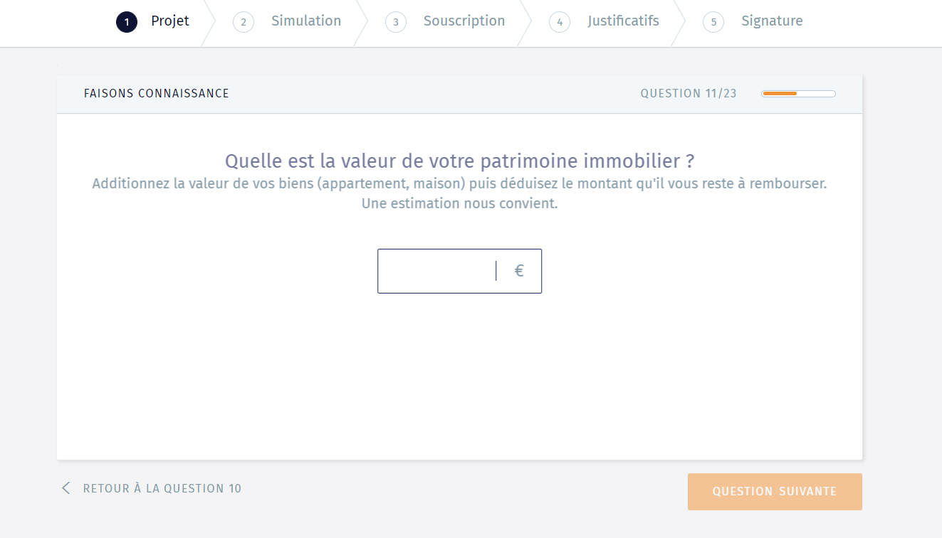
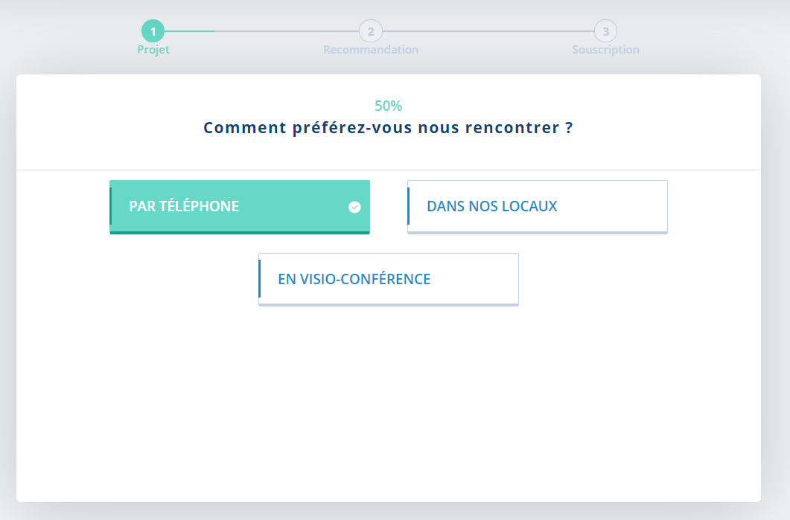
Illustration: CG could provide a dedicated cloud software for CPAs prescribers so that they carry out the first steps of a wealth management service before an advisor from CG takes over
First steps of a wealth management service for CPAs before CG’s advisor takes over
Identification of the prescription opportunity by the CPA
Assessment of investment objectives by the CPA
Collect of key information and documents from the CPA
Wealth management simulation and “call to action”
A CPA identifies an opportunity to provide wealth management services to one of its client
The CPA enters the prospect information on CG’s tool
The CPA, who has built a trust relationship with his client, leverages CG’s tool to assess investment objective…
… and collects key documents to help CG’s advisor carry out his wealth management simulation
A call to action is given to the client so that he asks a meeting with CG’s advisor (with or without the CPA).
Prospect information
Two possibilities:
Interfaces directly shared to the end-customer,
Or filled by the CPA
Updated
Source: Illustration screeshots from althos-patrimoine and Yomoni

Slide 39
Executive summary
CG’s wealth management ecosystem and macro-digital trends
CG’s ecosystem of prescribers: overview of CG’s prescription models and ongoing trends within those prescribers’ industries
Wealth management products: customers’ expectations related to underlying assets and investment vehicle
1
Wealth management ecosystem
2
AGENDA
Wealth management B2C customers’ experience
3
Digitalizing financial advisors’ day to day operations: CG’s positioning and underlying opportunities
4
Digitalizing CGP’s back and middle offices: comparison of CGP’s organizations and models
5
Highlights on key digital growth opportunities for CG
6

Slide 40
CGPs’ “reason to be” lies in their capacity to address the “Mass Affluent” segment compared to traditional players (e.g., private banks, …) and pure digital players
Wealth management industry new paradigm
Two areas of opportunity for CGPs and CGPIs to address the Mass Affluent segment with a real coherence on the market, thanks to:
Very light fixed costs compared to private and retail banks
Ability to provide human interactions compared to pure digital players
UHNW individuals¹
>5m€
Private Banks are increasingly focusing on high-end customers with very high income and wealth (HNWI & UHNWI¹), due to their high fix costs and increasing fee transparency constraints that have weakened their business model
HNW individuals¹
>1m€
Traditional Retail banks can’t address the Mass Affluent segment properly anymore due to:
Increasing network size reduction constraints
Bad retail banking experience that has rubbed off on every experience in wealth management banking
1
Mass & Core Affluent
[100k€ - 1m€]
2
100% digital players (e.g., Yomoni) are stuck to the Mass Market segment (<100k€) and hardly manage to address the Mass Affluent segment, mainly due to:
High online customer acquisition costs
Lack of human interaction when it comes to insurance and reinsurance about long-term projects (e.g., retirement plans, plans involving customers’ children)
« Mass Market »
<100k€
Source: eleven research & analysis ; 1. HNWI: High Net Worth individuals, UHNWI Ultra High Net Worth individuals

Slide 41

The volume and nature of available investment products (i.e., banking, finance, insurance, real estate) depend on the level of wealth of the client segment
Inventory of market players according to the client’s level of wealth
Available offer that CGPs can provide in products aggregation
HNWI
>1m€
Tailor-made and exclusive products requiring a high level of engineering
Distributors provide all the available products of the market and assemble them accordingly to the client’s needs
Club deal
Family offices
Private equity
Mass & Core affluent
[100k€ - 1m€]
Structured products
Hybrid offer combining standardized products and personalized investment advice
Personalization level of investment products
Real estate
OPCVM
CGP/CGPi
Automation potential with digital
Life insurance
Standardized products with low-cost and accessible passive management offer
The reduce product offering for this customer segment makes it possible to industrialize the wealth management processes
Crowd-lending
Mass market
<100k€
Stocks
Digital CGPs and Robo advisors
Source: eleven research & analysis ; 1. HNWI: High Net Worth individuals, UHNWI Ultra High Net Worth individuals

Slide 42
However, asset suppliers do not have the same level of digital maturity which complexifies operations when CGPs expand their offers
Products aggregators (single and multi suppliers) ranking on customer satisfaction (2019)¹
Areas of progress expected from the platforms by the CGPs in terms of day-to-day management
Key take-aways
The more a CGP works with different suppliers, the more complex and cumbersome the process is, which prevents him from creating added value for the customer and focusing on advisory
Ease of connection to suppliers’ offers by simplifying processes (e.g., electronic signature) is key for CGP in order to reduce time-consuming administrative constraints
Updated
Source: eleven research & analysis; 1. Pericles/L’argus de l’assurance, 2019

Slide 43








With outstanding assets exceeding 1,000bn€ in 2019 in Europe (+30% growth S2 2019), ETFs have become a product to be considered in CGPs' offerings
What is it?
How an individual can invest in ETFs?
How do CGPs use ETFs?
An ETF is a basket of securities that tracks an underlying index (e.g., the SPY tracks the S&P 500 index,…) and contains many types of investments (e.g., stock, commodity, bond,…)
ONLINE/TRADITIONNAL BROKERS
ROBO-ADVISORS
Robo-advisors construct their portfolio out of low-cost ETFs, making these assets accessible and affordable to all investors
CGPs
Some CGPs now include ETFs in their offers to their clients (e.g., Crystal with Primalys7, Primonial with LinkVie,…)
Some CGPs also recommend to some of their clients who wish to manage part of their assets in a more autonomous way to turn to robo-advisors
How does it work?
An ETF provider considers a universe of assets and create a basket of them with a unique ticker
Investors buy a portion of the basket instead of buying of the components individually
ETFs are traded on an exchange just like stocks
Key take-aways
An ETF is therefore a product like any other that has been added to the range of offers of the CGPs
They do not represent a disruption for the CGPs as they are mainly proposed by digital players with more passive investment and management offers
Source: eleven research & analysis; Investopedia, LesEchos
Notes:
https://www.lesechos.fr/finance-marches/gestion-actifs/la-gestion-passive-atteint-de-nouveaux-sommets-en-europe-1161082

Slide 44
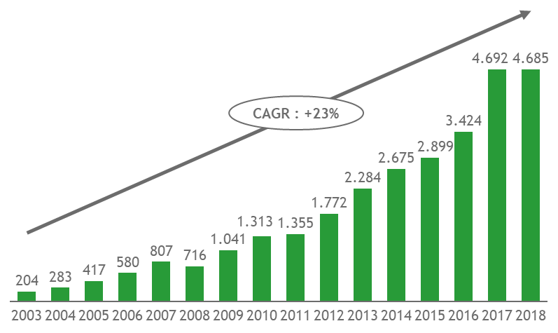

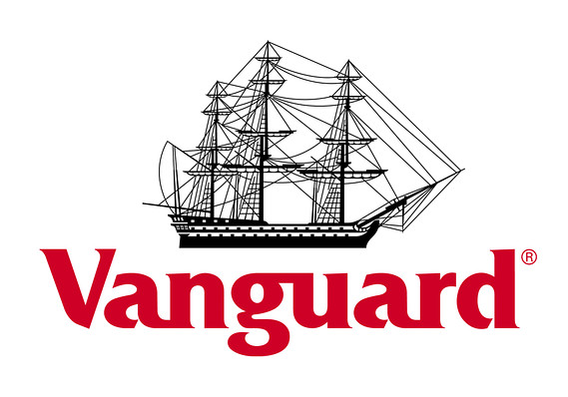



Illustration: The thrive of passive investment solutions such as ETFs is increasing expectations in terms of cost/performance ratio
… raising key strategic questions for incumbents
The value of worldwide ETF assets under management has increased by a 23% CAGR since 2003…
Worldwide ETF assets under management – 2003-2018
$ bn
Less than 10% of traditional “OPCVM” outperform the market (including ETF) every year
How to implement ETFs to reduce costs while maintaining or outperform traditional “OPCVM” performance?
Traditional “OPCVM” performance is burdened by very high costs, that often excess 2% per year (versus 0,4% on average for ETFs)
Breakdown of market share of assets of Top 5 ETF Issuers (2017)
How to compete with ETFs already established in the market regarding access to information and transparency?
Traditional banks have not entered the ETF market yet
…
Sources: Statista; epargnant30.fr “ETF vs OPCVM”, La lettre de l’Observatoire de l’épargne – n°13 – Juin 2015

Slide 45
CG can seize the opportunity to develop an alternative digital journey by leveraging ETFs in self-care solutions and increase its collection of assets
LOW POTENTIAL OF IMPACT (>150K€)
ETFs are like any other products a CGP can include and value to widen its global offer
Wealthier clients are less sensitive to the value proposition of ETFs, which is based on robo-advisor or digitalized brokerage services to the detriment of human interaction
HNWI
>1m€
Mass & Core affluent
[100k€ - 1m€]
CG positioning
MEDIUM POTENTIAL OF IMPACT (80K-150K€)
ETFs can represent an opportunity for CG to design and implement an alternative, fully digitalized customer journey for a customer segment that wants to focus on self-care solutions
Mass market
<100k€
RELATIVELY HIGH POTENTIAL OF IMPACT (0-80K€)
Mass-Market investors have the possibility to access ETFs through online brokers or robo-advisors
Passive management solutions using ETFs represent an accessible alternative to CGPs for the mass market
Key take-aways
The potential impact of ETFs is reversely proportional to the client's level of wealth and therefore applies especially to the mass market
Source: eleven research & analysis;

Slide 46



By offering a reduced product offering (i.e., <20 products), traditional CGPs can guarantee a relatively smooth digital user experience
Trade-off between product sophistication and digital user experience
Main areas for digital UX improvement according to CGPs in their relationship with asset providers (2017)¹
Product sophistication
Large range
Family office
Improving the value of the offer with more products, but risks on UX
Retail bank
<20 products
CGP
Digital CGP
Need to simplify the product offer in order to digitalize the UX through simplified operations
Robo advisors
<5 products
+
Digital UX
+++
Key take-aways
CGPs are on the borderline between a diversified offer and a fully optimized digital UX
The improvement of the online user experience coupled with a richer product offering will mainly involve the ability of suppliers to simplify their management procedures, improve back-office responsiveness and the ability to adapt to complex situations
Source: eleven research & analysis; 1. Pericles/L’argus de l’assurance

Slide 47
Executive summary
Customers’ expectations regarding wealth management services
Overview of customers’ journeys for mass market, mass and core affluent
Focus on CG’s performance in terms of customer acquisition and online visibility
1
Wealth management ecosystem
2
AGENDA
Wealth management B2C customers’ experience
3
Digitalizing financial advisors’ day to day operations: CG’s positioning and underlying opportunities
4
Digitalizing CGP’s back and middle offices: comparison of CGP’s organizations and models
5
Highlights on key digital growth opportunities for CG
6

Slide 48
Offering a state-of-the-art digital UX today is key to secure CG’s long-term growth as customer’s expectations are evolving rapidly
Indicative proportion of clients by age in France, 2020
5 + 5 years
The average age of robo-advisors customers is 40 years old (60% executives)
the average age of the CGPs' customers is 60 years old (48% of executives)
Key Take-aways
By targeting a younger customer base, the robo-advisors capture the future customers of the CGPs with a digitalized offer on which the CGPs are not yet mature
The challenge for the CGPs is to develop their customer journey with a more digital offer in order to meet the changing needs of their future customers and capture the robo-advisor's clients when they become wealthier
Source: eleven research & analysis, Kantar TNS 2017, Nalo website, Statista

Slide 49
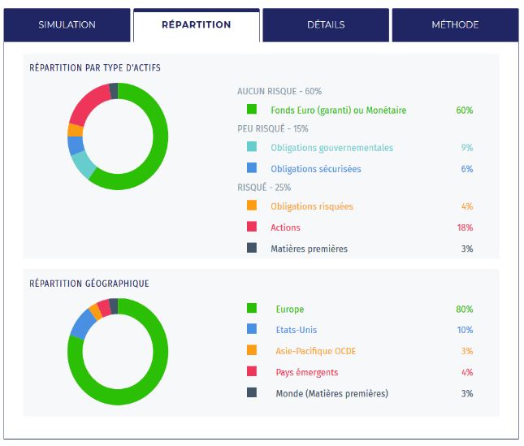
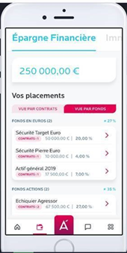
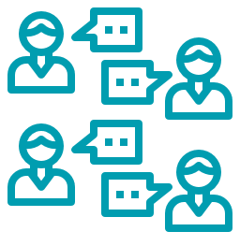
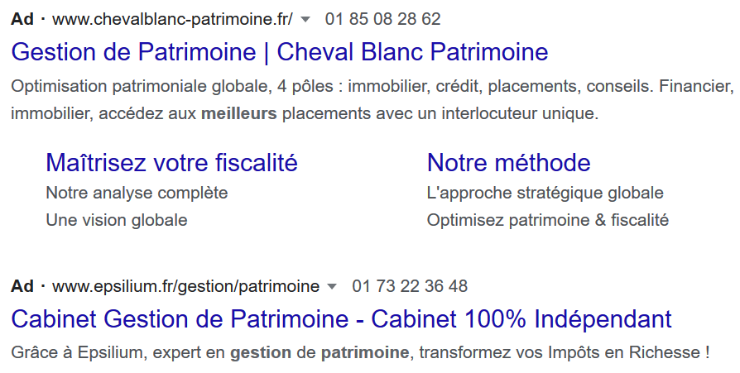
CGP’s customer journey is made up of a direct or indirect contact phase, a conversion phase and a management phase in which the client follows-up and makes patrimonial strategic arbitrations
CGP’s customer journey
Contact phase
Conversion phase
Management phase
First contact with mass and core affluent and (U)HNWI is mainly indirect and made through recommendations from the personal network and prescriptions (e.g., lawyer, accountants,…)
First contact with mass market is mainly initiated by the prospect through direct digital channels (e.g., website, mobile app,…) or by solicitation from a CGP (e.g., sponsored advertising, email,…)
Definition of the asset management strategy after an in-depth analysis of the client’s needs
Sharing and verification of all the legal documents (e.g., account balance sheet, identity papers,…) required for the signature of the contract
Compliance checking
Follow-up of the wealth management strategy
Centralization and reporting of all of the investments from different angles (e.g., risk level, sectors, geographical area,…) with complete consolidations of the assets
Personal recommendation
Yomoni online wealth assessment
Primonial mobile dashboard
Direct acquisition with SEA
Source: eleven research & analysis

Slide 50

Clients expect a fully-personalized offer combined with a simple yet high-end service provided by the CGP throughout the customer journey
Clients’ expectations throughout the customer journey
Contact phase
Conversion phase
Management phase
TRANSPARENCY AND CLARITY
Both in terms of provided services (e.g., advise support, reporting and fees,…) and underlying assets (i.e., ETFs, diversified funds, thematic investments,…)
TRUSTWORTHINESS AND EXPERIENCE
Coupled with established partnerships with renowned & secured assets suppliers (e.g., BNP, Axa,…)
ACCESSIBILITY AND REACTIVITY
Particularly regarding the ability to quickly provide quotations and to schedule a first meeting to establish a wealth assessment
SAFETY, SIMPLICITY AND CONVENIENCE
For all the compulsory paperwork related to administrative part of the opening of the account
FINE UNDERSTANDING
Both in terms of the patrimonial situation (e.g., fiscal complexity,…) and its particular needs (e.g., legal, banking, financial) and objectives (e.g., nature of investment, level of risk, maturity, fiscality,…) that lead to an ultra-personalized offer
QUALITY OF THE ADVICE
With regards all the proposed services directly (e.g., quarterly reviews, alert system,…) and indirectly (e.g., conciergerie, integration into a networks of peers,…) related to wealth management
RESPONSIVENESS
For both changes in the wealth management strategy and for quick minimum viable answers for ad-hoc questions in timeframe not always corresponding to the usual business hours
SIMPLICITY
To access relevant and time-saving tools (e.g., reporting, alerting system, accounts aggregation) with notifications at the right moment and excellent omnichannel user experience (e.g., physical meeting, mobile app, phone call) to have a complementary approach between automated and personal advisory
PERFORMANCE
In the investments (e.g., profitability, risk management) and advice (e.g., evolution of the strategy, tax optimization) and easy access to expert advice (e.g., accountant, legal)
Clients expectations
«Trust is one of the main KPCs in the contact phase»
Expert, CC&A Finance Patrimoine
«Administrative burdens should not weigh on human interactions during physical meetings »
Expert, former associate at Cyrus Conseil
«The reporting and the alert system are a must-have and must be adapted to the client’s needs (e.g., periodicity, format)»
Expert, CC&A Finance Patrimoine
Source: eleven research & analysis

Slide 51
Unlike the Mass Market segment sensitive to a unified digital UX with mature self-care solutions, the top-rich segment demands a high-end and fully-personalized offer requiring human interactions
Client’s expectations throughout the customer journey
Main phases of the customer journey
Prospection phase
Conversion phase
Management phase
Precise customer knowledge and recognition leading to ultra-customized and premium services
Creation and development of a network with trusted and qualified connections (e.g.; experts, peers)
Form of the follow-up perfectly tailored to the customer’s needs
Ease of sharing information about the wealth situation accordingly to one’s specific needs and constraints
Feeling of trust
Easy-to-find information
Clarity of the offers
Transparent pricing
Easy-to-use and responsive website
Guarantee of the confidentiality
Fine understanding of the patrimonial situation and needs
Secure online area to share all the requested documents
Electronic signature for smoothing the process
HNWI
>1m€
Empowerment of the clients thanks to insights and an open knowledge base
Virtual interactions when physical ones are not essential
Improved availability of the
Convenience at every step of the processes
Human presence for valued life moment
Quick minimum viable answer for questions in timeframe not always corresponding to the business hours
All accounts aggregation
Good to excellent user-experience no matter the channel
Complementary approach between automated and personal advisory accordingly to the complexity of the client requirements
Transparency on the operations
Sustainable and impact investing offers
Automated tools and cured database access for the new generation of tech-savvy clients
Ability to change strategy or offer or exit the contract easily
Mass & Core affluent
[100k€ - 1m€]
Easy access to the advisor’s agenda to schedule a first contact
Fair price with good value-for-money perception
Quick return from the commercial
Quick account opening
Mature self-care solution
Mass market
<100k€
Source: eleven research & analysis, BNP Paribas wealth management market study

Slide 52
Executive summary
Customers’ expectations regarding wealth management services
Overview of customers’ journeys for mass market, mass and core affluent
Focus on CG’s performance in terms of customer acquisition and online visibility
1
Wealth management ecosystem
2
AGENDA
Wealth management B2C customers’ experience
3
Digitalizing financial advisors’ day to day operations: CG’s positioning and underlying opportunities
4
Digitalizing CGP’s back and middle offices: comparison of CGP’s organizations and models
5
Highlights on key digital growth opportunities for CG
6

Slide 53

The reputation of the advisor along the brand and quality image of the CGP are essential to attract, convert and ensure the satisfaction of the client
CGPs objectives throughout the customer journey
Contact phase
Conversion phase
Management phase
DEEP UNDERSTANDING
Of the client’s psychology to identify his/her needs, even those that are not clearly expressed, to determine his/her profile (e.g., emotional, relationship to money,…)
ADAPTABILITY, FLEXIBILITY AND RAPIDITY
To the prospect’s contact and for the first meeting (i.e., give access to the agenda,…) and in the contact medium (i.e., phone, visio, physical,…)
TRUST
By leveraging word of mouth and the network of existing customers and promoting partnerships with trustworthy actors
SMOOTHNESS AND LIGHTNESS
Of the process (e.g., documents collection, compliance, mission report) by leveraging digital tools (e.g, online dashboard, electronic signature,..) in order to focus on advisory and wealth management only
PERSONALIZATION AND MODULARITY
Of the offer made to the client accordingly to the evolutions of its patrimony and the great moments of his/her life (e.g., wedding, birth, home purchase,…)
FLEXIBILITY
Of the certain stages of the process whether the clients want to be autonomous (e.g., self-care solutions,…) or supported (e.g., phone call, email,…)
VALUABLE
Perception of the clients of all the services and offers throughout maintained throughout their life-cycle
AVAILABILITY AND FLEXBILITY
Of the advisor and his/her offers to match customer’s expectations and constraints (e.g., choice of the cannel, quick update, in-depth analysis,…)
CLOSE AND PRECISE
Monitoring of asset allocations to remain in line with clients’ objectives and relevant offer of specific product opportunities (e.g., structured product,…)
Advisors objectives
«The human and experienced dimension of the advisor during the first contact remains key to push to prospect forward in the conversion phase»
Expert, CC&A Finance Patrimoine
«The difficulty is to digitize the entire conversion phase to focus on the core consulting business»
Expert, former associate at Cyrus Conseil
«Making the client focus on the organization rather than of the advisor him/herself highly reduces the risk of churn »
Expert, CC&A Finance Patrimoine
Source: eleven research & analysis

Slide 54




Depending on their level of wealth, customers have heterogeneous expectations regarding CGP, therefore different customers’ journeys can be highlighted according to the client segmentation
Wealth segmentation
Highlight on customers’ journeys
Illustration
Customers’ journeys include other premium services than wealth management (e.g., conciergerie,…)
The need for ultra-customization and for a single stop for all services is a key for these type of customers
This segment has a strong need for recognition and exclusivity as well as comfort throughout its customer journey
HNWI
>1m€
Mass & Core affluent
[100k€ - 1m€]
CGP offering wealth management, health and life insurance
Customers operations are fully digitalized to simplify all customers’ administrative tasks related to wealth management (e.g., portfolio management, electronic signature, …)
Still, customers’ journeys include human interactions, as personalization is requested by some customers. Such interactions are valued, especially when it comes to very specific and complex situation or advice (e.g., legal, fiscal,…)
Retail bank offering wealth management
Focus 2
B2C mass market platform (robot advisor), created in 2014
Customers journeys are based on digitalized models with limited human interaction to reduce costs (e.g., number of customers per advisor,…) and offer competitive services
Journeys are not personalized, but data analytics and software settings enable to tailor the wealth management service
Mass market
<100k€
App for small investments (directly taken from day to day expenses), launched in 2019
Focus 1
Source: eleven research & analysis; 1. HNWI: High Net Worth individuals, UNWI Ultra High Net Worth individuals

Slide 55
The conversion phase of the customer journey requires the collection and processing of numerous administrative documents necessary for compliance
Main steps in the customers’ journey
Contact phase
Conversion phase
Management phase
Main steps of the CGP customer journey
Information query
First exchanges with the CGP
First appointment
Contract signature and first operations
Asset management follow-up
Arbitration of the patrimonial strategy
End of the relationship with the CGP
The prospect contacts the CGP via a form
Information Request Document
Contact document
Portfolio simulation
Aggregation under Harvest/Manymore then presentation of a synthesis to the client
Carrying out arbitration
Migration of contracts to another CGP
Personal recommendation (e.g., friends, family,…)
Commercial brochure
Mission statement
Information on the product's functioning
Concierge service
Subscription to new products
Prospection by the CGP
Appointment proposition
GDPR consent letter
Offer acceptance and signature
Definition of a reporting and alert system according to the client's needs
Prescription (e.g., lawyer, accountant,…)
Sharing of all the documents required for the patrimonial assessment
Recovery of contracts at Harvest /Manymore
Presentation of the patrimonial assessment
Registration of the CGP on supplier platforms or extranets
Creation of an intuitu personae
Source: eleven research & analysis, expert calls

Slide 56

Mass market (1/3) - The customer journey is mostly digital when it comes to < 100K€ investors
Mass Market customer journey
Contact phase
Conversion phase
Management phase
Main steps of the CGP customer journey
Information query
First contact and sharing of financial project
Commercial relaunch
Contract signature and investments
Asset management follow-up
Arbitration of the patrimonial strategy
End of the relationship with the digital
CGP
Examples
The prospect looks on search engine for wealth management information
The prospect shares key information about his/her wealth.
The company defines a specific investment profile
The prospect receives a commercial email and a phone call may be arranged if not converted
The client receives a welcome pack
The prospect does his/her first financial investment
The client regularly reviews his/her investments and decides to make new investments or not
The client arbitrates between different patrimonial strategies
The client may end his/her investments or look for another service provider
Touch points
Physical meeting
Human personalized
« Some clients with technical expertise wish to have independence in the management of their investments and no longer need a traditional CGP »
Expert, CC&A Finance Patrimoine
Visio meeting
« Digital investment platforms are genuine digital CGP that target clients that don’t need human interactions »
Expert, CC&A Finance Patrimoine
Phone call
Email
Website
or app
The opening of an account can be done in less than 30 minutes for digital CGPs
Social network
Digital, standardized
Chat/
chatbot
Adequation of journeys to expectations
Adequation
Source: eleven research & analysis, expert calls

Slide 57
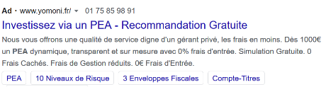
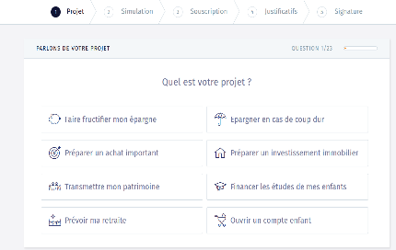
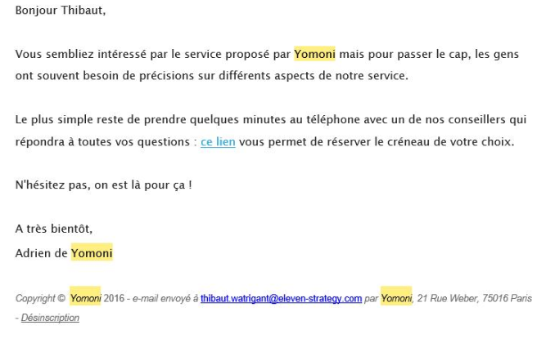
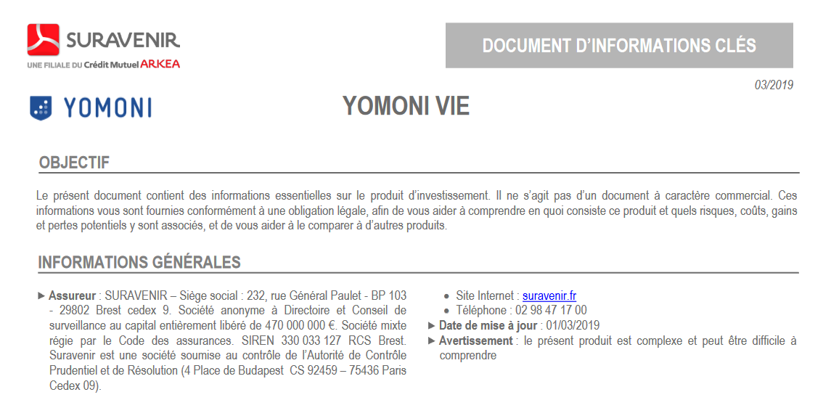
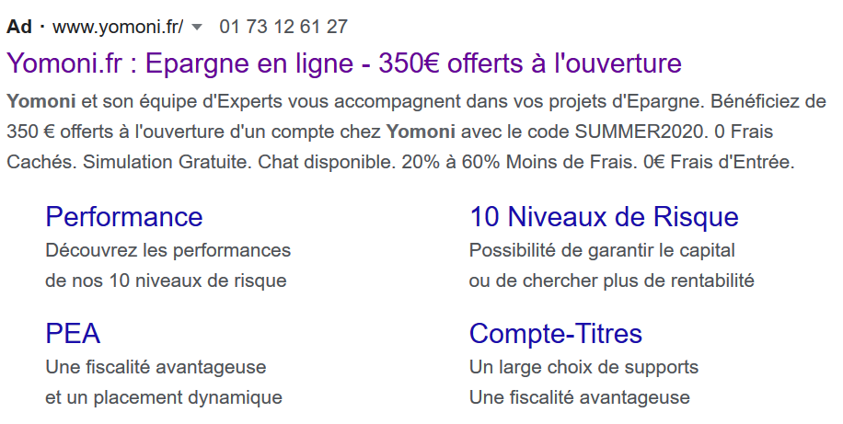
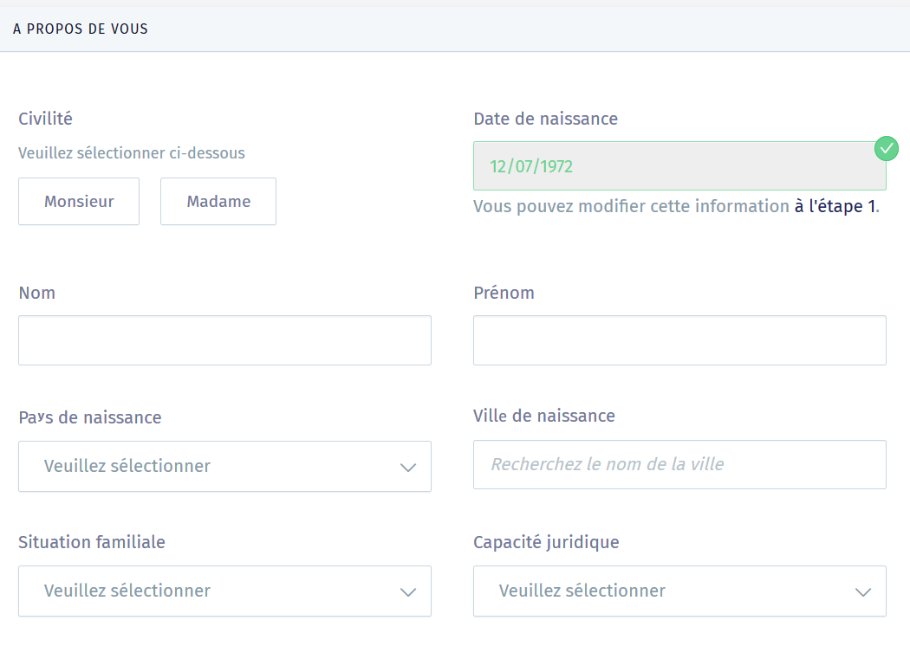
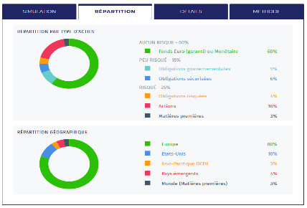
Mass market (2/3) - Focus on Yomoni contact and conversion phase
Contact phase
Conversion phase
Information query
First contact and sharing of financial project
Commercial relaunch
Contract signature and investments
Strong presence on digital channels (e.g., SEO, SEA, social network)
Rich and varied content (e.g., blog) with clear and easy-to-access information
Quick and easy questionnaire leading to the creation of a standardized profile (e.g., low/medium/high-risk)
Quick follow-up email (less than 24hours)
Phone-call proposition to exchange with a commercial about the offers with an agenda to book a preferred time-slot
Quick and easy legal documents sharing
Online signature
Yomoni sponsored ads
Yomoni profile questionnaire
Yomoni follow-up email
Yomoni contract
Source: eleven research & analysis

Slide 58
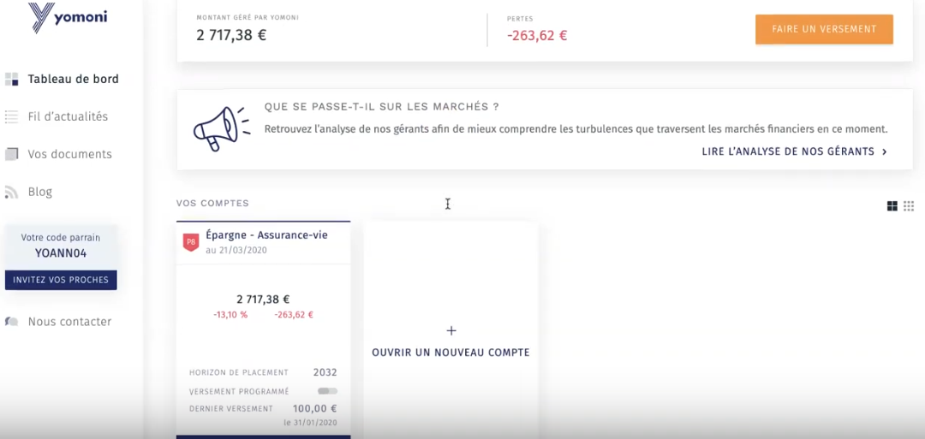
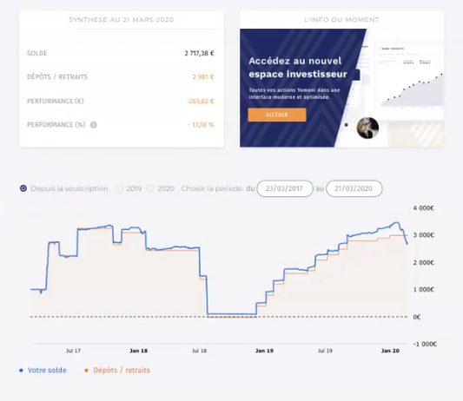
Mass market (3/3) - Focus on Yomoni management phase
Glimpse of Yomoni asset management dashboard
Yomoni Client Portal
Yomoni Performance Report
The home page of Yomoni's personal section allows the client to
Access immediately to all of his investments with the associated performances
To have access to dedicated articles on the Yomoni blog
To update personal documents
…
The performance report centralizes all the information related to the investment:
Variations of performance over a specific period of time
The balance
Deposits and withdrawals
Source: eleven research & analysis

Slide 59


Mass & Core affluent (1/3) - The customer journey becomes less digital to get a more human interactive and tailor-made experience when the customer is wealthier
Mass & core affluent customer journey
Contact phase
Conversion phase
Management phase
Main steps of the CGP customer journey
Information query
First exchanges with the CGP
First appointment
Contract signature and first operations
Asset management follow-up
Arbitration of the patrimonial strategy
End of the relationship with the CGP
The prospect looks on multiple sources to find information about wealth management (i.e.; accountant, blogs)
The prospect shares key personal information.
The CGP proposes an appointment
The CGP assesses the prospect’s needs which potentially leads to a quotation proposal
The client and the CGP both agree on the patrimonial strategy and the first operations are initiated
The client assesses the results of the strategy with or with the CGP and has access to some insights to guide his/her choices
The CGP and the client regularly review the strategy. New investments might be implemented
The investments reach maturity, or the client may decide to end the collaboration
Examples
Touch points
Physical meeting
Quick response from Crystal in less than 12hours
Anonymous test
Human personalized
Visio meeting
Phone call
Sharing and verification of all the necessary documents can be burdensome and time-consuming
“Reporting and alerting systems on major mouvements related to changes in assets are two key client's expectations”
Expert, Patrimoffice
Email
Website
or app
Visibility, transparency and responsibility of the investments become key criteria for investors in their strategy
« Customers are expecting their CGP to master digital tools in order to increase speed and convenience of the services”
Expert, CC&A Finance Patrimoine
Social network
“ Online leads represent a very small minority of CGPs acquisitions”
Expert, Patrimoffice
Digital, standardized
Chat/
chatbot
Adequation of journeys to expectations
Adequation
Source: eleven research & analysis, expert calls

Slide 60
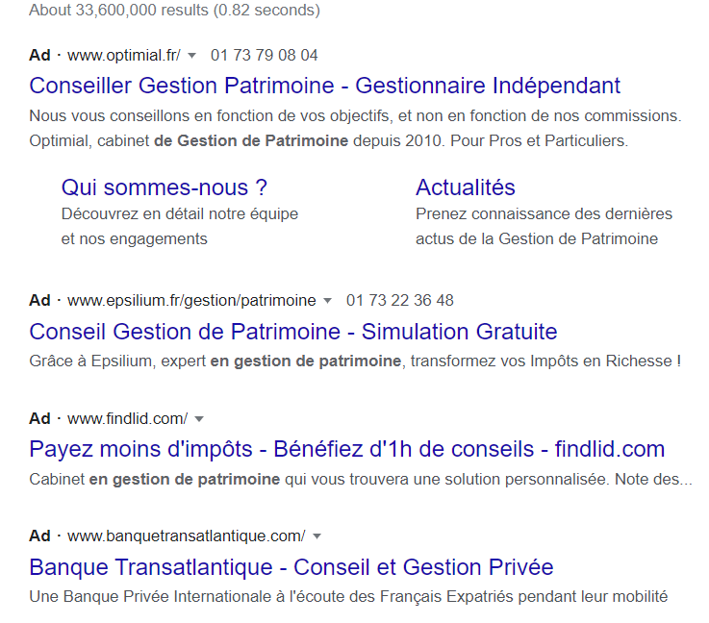
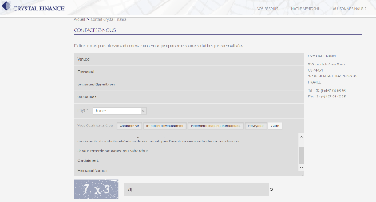
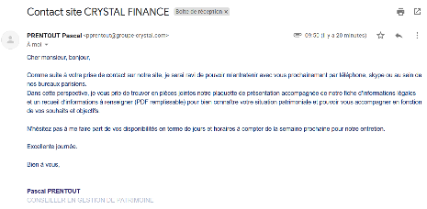
Mass and core affluent (2/3) - Focus on CG contact and conversion phase
Contact phase
Conversion phase
Information query
First contact and sharing of financial project
Commercial relaunch
Contract signature and investments
Absence of CG in organic or sponsored research results for wealth management related keywords
Less precise and granular contact form than other actors (e.g.; Nalo, Yomoni,…) when gathering first contact information
Quick follow-up email (e.g.; less than 12hrs)
Phone-call proposition to exchange with a commercial about the offers with an agenda to book a preferred time-slot
Face-to-face meeting
More complicated and burdensome collection of legal document
Search results for “Conseiller gestion patrimoine”
CG contact form
CG commercial follow-up email
Source: eleven research & analysis

Slide 61

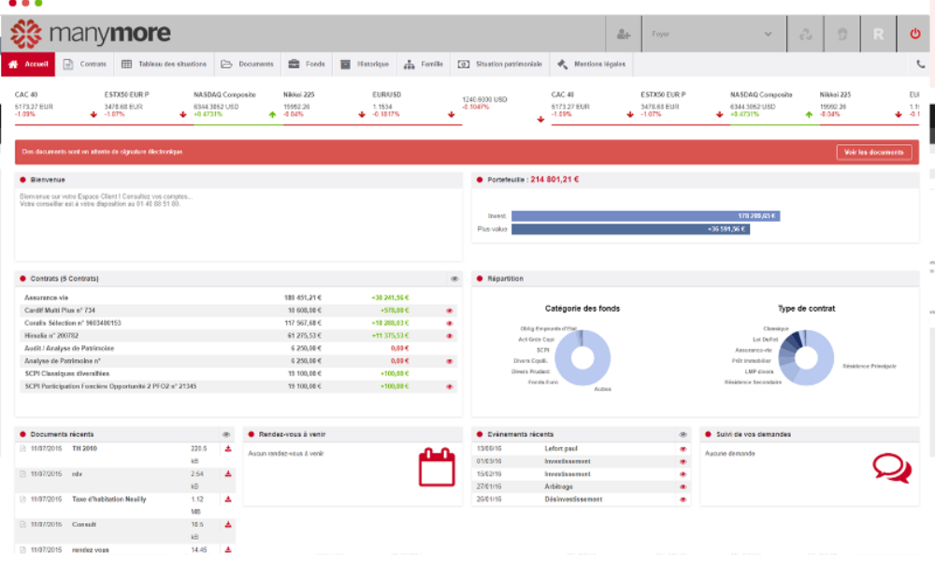
Mass and core affluent (2/3) - Focus on CG management phase: CG leverages Nexus solution from Manymore, a mobile and desktop customer interface to provide wealth management reporting to the end-customer
Key features of Nexus solution from Manymore
Client’s relatives
Wealth situation
Advisor contact
Amount invested
Detail per contract
Investment breakdown
History of shared documents
Demands to advisor follow-up
Planned meeting with advisor
More details in part 5 when describing Manymore’s software
Source: eleven research & analysis, Expert calls
Updated

Slide 62
Executive summary
Customers’ expectations regarding wealth management services
Overview of customers’ journeys for mass market, mass and core affluent
Focus on CG’s performance in terms of customer acquisition and online visibility
1
Wealth management ecosystem
2
AGENDA
Wealth management B2C customers’ experience
3
Digitalizing financial advisors’ day to day operations: CG’s positioning and underlying opportunities
4
Digitalizing CGP’s back and middle offices: comparison of CGP’s organizations and models
5
Highlights on key digital growth opportunities for CG
6

Slide 63

Acquisition channels based on the recommendation of trusted individuals (e.g, personal or professional network) are the most effective and are those on which CG could further capitalize
Acquisition channels ranked by efficiency
- Acquisition efficiency
+ Acquisition efficient
Digital marketing
Prospection (phone call)
Recommendation
Prescription
Social network
Search engine optimization (SEO)
Search engine advertising (SEA)
Mainly by phone calls (e.g., alumni directories)
Depends on the ability to satisfy existing customers (e.g., quality of the service, follow-up)
Cheapest acquisition channel¹
Requires experience and recognition as a CGP
Relies on a strong network of prescribers (i.e., lawyers, notaries, chartered accountants) met in in professional clubs and associations (e.g., club of entrepreneurs)
Illustrations pages 64-68
Illustration page 70
« Digital marketing initiatives are not very effective in capturing a wealthy clientele»
Expert, former associate at Cyrus Conseil
« The more senior the CGP is, the less he is prospecting »
Expert, former associate at Cyrus Conseil
« Recommendations supply 50% of new customers in volume»
Expert, former associate at Cyrus Conseil
« This is the acquisition channel that brings in the most assets under management»
Expert, former associate at Cyrus Conseil
CG’s today
Potential of growth
Direct
Indirect
- Complete +
Source: eleven research & analysis, 1expert calls

Slide 64





SEO performances of a website depend on several criteria specific to the algorithm of each search engine (e.g., Google, Bing, Yahoo,…)
4 main ranking algorithm criteria for Google search engine
Website performances
Content / Semantics / Keywords
Loading time
Source code quality
Multi-device responsiveness
…
Quality of content
Keyword quality and number
…
Google search engine
Social media presence and backlinks
Traffic history
Social media presence and backlinks
Number of unique visitors
Website seniority
…
Social media content that refers to the website
Number of relevant backlinks
…
SEO strategies rely on the ability to make the website readable to search engine crawlers so they can understand its content and index it in the search results
Source: eleven research & analysis

Slide 65







Fintech players are well-mastering SEO while CG and similar-sized peers are average-performers with room for further potential enhancement
Competitors SEO capability assessment
SEO performance assessment levers
Website performance
Content / Semantics / Keywords
Traffic History
Social media presence / Backlinks
Loading time
Source code quality
Multi-device responsiveness
…
Percentage of unique/ common/ duplicated content
Keyword quality and number
…
Number of unique visitors
Website seniority
…
Social media content that refers to the website
Number of relevant backlinks
…
Overall SEO Maturity
Players
Speed page grade¹: Needs improvement
Fully load time²: 3,3s
Unique content: 32%
Common content: 52%
Duplicated content: 16%
Estimation based on Google trends analysis
Linkedin subscribers: 16,7K
Facebook fans: 574
Backlinks: 19k
CG
S
Speed page grade: Poor
Fully load time: 10,6s
Unique content: 46%
Common content: 22%
Duplicated content: 32%
Estimation based on Google trends analysis
Linkedin subscribers: 6,7K
Facebook fans: 3,7K
Backlinks: 5K
Speed page grade: Needs improvement
Fully load time: 3,7s
Unique content: 56%
Common content: 25%
Duplicated content: 18%
Estimation based on Google trends analysis
Linkedin subscribers: 7,3K
Facebook fans: 8,4K
Backlinks: 1,7K
Speed page grade: Good
Fully load time: 1,5s
Unique content: 63%
Common content: 22%
Duplicated content: 15%
Estimation based on Google trends analysis
Linkedin subscribers: 3,9K
Facebook fans: 6,4K
Backlinks: 7,7K
Speed page grade: Needs improvement
Fully load time: 3,9s
Unique content: 57%
Common content: 33%
Duplicated content: 10%
Estimation based on Google trends analysis
Linkedin subscribers: 981
Facebook fans: 0
Backlinks: 390
Speed page grade: Needs improvement
Fully load time: 3s
Unique content: 41%
Common content: 44%
Duplicated content: 16%
Estimation based on Google trends analysis
Linkedin subscribers: 3,9K
Facebook fans: 0
Backlinks: 2,3K
Source: eleven research & analysis, siteliner, googletestmysite, similarweb, google trends
1. Only for Google search engine, 2. 4G in France - Av. : 2,5s (bounce rate raises above this time)

Slide 66
As searches for investment products account for most of all queries in CG’s semantic universe, compared to business and company names keywords…
Google trends of CG-related keywords in France, 2015-2020, index base 100
Keywords related to CG’s products
PEA
SCPI
ETF
Produit structuré
Keywords related to CG’s business Gestion de patrimoine
Optimisation fiscale
Plan retraite
Conseil patrimoine
Keywords related to CG’s peers' companies
Cyrus conseil
Expert & Finance
Yomoni
The results reflect the proportion of searches for a given keyword and not the volume of queries
2020
Key Take-aways
Query volume for the three semantic sub-universes has remained stable over the last five years with 1. Product, 2. Business and 3. Company
All of CG’s brand websites have a volume of requests similar to its competitors
CG could focus its SEO strategy on the semantic universe Product in order to make all of its website easily accessible through organic path to potentially qualified leads
Source: eleven research & analysis, Google trends search France between 2015-20

Slide 67



… CG can capitalize on product-related semantic universe to improve its SEO maturity
CG SEO maturity assessment in its semantic universe
Keywords related to CG’s products
Keywords related to CG’s Business
Keywords related to CG’s Company
PEA
OVPCM
SCPI
Structured product
Stocks
Life insurance
ETFs
PER
…
CGP
Wealth management
Investments
Patrimonial strategy
Tax optimization
Pension plan
…
Crystal Finance
Expert & Finance
Cyrus Groupe
Primonial
Yomoni
…
Example of keywords of CG universe*
How often are these keywords searched
How easy is CG to find with these keywords
How often are these keywords searched
How easy is CG to find with these keywords
How often are these keywords searched
How easy is CG to find with these keywords
Key Take-aways
CG’s websites appear organically in the search results on the 1st page essentially when the user types the exact name of the company
It becomes more difficult to find CG websites when queries are made on other semantic universes
- Complete +
Source: eleven research & analysis, Google trends search France between 2015-2020, * French keywords

Slide 68
Therefore, CG has the opportunity to reinforce its visibility in organic search results thanks to a better positioning on its product/business-semantic universe
Comparison of the occurrence of CG and peers in Google search results
Selected keywords*
CG
0
1
2
3
4
0
1
2
3
4
0
1
2
3
4
0
1
2
3
4
0
1
2
3
4
Gestion patrimoine expatrié
Gestion patrimoine
CGP
PEA
Assurance vie
Optimisation fiscale
Stratégie patrimoniale
Conseil en gestion de patrimoine
Gestion privée
Transmission patrimoine
Key Take-aways
Very few actors of CG ecosystem appear organically at the top of the first page for the selected keywords: CG is the best performer with 2 times out of 10 in the top results
CG has the opportunity to improve its direct digital acquisition channel by leveraging a content creation strategy (e.g., writing articles on specific themes, blogs, etc.)
Some players (e.g., Primonial, Yomoni) bid on specific keywords to appear in the sponsored results in order to capture part of the traffic
0
1
2
3
4
Does not appear
Appear end of 2nd page
Appear top of 2nd page
Appear end of 1st page
Appear top of 1st page
Source: eleven research & analysis, Google trends search France between 2015-20
*KW are selected upon Google’s Keyword planner tools that recommends associated pertinent KW
Organic
Sponsored

Slide 69



CG could also enhance its digital brand equity and attract more qualified leads into its ecosystem by leveraging SEA – Search Engine Advertising
How does SEA work?
One-month simulation of SEA campaign (1,40€ CPC max)
Quality score ranking criteria
Keyword
How much I am willing to pay (e.g., CPC max)?
SEA keywords: example of “gestion de patrimoine” keywords
Cost per click
# of clicks
# of impressions
Assurance vie
1,4€
3,6K
70K
Conseil gestion patrimoine
1.4€
27
782
Conseil investissement
1,4€
68
546
FCPI
1,4€
17
148
Gestion de patrimoine
1,4€
148
4,1K
Landing page
How performant and pertinent is my redirection link?
Advertising
How appealing is my ad?
Investissement
1.4€
1,7K
43K
PEA
1.4€
800
20,5K
SEA aims to reach the targeted audience with sponsored content at key moments of the customer journey (e.g., active search) according to the specific objectives of the advertiser (e.g., website visits, calls, online sales)
The ranking of the ad depends of the quality score from 1 to 10
SCPI
1.4€
361
8,5K
Total cost of 7,6K€, with 8k estimated clicks, 180k impressions and an average position of 2¹ for the 8 selected keywords
Relatively high ratio click/ impression of 4,4%²
Source: eleven research & analysis,
Google keyword planner, 1 CPC max was selected to have an estimated # of clicks superior than the investment 2 hubspot

Slide 70




In terms of marketing claim, Family Offices and robo-advisor promote an avant-garde and exclusive identity while traditional CGPs capitalized on their history and reputation
Family office
Genuine identity
High-end positioning
Well-designed website and UI
“Letus Private Office, le Family Office des entrepreneurs”
“Dans le seul intérêt des familles – Le multi-family Office par intutae”
“Le monde change… Le family office aussi. Ivesta, le family office qui réunit les entrepreneurs”
CGP /CGPi
Factual positioning (e.g., highlighting figures,…) that do not capitalize on emotion
Capitalize on their history and reputation
“Ensemble, donnons du sens à votre patrimoine”
“30ans de conseil en gestion de patrimoine pour nos 20 000 clients”
“Banque conseil gestion de patrimoine”
“1er groupe independant de gestion en patrimoine”
Robo-advisor
Positioning as simple, accessible and efficient
Well-designed website and UI
“Faîtes le choix d’un investissement éclairé: Le service d'une banque privée et d'une plateforme digitale pour vous offrir une gestion optimisée, maîtrisée et personnalisée ”
“The Smart Money Manager – Save, Invest, Retire”
“L’investissement enfin intelligent:
Conseil en investissements financiers, et assurance-vie pilotée sur mesure. Nous investissons, vous faites fructifier votre épargne”
Key Take-aways
CG can further stand out from other traditional CGPs by combining its current trusted positioning with a more cutting-edge branding
CG could also seize the opportunity to improve its image in certain customer segments (e.g., young entrepreneurs, sports, ...) by modernizing its CGP appellation to a more contemporary naming (e.g., wealth manager, …)
Updated
Source: eleven research & analysis, company websites

Slide 71
Executive summary
Stakes and ongoing digitalization related to CGP’s day to day operations
CGP’s positioning compared to peers in terms of operations digitalization
1
Wealth management ecosystem
2
AGENDA
Wealth management B2C customers’ experience
3
Digitalizing financial advisors’ day to day operations: CG’s positioning and underlying opportunities
4
Digitalizing CGP’s back and middle offices: comparison of CGP’s organizations and models
5
Highlights on key digital growth opportunities for CG
6

Slide 72
The main steps of customers’ journey of a wealth manager can be mapped to the corresponding operations
Main steps of the CGP customer journey
Contact phase
Conversion phase
Management phase
Information query
First exchanges with the CGP
First appointment
Contract signature and first operations
Asset management follow-up
Arbitration of the patrimonial strategy
End of the relationship with the CGP
Prospecting & Marketing
Generate leads, attract and convince them
Front office
Choose the product CGPs are going to sell to clients according their risk profile and willingness
Strategic Advisory
Managing contracts
Follow clients’ portfolio performances, perform arbitrage when needed and help clients with their request
Middle office
Contract Settlement
Perform regulatory and administrative duties
Back office
Key take-aways
The more complex the customer path, the more time consuming the operational chain that will face the CGP. We can then explain the standardization of mass market in order to maintain proper margin levels.
Source: Crystal group IM, eleven research & analysis, Expert calls

Slide 73


CGPs work along a complex operational chain where back and middle office tasks have a poor balance between time invested and value perceived by the end-customer
CGPs’ operational chain regarding ratio time invested and value perceived
Front office
Middle office
Back office
Prospecting & Marketing
Strategic Advisory
Managing contracts
Contract Settlement
1
Marketing
Client targeting
Creation of commercial operations
Events organization
1
1
1
Products administration
Market insight gathering
Suppliers management
Selection of saving solutions
Financial engineering
Portfolio management
Portfolio performance monitoring
Risk management
Regulatory follow-up
Administrative settlement
Anti Money Laundering analysis
Legal and regulation duties completion
Contract ratification
2
Prescribers management
« Intermediate » prospection
Provision of tools: Expert & Fees
Formations organization
« Community » animation (blog, newsletter ..)
2
Client discovering
Connection document creation
Understanding of client’s needs
Definition client’s goal & risk aversion
2
Reporting and arbitrage
Aggregation of the whole client’s patrimony
Creation of portfolio reporting for the client
Providing of arbitration options
2
Fees management
Fees collection from the client
Sharing with intermediates
3
3
3
Leads management
Exchanges recording
Commercial relaunching
KYC: client scoring
Wealth diagnostic
Client’s wealth situation analysis
Mission report creation
Customer service
Answering clients’ questions
Providing of historical documents
4
Recommendation
Optimization recommendation
Provision of portfolio simulation
« [Other tasks] take time and prevent from focusing on the core job which is advising »
Expert call, Gresham & Patrimoffice
HNWI
Core affluent
low
high
low
high
low
high
low
high
Mass Market
Specific to indirect distribution channel
Time invested
Value perceived by the end-customer
Sources: Crystal group IM, eleven research & analysis

Slide 74





Despite an ongoing digitalization, there is still improvement opportunity to address CGPs’ pain points especially on regulatory and time-consuming tasks that are decreasing their profitability
CGPs’ operational chain and associated pain points
Front office
Middle office
Back office
Prospecting & Marketing
Strategic Advisory
Managing contracts
Contract Settlement
Time-consuming appointment booking and commercial relaunching
Hard KYP¹ and financial engineering to be able to defend margins
Time-consuming standard “paper” tasks make hard the focus on the advisory aspect
Constraining regulations that keep changing.
Hard to have a transparent asset traceability
Risk to loose a lead due to long document check
Hard understanding of clients’need
Difficulty to keep client informations
Complexity in the integration of all the tools available to facilitate transactions and their management
Complexity to satisfy compliance duties especially KYC aspects
Difficulty to project the customer in investment proposition
Difficulty to aggregate clients’ whole patrimony
Hard consolidation of clients’ patrimony due to multiple data source
Criticality
Difficulty to target relevant customer
Time-consuming billing and payment process.
Hard balance between satisfying returns and responsible investment (e.g., green investments …)
Difficulty to handle multi-canal clients’ request
Complexity to engage new generations on a face-to-face relation
Delicate fees sharing between counterparty
Difficulty to give the customer a clear overview of his portfolio constitution
Complex integration of additional services: concierge …
Difficulty to justify recurring fees once the product sold
Complexity to handle “gambler” customer
Maintaining relationship with customer
Handling IT tools
Complying with regulation
Pain points segmentation
Allocating time
Being efficient in core business
Sources: Crystal group IM, eleven research & analysis ; 1. KYP: Know Your Products

Slide 75

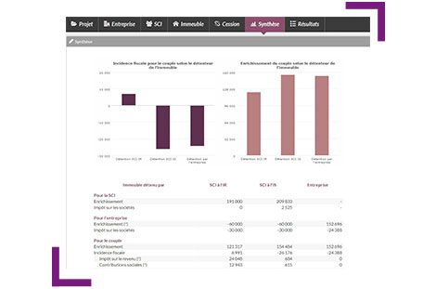
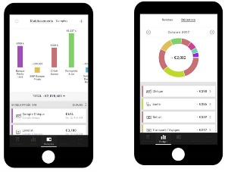
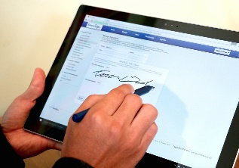
There is yet some solutions that progressively digitalize CGPs’ operational chain especially for the back and middle office
CGPs’ operational chain and existing tech enablers
Existing solutions to digitalize operational chain
Front office
Middle office
Back office
Prospecting & Marketing
Strategic Advisory
Managing contracts
Contract Settlement
CRM that saves clients’ information through the process
Connection to many asset suppliers through a unique platform
Customer’s whole patrimony aggregation
Reminder of all the regulatory step and creation of official documents
Online marketing to onboard new customers
Simulation of different investment solutions
Following regulatory change through an information tools
Keeping clients’ information in a secure platform
Automatization of customers’ wealth audit
Visualization of portfolio for end customers
Regulation reminder to ensure compliance
Electronic signature of contract
Big Expert from Harvest allows both simulation and audit
Portfolio visualization in LaFinBox application
Electronic signature (e.g. DocuSign, Yousign …)
Mobile app
API
Electronic signature
Existing tech enablers
Platform
SEO/SEA
Sources: Crystal group IM, eleven research & analysis

Slide 76

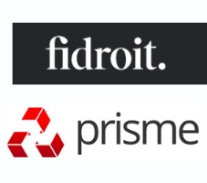











Illustration – software and tech providers: On top of internal development to digitalize processes, CG could leverage many existing players that have implemented tools related to wealth management operations
CGPs’ operational chain and some technological players
Front office
Middle office
Back office
Prospecting & Marketing
Strategic Advisory
Managing contracts
Contract Settlement
Use case: Global software solution
Techno: Webapp, Machine learning, Robotics
Use case: Global software solution
Techno: Webapp, Machine learning, Robotics
BIG
O2S
O2S
MoneyPitch
O2S
Technological advancement
Techno:
Machine learning,
NLP
Techno:
Machine learning, Robots
Techno:
Web app
Techno:
Web app
Use case:
NLP algorithm to automatically collect commercial interesting profile
Use case:
Provide robot advisor in white label in order to help CGP in their recommendations.
Use case:
Solution that allow CGP to evaluate their compliance and to give solution in case of problem
Use case:
Mobile app that allow investment on financial products from 5€
Techno:
VR
Techno:
Machine learning
Techno:
Machine learning
Techno:
Blockchain
Use case:
VR to immerse customer in the different investments proposals
Use case:
Solution that evaluate clients’ investment profil based on playful experiment
Use case:
Deep learning algorithm to help perform portfolio arbitration
Use case:
Platform that allow exchange of reliable clients’ information's
Source: Crystal group IM, eleven research & analysis, Expert calls
Country of incorporation (outside France)

Slide 77





To go further in this digitalization journey 5 new technology enablers could solve additional CGPs’ pain points on the long term
Presentation of major technology enablers identified …
Machine learning
Robot
Blockchain
Web app
Virtual Reality
Algorithms that are able to learn to predict events by detecting complex patterns in data
Algorithms that can perform automatically simple tasks described by binary operations
Decentralized database based on multiple node and that allows to store and verify information
Software hosted on a distant server and reachable through web navigator
Technologies that allow to immerse people in an artificial word
… that have different transformation potential on CGPs operations
Strategic Advisory
Prospecting & Marketing
Managing contracts
Contract Settlement
Source: Crystal group IM, eleven research & analysis, Expert calls
Strategic advisory
Marketing & prospecting

Slide 78




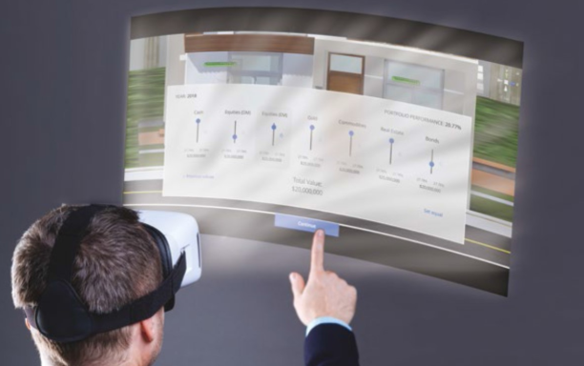
In the future, these enablers could allow CG to stand out by freeing CGPs from non core-business tasks and help them in their core-business creating data-augmented CGPs
CGPs’ operational chain and technology enablers
Front office
Middle office
Back office
Prospecting & Marketing
Strategic Advisory
Managing contracts
Contract Settlement
Technological solutions to solve pain points
CRM robot automatizing relaunching and appointment booking
Client clustering to improve clients’ need understanding
A digitalized platform that covers the whole customer journey and interaction
Blockchain to ensure credible and accurate client information's
Signal analysis that automatically determine best investments solutions
NLP¹ and chat bot to answer to client requests
Blockchain on assets
Web scrapping combined to NLP for lead relevance analysis
Show investments impact through VR imagery
Algorithm to standardize assets and related data through all the asset suppliers.
Blockchain to centralize
wealth information's
Mutual platform to share fees with intermediates
Synechron gives the possibility immersive experience to visualize investments possibilities
Efficient alerting thanks to machine learning prediction and recommendation tools
Regtech to automatically learn regulation changes
Simplicity of the solution
Existing technologies but requiring an adaptation
Application in a research phase
Sources: Crystal group IM, eleven research & analysis; NLP: Natural Language Processing

Slide 79
Opportunity - Data augmented advisor: CG could increase its level of offer personalization and switch to proactive advices by knowing its customers better, through three digital levers
Aggregating customers bank account, including non-intermediated accounts
CG’s advisors could widen their offer with an account aggregator to provide a more unified customer experience
CG’s advisors will get their client's banking information up to date and will be able to fine-tune their advice
Access to the customer's banking situation in real time represents an up-sell opportunity for CG by detecting unusual movements or particular moments in life
Offer an aggregator that goes beyond bank accounts by conglomerating all investments, even those on which the CGP is not the intermediary
1
Create an end-to-end "one-stop shop" experience so that the client can access all their asset and wealth information easily and at a glance
Giving advices based on customer profiling and C2C recommendations
CG’s advisors could offer products and advice to their customers according to recommendations based on similar customer profiles
Personalized recommendations may be given to advisors or directly pushed to the clients directly on its dashboard
A
2
For advisors: access to client categories by typology (e.g., level of risk, profession, level of wealth, complexity of assets)
C
Recommendations to clients: “80% of clients similar to your profile have chosen this product and have expressed their satisfaction”
A
B
C
REINFORCEMENT OF CUSTOMER KNOWLEDGE
Steering tool for CGPs
Investment opportunity identification through clustering of client profiles
Sale support tool for CGPs
Identification of sales opportunity and recommendation to CGPs based on the clients’ clusters
Recommendations to clients
Tailor-made offers proposed to the client according to the investment history of the cluster to which he belongs
B
Alerts to advisors when an investment opportunity is identified based on customers segments
Detecting customers’ moments of life through through their bank accounts, social networks and online data (e.g., Infogreffe)
An access to customers’ banking account information makes it possible to detect “big life changes” through application of machine learning algorithm and thus to push proactively highly personalized recommendations
Similarly, other online data sources may help increase customer knowledge (e.g., such as social medias, or specialized websites Infogreffe)
For instance, exceptional balances may be detected by advisors and triggers personalized recommendations
3
Exceptional incomes can be linked to life events
Balance evolution €
“Normal” balance
“Exceptional” balance: proactive advices from the CGP to the customer
Date
More details of underlying digital opportunities for CG on part 6 of this document
Sources: Crystal group IM, eleven research & analysis; NLP: Natural Language Processing

Slide 80
Executive summary
Stakes and ongoing digitalization related to CGP’s day to day operations
CGP’s positioning compared to peers in terms of operations digitalization
1
Wealth management ecosystem
2
AGENDA
Wealth management B2C customers’ experience
3
Digitalizing financial advisors’ day to day operations: CG’s positioning and underlying opportunities
4
Digitalizing CGP’s back and middle offices: comparison of CGP’s organizations and models
5
Highlights on key digital growth opportunities for CG
6

Slide 81
Among the 4 lines of work in the CGPs’ operational chain 5 digitalization areas can be highlighted
Front office
Middle office
Back office
Prospecting & Marketing
Strategic Advisory
Managing contracts
Contract Settlement
Digitalization of customer acquisition
Generation, management of direct and indirect leads
Digitalization of client interaction
Management, support, and services brought to the client along his investment’s life
Digitalization of administrative tasks
Back office and compliance tasks
1
2
4
Automation of core business (processes)
Selection of wealth products, analysis of client and investment recommendations
Digitalization of supplier’s interactions
Connection and aggregation of suppliers’ product
3
5
Digitalization priority
Importance
Current market digitalization
Source: eleven research & analysis, Expert calls

Slide 82
Various digital solutions could help CG move forward on those digital areas
Front office
Middle office
Back office
Prospecting & Marketing
Strategic Advisory
Managing contracts
Contract Settlement
Digital solutions
Visio meeting
Electronic signature
Compliance robot
SEO/SEA
Online wealth diagnosis
Web customer interface
Document & data cloud storage
CRM
Automated live patrimony consolidation
Customer Mobile app
Digital KYC
Digitalized tools provided to prescribers
Automated portfolio management and arbitration
On-demand access to portfolio performance
Integration with other players’ IT
Robot advisor
Chatbot
Unique web platform with numerous product
Investment simulations
Multi canal support
Ability to perform self arbitration
1
2
3
4
5
Digitalization areas
Digitalization of customer acquisition
Digitalization of client interaction
Automation of core business (processes)
Digitalization of administrative tasks
Digitalization of supplier’s interactions
Source: eleven research & analysis, Expert calls

Slide 83
Assessing CG’s digitalization to its peers actually consists in comparing their choices between Harvest, Manymore and an internal development of software solution
Comparison of CG and its peers on our analytical framework
Other CGPs
Key digital maturity Criteria
Importance of criteria
through
through
1
0
1
2
3
4
0
1
2
3
4
0
1
2
3
4
0
1
2
3
4
0
1
2
3
4
Digitalization of customer acquisition
2
« Cyrus have tried to advertise online but they didn’t get the expected success»
Former general secretary at Cyrus
Digitalization of client interaction
External considerations only
Understanding the level of digitalization therefore involves analyzing peers’ choices in terms of providers
See next part (“Digitalizing CGP’s back and middle offices”) for the assessment
3
Harvest is standardized and robust while Manymore enables more customization and supports
Automation of core business
« Harvest is the only software that automatically do wealth audit»
CGP at Expertis
4
Digitalization of administrative tasks
5
Digitalization of supplier’s interactions
Quality
Importance
0
1
2
3
4
Source: eleven research & analysis, Expert calls; 1: assessed in the next pages in term of IT supplier

Slide 84
Executive summary
Identification of digital tools available for CGPs
Overview and assessment of CGP’s trade-offs when selecting its digitalization provider
Manymore architecture and underlying opportunities of customization
Impact of back and middle offices digitalization on organizations and models
1
Wealth management ecosystem
2
AGENDA
Wealth management B2C customers’ experience
3
Digitalizing financial advisors’ day to day operations: CG’s positioning and underlying opportunities
4
Digitalizing CGP’s back and middle offices: comparison of CGP’s organizations and models
5
Highlights on key digital growth opportunities for CG
6

Slide 85


Digital is a key opportunity to streamline internal operations while improving both customers’ and CGPs’ journeys by modularizing exchanges with customers and freeing CGP from back and middle offices
Traditional organization
Digital organization
Suppliers
End customers
End customers
Suppliers
Suppliers’ extranet
CGP
CGP
The advisor has a tool that streamline processes
The advisor can focus on its main added-value: advice
The advisor loses time with administrative and legal tasks
Time for advice is limited
Mail,
physical signature
Multi-canal on demand
Letter,
Mail
Back & middle office
Aggregators
API
IT
Large number of FTE to manually fill contracts
IT service to integrate tools and develop on-top modules
Size of staff
Source: eleven research & analysis, Expert calls

Slide 86




CGPs work along a complex operational chain where the number of tools to master can explode
Electronic signature
Wealth audit
Providers’ extranets
Simulation
Online completion of contracts documents
Settling and managing contracts
Managing CGP operations
Arbitration
Storage of customers’ documents
Product platforms
Wealth aggregation
Set of digital tools
for CGPs
Visio meetings
Reminder of legal steps
Interacting with customers
Managing regulations
CRM
KYC
Multi-canal support
Legal watch
Source: eleven research & analysis, Expert calls

Slide 87


Illustration – Harvest & Manymore (1/2): Two wealth management software dominate the market, Harvest being the leader with a standardized and robust solution and Manymore offering more personalization
Harvest & Manymore key data
Harvest & Manymore pros and cons from a CGP’s perspective
Pros
Cons
Rank on french market
1st
2nd
Functionalities covering 80% of CGPs needs along their operational chain
Compliance rationalization facilitating administrative tasks
Inheritance engineering tools
“Clients’ data hijacking” once in the platform
API causing connectivity issues with other CGPs’ tools
International wealth consolidation problem due to data heterogeneity
Creation
1989
2006
Number of clients
4000+
3000+
Revenues (2019)
31,9 M€
5,1 M€
Key take-aways
Axa and Cardiff have invested respectively in Manymore in order to progressively replace their own extranet showing their willingness to get closer to end-customers and to accumulate more data
Source: eleven research & analysis, Expert calls

Slide 88
Illustration – Harvest & Manymore (1/2): Harvest and Manymore have significantly incorporated existing digital enablers in their offers, becoming must-have tools for most of CGPs
CGPs’ operational chain and related software tools
Front office
Middle office
Back office
Prospecting & Marketing
Strategic Advisory
Managing contracts
Contract Settlement
Account consolidation
O2S
Prisme
CRM
O2S
Prisme
Electronic signature
Money Pitch
Nexus
MIF2/DDA compliance
O2S
Prisme
Customers’ interface & reporting
Money Pitch
Nexus
Arbitration
O2S
Prisme
Robot advisor
Money Pitch
─
Extranet multi-companies
O2S Business Link
Connective Software
Simulation
BIG
─
Wealth audit
BIG
─
Key strategical stake for CG is to smartly leverage best-in-class tech tools (incl. products brokerage platforms, software editors) in order to streamline its operations and focus and high value-added services (i.e., customer relationship, advisory)
A smart use of software editors requires a deep understanding of the pros and cons of each solutions (e.g., Harvest’ robust and standard solutions vs. Manymore’ more customizable but less robust solutions)
Legend:
Harvest
Manymore
Differentiating factor
Source: eleven research & analysis, Expert calls

Slide 89
Illustration –Manymore (1/3): Connective software aggregates insurers’ products to help advisors subscribe for clients on selected products directly on the Manymore environment
Key features of the Connective software from Manymore
Aggregating products and managing subscription
Helping advisors in its subscription and customer management processes
Providing insights directly to the end customers
Managing contracts
Electronic signature
Managing advisors’ profiles
Entering client information
Updated
Source: eleven research & analysis, Expert calls

Slide 90
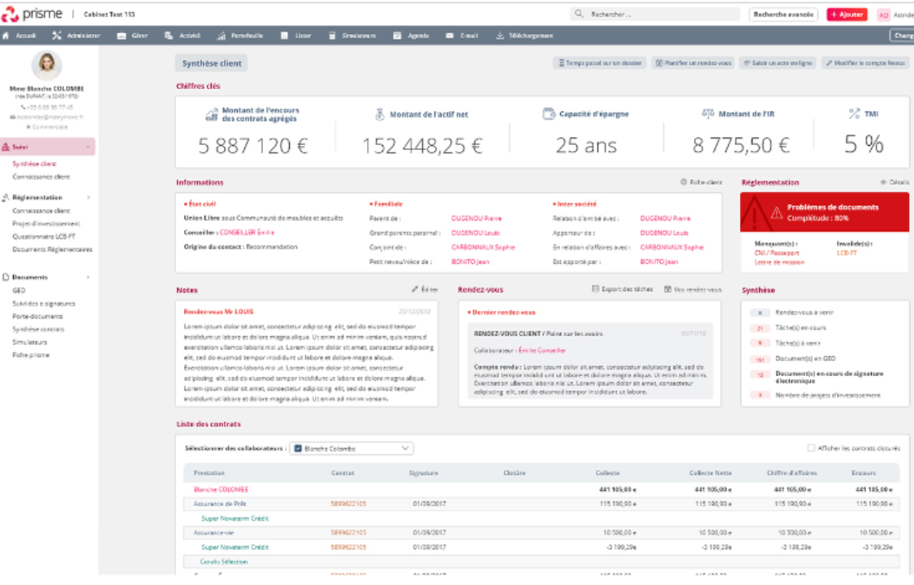
Illustration –Manymore (2/3): Prisme solution helps advisors manage their operations and stores key insights regarding their clients
Key features of the Prisme solution from Manymore
Aggregating products and managing subscription
Helping advisors in its subscription and customer management processes
Providing insights directly to the end customers
Customer profile, key information and figures
Customer’s insights
Regulation reminders
Underlying regulation database
Synthesis of pending actions for the advisor
Notes from the last meeting
Detail per contract
Updated
Source: eleven research & analysis, Expert calls

Slide 91
Illustration –Manymore (3/3): Nexus is a mobile and desktop customer interface to provide wealth management reporting to the end-customer
Key features of Nexus solution from Manymore
Aggregating products and managing subscription
Helping advisors in its subscription and customer management processes
Providing insights directly to the end customers
Client’s relatives
Wealth situation
Advisor contact
Amount invested
Detail per contract
Investment breakdown
History of shared documents
Demands to advisor follow-up
Planned meeting with advisor
Updated
Source: eleven research & analysis, Expert calls

Slide 92
Executive summary
Identification of digital tools available for CGPs
Overview and assessment of CGP’s trade-offs when selecting its digitalization provider
Manymore architecture and underlying opportunities of customization
Impact of back and middle offices digitalization on organizations and models
1
Wealth management ecosystem
2
AGENDA
Wealth management B2C customers’ experience
3
Digitalizing financial advisors’ day to day operations: CG’s positioning and underlying opportunities
4
Digitalizing CGP’s back and middle offices: comparison of CGP’s organizations and models
5
Highlights on key digital growth opportunities for CG
6

Slide 93



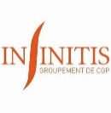







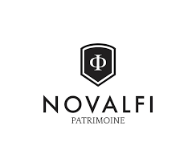






When selecting a digitalization provider, CGPs face trade-offs between internal developments and off-the-shelf solutions of the market with pros and cons on both side
Selected examples of digitalization providers of major CGPs players
Major solutions
Examples of customers
Pros & Cons
Highly integrated
Best quality/ price ratio
Robust
Advanced functionalities (i.e., automated wealth diagnosis and recommendations)
Painful & costly integration/ implementation and maintenance
Poorly customizable (very standardized functionalities)
High quality
No maintenance constraints
Highly customizable solution
High pricing
Less Robust than Harvest (frequent bugs)
Internal development
Highly personalized solution
Proprietary tool (independency from external providers)
Costly and complex development (developing a software is very far from CGPs’ core business) requiring external providers
No possibility to benefit from solution frequent updates with market changes (e.g., new regulations)
…
Small and self employed/ independent CGPs (not integrated in partnerships)
Not expensive
No scalability: painful operations when customers volume increases
Source: eleven research & analysis, Expert calls

Slide 94






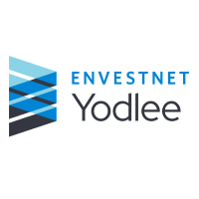
Illustration – International benchmark: Many international players are also providing CGPs’ software digitalizing wealth management
Action performed by CGP and corresponding tools
Assets
End-Clients and prescribers
Digitalization of supplier’s interactions
Digitalization of client journey
Digitalization of customers/prescribers acquisition and interactions
Digitalization of administrative tasks
Automation of core business (processes)
Country of incorporation (outside France)
Updated
Source: eleven research & analysis, Expert calls

Slide 95
CG’s choice to leverage Manymore’s cloud-based wealth management software instead of developing its own software will help save resources maintaining IT up to date to meet evolving regulation
Use of internal software
4D tools developed internally to support advisors’ operations
High level of personalization but implies a lot of resources to maintain systems up to date with evolving regulation
Migration of E&F under Manymore
Transition to manymore in order to unify tools among CG
Delay in the migration (end 2019 to end 2020) as DSI resources were mobilized on B2B business
EF
2017
2018
2019
2020
2021
Time
CG
Transition to Manymore
Why ?
Streamline CG’s processes
Interface better with suppliers
Comply easily with many regulation changes
Exception: Harvest’s Big Expert software for wealth management simulation
Customization ads-on of Manymore
On-demand development of additional features to differentiate CG’s offer:
Module for expatriates?
Tools for accountants?
Module for VIP customers?
Source: eleven research & analysis

Slide 96





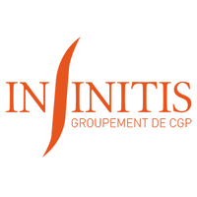


The level of digitalization also depends on the ratio between development of the tools needed and budget CGP companies can allocate to develop and maintain them
Digitalization of CGPs under the trade-off quality/cost
Quality of digital tools
B2C fully digitalized mass market platform:
High
Players that have developed internally:
users:
users:
Standard
Small “old-fashioned” CGPS:
Low
Solution price (implementation & updates)
Expensive
Affordable
Solution “made”
Solution bought
Updated
Source: eleven research & analysis, Expert calls
Notes:
Note : Astoria et Asteria sont deux CGP. Astoria finance est le plus grand, ici l’illustration porte sur Asteria, plus petit et moins digitalisé.

Slide 97
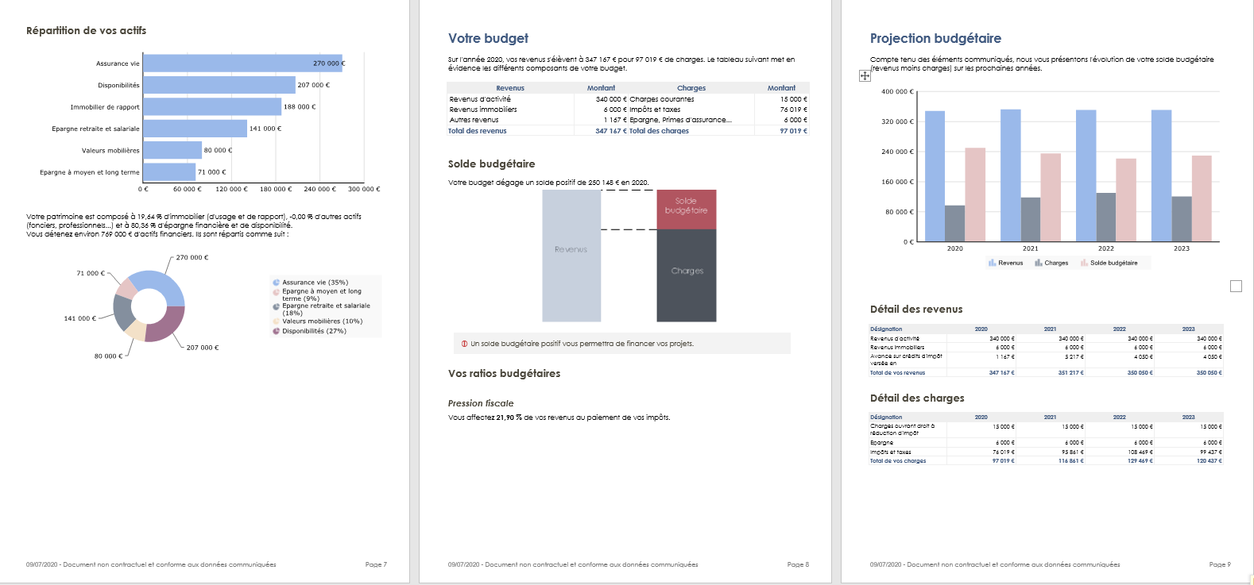
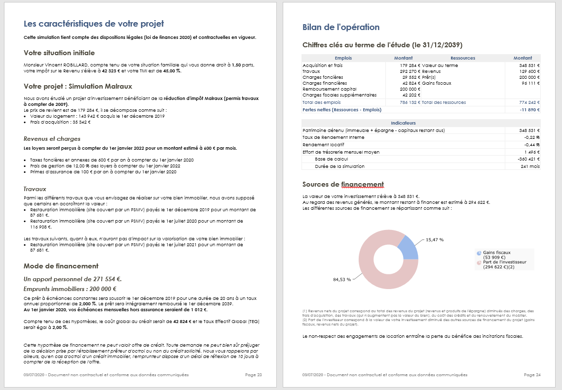
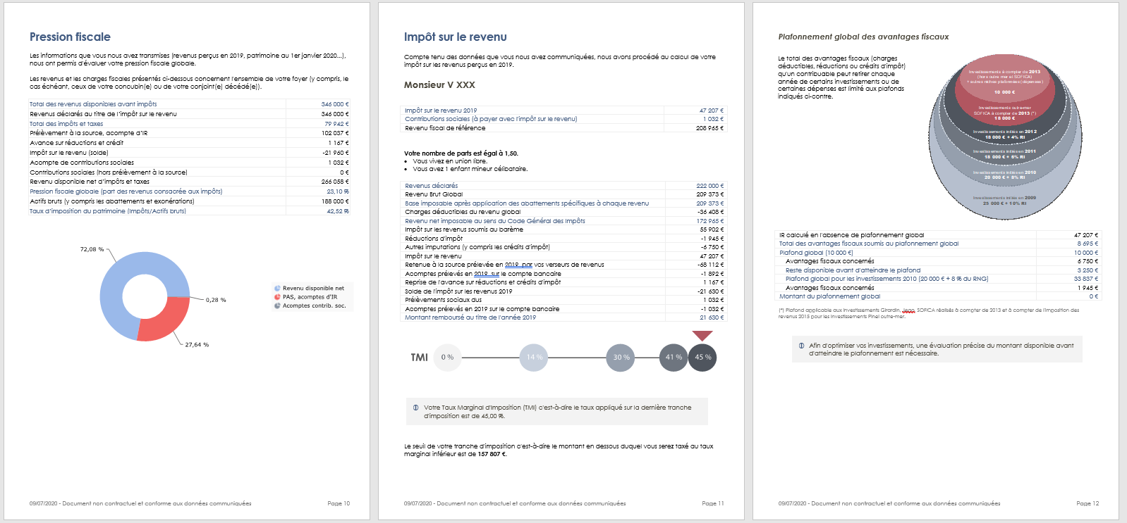
Illustration: Harvest Big Expert solution offers an automated wealth diagnosis coupled with strategic wealth management recommendations
Selected views of Big Expert report
Source: eleven research & analysis, Expert calls

Slide 98
CG relies on a strong SI organization and will be able to allocate its resources on B2C to help E&F migrate to Manymore
SI organizational chart is divided between B2C and B2B activities
Key learning
SI
CG has developed a business centered approach: launch of new development always come from business needs
Teams are nowadays mobilized on B2B that explains the many external providers working on B2C side.
End 2020 and early 2021 should be dedicated to the migration of E&F to manymore
B2C
B2B
7 employees
1 external provider (SSII)
1 employee
12 external providers
Source: eleven research & analysis, Expert calls

Slide 99
Executive summary
Identification of digital tools available for CGPs
Overview and assessment of CGP’s trade-offs when selecting its digitalization provider
Manymore architecture and underlying opportunities of customization
Impact of back and middle offices digitalization on organizations and models
1
Wealth management ecosystem
2
AGENDA
Wealth management B2C customers’ experience
3
Digitalizing financial advisors’ day to day operations: CG’s positioning and underlying opportunities
4
Digitalizing CGP’s back and middle offices: comparison of CGP’s organizations and models
5
Highlights on key digital growth opportunities for CG
6

Slide 100



CG’s operation are mostly covered by Manymore’s standard modules even if Harvest is still used for wealth diagnostic and customization could be needed especially in the interaction with end-clients and prescribers
Action performed by CGP and corresponding tools
Assets
End-Clients and prescribers
Digitalization of supplier’s interactions
Digitalization of client journey
Digitalization of customers/prescribers acquisition and interactions
Wealth aggregation
Customer support
Customer interface
Digitalization of administrative tasks
Prescribers management
Products aggregation
MIF2/DDA compliance
Document completion and signature
Fees management
Automation of core business (processes)
Arbitration
Wealth diagnostic and simulation
Registration of clients’ data and exchange
Areas not covered by Manymore
Modules with potential added-value in customization
Updated
Source: eleven research & analysis, Expert calls

Slide 101

Customization consists in a modification of existing process in order to strengthen the human added value…
Action performed by CGP and corresponding tools
Assets
End-Clients and prescribers
Digitalization of supplier’s interactions
Digitalization of client journey
Digitalization of customers/prescribers acquisition and interactions
Provide different level of support according the segmentation
Add a button automating skype direct contact for HNWI expatriates
Add services: conciergerie …
Customer support
Wealth aggregation
Provide tools enhancing CGP prescription
Provide prescribers with valuable content
Customer interface
Digitalization of administrative tasks
Prescribers management
Products aggregation
Build a self-care module where client can fill document to the extent they want
Allow documents completion before the meeting to increase advise time
Document completion and signature
MIF2/DDA compliance
Fees management
Automation of core business (processes)
Record special data according the client segmentation
E.g. add residence location the 1st year after the wedding for expatriates
Arbitration
Wealth diagnostic and simulation
Registration of clients’ data and exchange
Areas not covered by Manymore
Modules with potential added-value in customization
Updated
Source: eleven research & analysis, Expert calls

Slide 102
… and therefore develop a tailor-made journey to specific end-clients
Examples of personalization impacting in the customers’ journey
Contact phase
Conversion phase
Management phase
Main steps of the CGP customer journey
Information query
First exchanges with the CGP
First appointment
Contract signature and first operations
Asset management follow-up
Arbitration of the patrimonial strategy
End of the relationship with the CGP
The prospect contacts the CGP via a form
Information Request Document
Contact document
Portfolio simulation
Aggregation under Manymore then presentation of a synthesis to the client
Carrying out arbitration
Migration of contracts to another CGP
Add a button automating skype direct contact for HNWI expatriates (instead of phone contact)
Single sign-in and links from and towards customer interface from the CPA if customer from prescription
Customization from the CGP of the number of digital actions the client can carry out in its interface depending on his digital maturity
Personal recommendation (e.g., friends, family,…)
Adjust form questions: add residence location the 1st year after the wedding for expatriates
Partial data exchanges with CPA’s interface if relevant?
Commercial brochure
Mission statement
Information on the product's functioning
Concierge service
Subscription to new products
Prospection by the CGP
Appointment proposition
GDPR consent letter
Offer acceptance and signature
Definition of a reporting and alert system according to the client's needs
Definition of reporting/alerting system according to clients’ needs
Create a powerful alerting tools self-customizable for end-customers
Prescription (e.g., lawyer, accountant,…)
Sharing of all the documents required for the patrimonial assessment
Recovery of contracts at Manymore
Portail of additional services (e.g., concierge)
Prescription (e.g.; lawyer, CPA …)
Allow documents completion by the customer before the meeting to increase advise time
Provide CPA with the possibility show basics wealth simulation to end-customers
Presentation of the patrimonial assessment
Registration of the CGP on supplier platforms or extranets
Interface dedicated to CG’s VIP customers with added services
Allow documents completion by the customer before the meeting to increase advise time
Creation of an intuitu personae
Source: eleven research & analysis, expert calls
Selected examples of personalization of the customer journey
Updated

Slide 103




4 levels of integration can be leveraged to personalize a software upon a standard solution, each level corresponding to a balance between personalization and size of developments
Off-the-shelf software
Parametrizing software
Customizable software
Off-the-shelf back-end
Front end
Built-in solution:
Tool also provide an interface for the final user
Impossibility to customize
Setting of parameters
Light development
Interface building
Configuration interface
Built-in solution with parametrization:
Tool also provide an interface for the final user
Possibility to change some parameters
White-label & customizable front-end
Modular solution:
Tool has to be integrated in its interface
Development are light
API
Back end
API solution:
Tool just provide the back-end solution
Need to build a front-end interface
High level of customization but investment needed
Solution provided by software editor
Customization adds-on
Updated
Source: eleven research & analysis, Expert calls

Slide 104



Illustration: Manymore has made the choice to build a more and more flexible software allowing customization, making its offer relevant for big CGPs that want a compromise between standardization and modularity
Off-the-shelf software
Parametrizing software
Customizable software
Off-the-shelf back-end
Quotes
Front end
Built-in solution:
Tool also provide an interface for the final user
Impossibility to customize
Setting of parameters
Light development
Interface building
«[With API] every one can customize its tools »
CEO at Manymore
Small parametrization can be done by the CGP?
Today basic modifications can be done by parametrization (e.g.; changing forms)
In September, advisors’ part of Prism will be available through API
Manymore is developing API for Nexus
Configuration interface
Next steps
Built-in solution with parametrization:
Tool also provide an interface for the final user
Possibility to change some parameters
White-label & customizable front-end
Modular solution:
Tool has to be integrated in its interface
Development are light
«We are trying to let [CPG] access to all their clients’ data through API»
CEO at Manymore
API
Back end
API solution:
Tool just provide the back-end solution
Need to build a front-end interface
High level of customization but investment needed
Manymore mainly rely on 2 technologies:
Symphony for the back-end
React for the front-end
«Big players are willing to customize their own client interface »
CEO at Manymore
Key take-aways
Manymore wants to further open its ecosystems through the development of new APIs in order to offer even more personalizable solutions to its customers
Updated
Source: eleven research & analysis, Expert calls

Slide 105
Executive summary
Identification of digital tools available for CGPs
Overview and assessment of CGP’s trade-offs when selecting its digitalization provider
Manymore architecture and opportunities of customization
Impact of back and middle offices digitalization on organizations and models
1
Wealth management ecosystem
2
AGENDA
Wealth management B2C customers’ experience
3
Digitalizing financial advisors’ day to day operations: CG’s positioning and underlying opportunities
4
Digitalizing CGP’s back and middle offices: comparison of CGP’s organizations and models
5
Highlights on key digital growth opportunities for CG
6

Slide 106

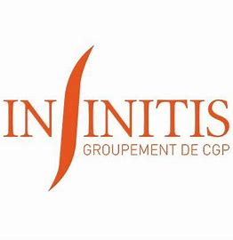

Due to the MIF2 regulation, and to keep their margin level at a constant level, the proportion of CGPi should decrease while the number of liberal CGPs could increase helped in their activities by digital tools
Segmentation of wealth management players
Difference between CGP and CGPi
CGP
Can earn money on both:
Commissions from products sold
Customer fees for the advises
CGPi
To guarantee their independency in view of MIF2: can only earn money on customer fees
Financial independency (CGP vs CGPI)
Pros & Cos of being a salaried CGP
CGP and employee
CGPI and employee
Pros
Cons
Have a guaranteed income
Rely on the brand image to find new clients
Heritage engineering tools
Benefit from the structure’s tools to work
Weaker commission
Restriction to leave the structure with its clients
Imposed set of investment assets available
Structural independency
(employee vs self-employed)
CGP and self-employed
CGPI and self-employed
Source: Crystal group IM, eleven research & analysis, Expert calls

Slide 107










Digital tools are paving the way for alternative models such as networks of self employed CGPs, gaining over banks and insurance companies
CGPs’ market structure and associated pros and cons from a CGP professional point of view
Network of employed IFAs
Network of salaried IFAs, not considered as independent
~ 10 players
Installed customer base, experimented colleagues and recognized brand name (particularly valuable for young professionals)
Streamlined operations due to integrated professional software, developed internally (e.g., Cyrus) or externally by major editors (e.g., Harvest)
Access to a large range of providers and consequently to a large product inventory
Access to installed networks of subscribers
Less revenues for CGPs (except for partners)
Franchises and concession
Paid administrative to commercial full support
~ 4players
Independency and flexibility
Highest revenues for each professional individual
Potential access to mutualized IT and digital tools (e.g., in partnerships) and
No brand name
Poor financial security compared to a salaried structure (that pays each of its workforce member despite no sale)
Poor access to experts’ advisors to solve complex cases
Partnerships
Group of office mutualizing some functions
~ 7 players
Affiliations
Group of 10 to 20 offices in order to carry out tasks together (e.g., reg. expertise)
~ 10 players
Autonomous small offices
Small size with less than 10 advisors
<3200 players
Independency and flexibility
No access to professional software for costs reasons causing painful operations (e.g., need to connect to each providers extranets one by one)
No brand name
Poor financial security
Pros
Cons
Source: Crystal group IM, eleven research & analysis, Expert calls

Slide 108
Opportunity - Network of independent CGPs: CG could leverage a white-label network of self employed CGPs to target the upper part of the mass market
Multi-Level-Marketing models are performant revenue models for networks of self employed professionals
CG could launch a white label MLM-based network of self employed CGPs to target the mass market segment
Mutualized costs between independent advisors
CG would benefit from different synergies if it launched a white label MLM-based network on independent / self employed CGPs:
Additional Stable and recurring revenues despite light structural costs
An acquisition lever to target mass-market customers, too costly for today’s CG organization
A way to drain premium customers that could be treated by CG current tools and personalization capacities
A preserved high-end brand image because this network would be white label
An advisor acquisition lever to drain competent advisors in his/her organization wishing to work as non-salaried for personal reasons
A way to pre-empt market changes (i.e., increasing number of self employed CGPs groupings) while remaining a solid group with renowned brand name
Access to expert networks
Access to professional software
Access to selected providers with dealt prices
Access to network’s professionals
STAKES
Strong additional compensation over time
Independent advisors, or “down line distributors” with two revenue streams
0,5%
1,5%
From day one, CG could rapidly launch such a network following the macro steps above:
File the legal status of an MLM based network
Assign a first advisor from CG internal team as “network developer” in charge of recruiting its first independent advisor (“down line distributor”)
Define an appropriate revenue model (i.e., commissions fees of the two revenues streams) that preserves CG salaried-based current model
Give access to independent advisors to mutualized tools and processes (already existing at CG), including:
Digital tools (i.e., access to professional software Manymore)
Externalized experts’ network (e.g., Fidroit providing tax and law experts)
Internal CG people
Remote training sessions (e.g., regulation, sales)
Market documentation
Adapt revenue and organization model following a “test and learn” methodology
0,5%
1,5%
…
CGPs’ Multi-Level-Marketing (MLM) distribution and organizational model derives its revenues from a non-salaried workforce selling one CGP’ services, while the earnings of the participants (i.e., independent/ self employed CGPs) are derived from a pyramid-shaped commission system
In such a model, independents advisors get two revenues streams:
Commissions of sales made by the participant directly to their own customers (upfront fees and commissions on AuM)
Commissions based upon the sales made by other distributors below the participant who have recruited those other participants
FEAISIBILITY
More details of underlying digital opportunities for CG on part 6 of this document
Sources: eleven research and analysis

Slide 109
Executive summary
Overview of digital opportunities identified
Banking-as-a-service with a neo-bank offer for expatriates
White label MLM network of independent CGP
360° customer knowledge solutions
“Agence à distance” model
1
Wealth management ecosystem
2
AGENDA
Wealth management B2C customers’ experience
3
Digitalizing financial advisors’ day to day operations: CG’s positioning and underlying opportunities
4
Digitalizing CGP’s back and middle offices: comparison of CGP’s organizations and models
5
Highlights on key digital growth opportunities for CG
6

Slide 110

Three levels of digital ambitions can be leveraged to enhance CG’s existing distribution channels in order to pre-empt the acquisition of digital native customers in the coming years
CG has already digitalized its operations (e.g., with the Manymore partnership), to reach direct competitors’ level (level 1 of digitalization)
The strategical question is whether to focus on level 2 (exceed competition to meet customers’ demand) or/and on level 3 (prepare to the expectations of tomorrow’s customers)
Digital ambition: level 1
Reach the market standard in terms of digitalization
Digital ambition: level 2
Exceed direct competitors’ digital performance and meet evolving expectations of todays’ customers
Digital ambition: level 3
Prepare the company to the expectations of tomorrow’s customers
Three levels of digital ambitions for CG
Underlying opportunities in terms of customer acquisition through prescribers
Underlying opportunities in terms of direct
customer acquisition
1
4
Digital reputation and communication
Enhance digital communication channels to enhance CG’s reputation and get closer to CPAs (e.g., webinars, e-trainings, specialized podcasts, advanced high-value-added functionalities in the existing dedicated portal)
Data-augmented advisors
Streamline back and middle office operations with smart use of digital off-the-shelf solutions to give more time to CGPs to focus on their core high value-added activity (i.e., advisory)
Digitalized CPAs and other prescribers (athletes’ agents)
Digital-native core affluent and HNWI customers
Maximize customer acquisition and satisfaction in an era where digital will be “the new normal”
2
5
Digital platform/software for prescribers
Develop (make or buy) and promote software solutions dedicated to CPAs (i.e., Alpheys, 360+1) to support them in their diversification towards wealth management activities
“Agence à distance”
Offer a state-of-the-art, full and seamless digital experience journeys leveraging digital-native customers self care usages
HNWI
2
4
Mass & Core affluent
1
6
Non-salaried CGPs
Mass market
3
5
Digital-native expatriates
3
6
White label MLM network of
independent CGPs
Launch a white label MLM-based network of self employed CGPs to target the low mass affluent segment
Neo-bank for expatriates
Benefit from the Open Banking new paradigm that has let emerged banking-as-a-service solutions and launch a neo-bank dedicated to expatriates offering highly personalized services
Digital Opportunity for CG
Level of digital ambition
Work in progress

Slide 111
Executive summary
Overview of digital opportunities identified
Banking-as-a-service with a neo-bank offer for expatriates
White label MLM network of independent CGP
360° customer knowledge solutions
“Agence à distance” model with a digital journey coupled with a human advisor
1
Wealth management ecosystem
2
AGENDA
Wealth management B2C customers’ experience
3
Digitalizing financial advisors’ day to day operations: CG’s positioning and underlying opportunities
4
Digitalizing CGP’s back and middle offices: comparison of CGP’s organizations and models
5
Highlights on key digital growth opportunities for CG
6

Slide 112



Illustration – Neo-banks (1/3): With fully Digitalized solutions and low fees, neo-banks could leverage their privileged access to end-customers to develop wealth management activities
1
Vertical neo-banks can leverage five competitive advantages versus retail banks
Selected examples
1
Technology
Fast and user-friendly interfaces due to modern and agile back office tools versus traditional banks bogged down with heavy legacy and unmanageable organizational structures
Offers its users to set up a business account in 1 minute
Neobank could step-by-step extend their activities to ultra personalized wealth management advisory as they target one specific section of the population
2
Affordability
Less fees required from customers due to less costs (most of operations are done online) versus costly brick and mortar establishments of retail banks
3
Transparency
Easy and real-time access to key documentation and information (e.g., dashboard) versus traditional banks
Has set-up a transparency dashboard
4
Easy onboarding
Swift onboarding due to utilization of fast customer-friendly technology and verification systems versus heavy process in retail banls
5
Better customer service
Personalized solutions (e.g., student loans refinance solutions) with better rate than retail banks
Offers physical checks for rent or other payments and do not imply any overdraft fees
Source: eleven research & analysis, Expert calls

Slide 113

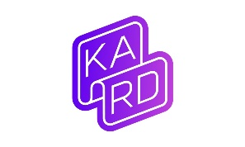


Illustration – Vertical neo-banks (2/3): More specifically, vertical neo-banks target a specific segment of the population and can differentiate from peers with hyper-specialized services
2
Selected vertical neo-banks
Competitive advantage versus generalist banks
Ultra-personalized banking services:
Less regulatory constraints than traditional banks due to their focus on niche products and/ or customer (e.g., entrepreneurs) and not the entire retail banking value chain
Selected examples
Atlanta-based Greenlight combines a "smart" debit card with an app to help kids improve their financial literacy while giving parents controls on spending
Since launching in 2017, half a million parents and kids have signed up.
France-based neo banks Shine offers a 100% online business account coupled with functionalities to support freelancers and entrepreneurs in their administrative tasks (e.g., creation of a business account, get a debit card, and take care of some administrative tasks)
French startup Kard, a challenger bank for teens that works a lot like N26 or Revolut.
Kard wants to empower teens with their own bank account, their own IBAN and their own Mastercard debit card.
Instead of controlling every expense, parents can just top up the Kard account and let their child spend it however they want
…
…
Source: eleven research & analysis, Expert calls

Slide 114
Illustration – Vertical neo-banks (3/3): For example, Société Générale group has acquired Shine, a neo-bank dedicated to self-employed and entrepreneurs to benefit from its modern, fully-digital, ultra-specialized offer
3
Shines’ key data points
Shine pros and cons versus retail banks from a customer perspective
Targeted customers: Entrepreneurs
Number of clients: 70,000+
Offer: 100% online business account coupled with functionalities to support entrepreneurs in their administrative tasks:
Accounting simplification
Invoicing
Check collection
Calculation of charges
Premium Master Card with exclusive insurances
…
Use case example:
For instance, Shine helps you incorporate a company and create invoices directly from the app (e.g., send a link to clients, get a notification when the client opens the invoice, client can see company Shine IBAN directly on the invoice)
Investment timeline:
Société Générale has announced acquiring France-based startup Shine for around EUR 100 million in an all-cash deal
The startup had previously raised EUR 10.8 million in total from Daphni, Kima Ventures, XAnge and various business angels
Pros
Cons
Affordability (i.e., low fees and first month for free)
Nonstop availability of the customer service (7 days a week)
High level of UX of the mobile application
Numerous administrative functionalities
High bank fees on day-to-day transactions
Poor banking services
Overdraft interdiction
No checkbook
…
Key take-aways
Recent acquisitions or investments of pure digital vertical neo-banks by large players shows that their competitive advantages are substantial:
Shine acquisition by Société Générale
Tencent investment in N26
Source: eleven research & analysis, Expert calls

Slide 115

CG’s opportunity to launch a verticalized neo-bank could appear difficult when considering, the competitive and growing ecosystem of neo-banks and the cost of creation of such a bank
Key figure of the neo-bank ecosystem
7 new neo-banks created in 2019
32 existing neo-banks in France
The number of active accounts in France went from 1,4 M in 2017 to 3,5 M in 2019 (x2,5 in 2 years)
Despite 500 M€ fundraised in 2020, Revolut has not yet reached profitability
CG’s project for a neo-bank
CG’s bank would target the community of French expatriates and would face 4 main challenges :
Acquisition of legal status that allows to act as bank
Development of the technological tools needed for a neo-bank
Development of a mobile app
Acquisition of a customer base
Source: eleven research & analysis, Expert calls

Slide 116












As shown by the growing number of neo-banks, it seems that neither the legal status nor the technical stack are the most complicated task in launching a neo-bank
Neo-banks and solutions chosen
Creation date
06/2016
01/2017
09/2017
02/2018
02/2018
Country
Professionals
+
Individuals
Professionals
+
Individuals
Young
individuals
Target
Professionals
Professionals
Perform by
Perform by
Perform by
EME status ?
EC status ?
Transfer¹ ?
100 per month
Unlimited
Unlimited
20 per month
Unlimited
Withdrawal¹ ?
3000€ per month
5 withdrawal per month
300€ per month
1€ per withdrawal
3 per month
Free exchange ?
Source: eleven research & analysis, Expert calls;
1. For the free version

Slide 117












Indeed, some Fintechs offer turnkey and white label solutions that comply both regulatory and technological needs included in a global offer called “banking-as-a-service”
Needs & solutions to launch a neo-bank
Regulatory
Technical
Needs
Legal status of EME (Établissement de monnaie électronique)
OR
Status of ”agent de prestataire de service de paiement” relying on an existing EME
Legal status of EC (Établissement de crédit)
OR
Through a partnership with an existing EC
Perform KYC on its
customer
Allow clients to send and receive payment
Provide clients with a bank card
Provide clients with an IBAN associated to a wallet
or
and
Provide clients with exchanges services
Allow ApplePay
Be able to grant a loan to its clients
Enablers and existing solutions
Existing white label EME status providers :
Existing EC partnership providers :
Connect platform to banking-as-a-services players’ API
KYC services
P2P transfers between wallets
Multi-currency wallet
Physical/Virtual
card
Money kept in an isolation account host by an EC
Banking-as-a-service players
Feature classification
“must-have” feature
“Optional” feature
Source: eleven research & analysis, Expert calls

Slide 118



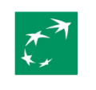
The core challenge for the launch of a neo-bank for expatriates therefore is the acquisition of a strong customer base
Channel
Value
Feasibility
Leverage for expatriates acquisition
French global companies
Develop a partnership with global French companies with geographical presence all around the world, especially in developing nations.
Classical banks
Develop a partnership with classical banks for whom expatriates are very complicated clients for risk management.
Administrative French places
All the French administrative places where there is a lot of French people: French embassy, French school …
Digital leverages
Website and networks where expatriates go to find information.
Source: Crystal group IM, eleven research & analysis; Expert calls

Slide 119
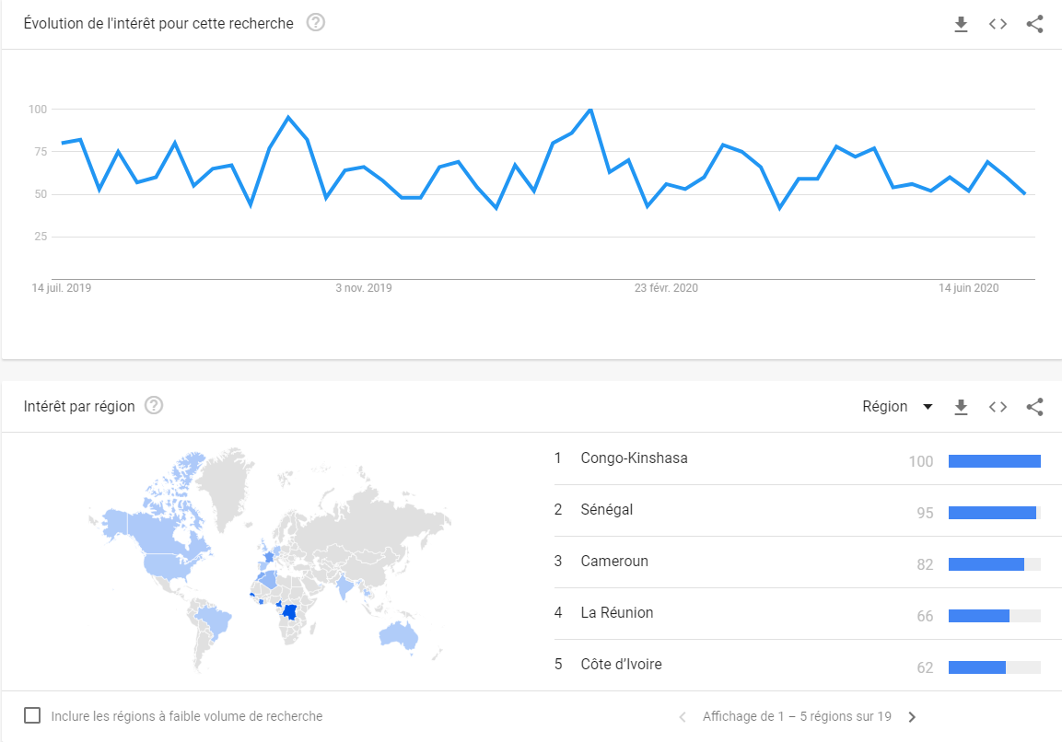



Illustration – Digital leverage: CG’s neo-bank could leverage on online marketing and social network in order to build a strong customer base
SEO/SEA leverage
Leverage on social network
SEO could be perform focusing on semantic field of “expatrié”
In addition SEA could be activate on the same field. Based on figure from other neo-banks:
2€ per click
An estimated conversion rate of 5%
50€ spent per year per client
Each ads would bring 0,1€
There are many expatriates group providing help and advises on Facebook
For instance “Les Français à Melbourne” gathers 21k people
Source: Crystal group IM, eleven research & analysis; Expert calls

Slide 120

CG could leverage expatriates-specialist neo-bank models to increase its customers’ acquisition on one side and leverage banking customers data to improve its wealth management advisory on the other side
Customer acquisition
Leverage banking customers
Through its neo-bank CG could:
Acquire wealthy clients from the neo-bank and therefore construct a new acquisition channel
Provide their existing expatriate clients with more services and then decrease churn rate
Build the reputation of a digital native company rejuvenating an ageing brand and thus draw in new customers
With the launch of a neo-bank CG could:
Acquire more data about their cross-client
Determine big life moments of their client to be able to proactively push highly customized recommendation
Have a better client segmentation and thus perform client clustering
Key take-aways
Working with/ building/ acquiring a vertical neo-bank (e.g., targeting expatriates) could help CG in:
Improve customer acquisition and retention enhancing highly personalized services in its neo-banks
Catch key customers’ life moments that would help proactivity in advisory (e.g., inheritance, geographic move)
Source: Crystal group IM, eleven research & analysis; Expert calls

Slide 121
Illustration – Leveraging customers’ data (1/2): Launching a neo-bank would give CG access to more acknowledgement about its client through the access to their bank account data
Customers key life moments data capture by banks vs. CGPs
Selected life moments
Rupture in data collection
Life moments captured by customers banks (i.e., detection of anormal money transfers)
Life moments captured by customers’ CGPs
Apartment/ house acquisition
Wedding
Child
births
Geographic move
Inheritance
Sale of company
Investment in product X
Investment in club deals
…
Discontinuous data collection
Data captured all along customers’ lifecycle if CG acquires/ builds from scratch its owned vertical neo-banks
Continuous data collection
Upstream proactive contact based on data collected via neo-banks and analyzed through Machine Learning
Illustration on the following page
Fully Digitalized offer with ultra-personalized functionalities dedicated to expatriates
Augmented wealth management advisory (e.g., proactive advisory) with ability to catch customers in key moments
Source: Crystal group IM, eleven research & analysis; Expert calls

Slide 122




Illustration – Leveraging customers’ data (2/2): : An access to customers’ banking account information makes it possible to detect “big life changes” through application of machine learning algorithm and thus to push proactively highly personalized recommendations
Balance evolution shows “big life changes” through anormal balance pattern
Balance evolution
Exceptional incomes candidates
Exceptional incomes can be mapped to life events
“Exceptional” balance
Balance evolution €
Balance evolution €
“Normal” balance
Legacy
Time
Date
Machine learning application to activate investment proposals
Balance analysis
Machine learning algorithm to detect exceptional balance patterns
Detection and qualification of “life changes”
Investment recommendation
Business sale
…
Job change
Legacy
Source: Crystal group IM, eleven research & analysis; Expert calls

Slide 123

Launching a neo-bank would be a major investment and would need a leverage on synergies in order to compensate the investment
Cost repartition for running a neo-bank
Business case
Based on the existing customer base of CG, we can imagine that CG’s neo-bank would address 5 000 customers when launched
Looking at the possible revenues from the neo-bank:
Considering CG’s premium target compared to other neo-banks CG could charge 120€ per client per year for the use of its neo-bank
The neo bank would also bring revenues by a sharing of the card utilization fees with the banking provider
CG would then need to earn ≈100€ per client per year by upselling its wealth management services to compensate the neo-bank investment
Possibility of development of a freemium model:
A free account with basic features
A premium account with additional services adapted to expatriates community
2(6*)
3
2
3
Public launch
4
0
4
3
1st year
« Normal running »
Wage cost
750 000 €
(1 150 000 €*)
840 000 € per year
Provider cost
≈100 000 €/200 000 € set-up fee
X% per functionality and per client account creation
(≈10 000 € /50 000 € per month)
Estimated wages
Business & Partnership developer
50 K€/year
Back-end developper
100 K€/year
Front-end developper
100 K€/year
Customer support
30 K€/year
*: estimation in the case of building a solution “from scratch”
Updated
Source: eleven research & analysis, Expert calls

Slide 124
Executive summary
Overview of digital opportunities identified
Banking-as-a-service with a neo-bank offer for expatriates
White label Compass-like network of independent CGP
360° customer knowledge solutions
“Agence à distance” model with a digital journey coupled with a human advisor
1
Wealth management ecosystem
2
AGENDA
Wealth management B2C customers’ experience
3
Digitalizing financial advisors’ day to day operations: CG’s positioning and underlying opportunities
4
Digitalizing CGP’s back and middle offices: comparison of CGP’s organizations and models
5
Highlights on key digital growth opportunities for CG
6

Slide 125




As for the Hubn’UP network, MLM-based models of self employed CGPs are extending, benefitting from digital tools to handle operations while keeping recruitment and training human
Providers and platforms
CGPs
Customers
Hubn’UP CGP network
No Fee charged by the CGP if a customer recommends another customer
Non-profit organization
Multiple providers of financial products
Platform of financial products
Self employed CGPs part of the network pay 35€ per year + 0,6% of commissions
CGPs spend time training their recruits
The network negotiates product prices on selected platforms
CGPs recommend other CGPs to join the network and earn commissions from their earnings
CGPs spend few time prospecting as they gain customers from recommendation
Customers recommend other customers to get the CGP service for free
Platform of real estate products
Multiple providers of real estate products
CGPs earn money from retrocoms on portfolio performance
“From 90 new recruits, 50 fail, 30 live from their activity and 10 become rich”
Expert
…
…
…
…
Customer portfolio depends on the CGP. E.g.; between 10k€ and 2m€ to invest
Works well far from major cities
The network provides tools to manage operations (O2S from Harvest) and handle evolving regulation
Software
provider
Tools to manage CGP’s activity
Customer interface
(e.g., money pitch)
Source: Crystal group IM, eleven research & analysis; Expert calls

Slide 126

Illustration (1/2): Access to financial market information is provided directly via La Financière d’Orion CGP-dedicated extranet supported by Harvest (O2s module)
Screenshot from Hubn’UP CGP network extranet dedicated to its CGPs
Financial press articles access and dashboard
Newsletters on financial news (written articles, webinars)
Source: Crystal group IM, eleven research & analysis; Expert calls

Slide 127

Illustration (2/2): Access to products’ performance is provided directly via La Financière d’Orion CGP-dedicated extranet supported by Harvest (O2s module)
Screenshot from Hubn’UP CGP network extranet dedicated to its CGPs
Products performance dashboard
Source: Crystal group IM, eleven research & analysis; Expert calls

Slide 128






Similarly, CG could leverage the strength of MLM-recruitment to overcome the challenge of new affluent client's acquisition and rapidly gain in Net New Money and Net New Revenue by capillary growth
Compensation scheme of MLM or sponsorship-based recruitment process
Examples of industries with MLM-based selling & recruiting processes
Illustrative figures
Strong additional compensation over time
Real Estate
0,2%
…
0,5%
Nutrition
0,5%
1,5%
1,5%
Beauty
3%
3%
7%
% percentage of the fee perceived on upfront fee and commission for AuM
Home
7%
69%
Etc.
69%
Strong recruitment channel enabling a fast expansion
Additional compensation offered to developers ensuring stickiness within the network, acting as a switching cost
Revenues generated by each new client through upfront fees and a commission on AuM
Additional compensation perceived by developers
Relevance for
CG
Source: Crystal group IM, eleven research & analysis; Expert calls

Slide 129
CG could launch a white label network of self employed CGPs MLM-models to target the mass market segment
Why?
How?
CG would benefit from different synergies if it launched a white label MLM-based network on independent/ self employed CGPs:
Additional Stable and recurring revenues despite light structural costs
A to target mass-market customers, too costly for today’s CG organization
A way to drain premium customers that could be treated by CG current tools and personalization capacities
A preserved high-end brand image because this network would be white label
A way to drain competent advisors in its organization wishing to work as non-salaried for personal reasons
A way to pre-empt market changes (i.e., increasing number of self employed CGPs groupings) while remaining a solid group with renowned brand name
From day one, CG could rapidly launch such a network following the macro steps above:
File the legal status of an MLM based network
Assign a first advisor from CG internal team as “network developer” in charge of recruiting its first independent advisor (“down line distributor”)
Define an appropriate revenue model (i.e., commissions fees of the two revenues streams) that preserves CG salaried-based current model (to mitigate the risk of
Give access to independent advisors to mutualized tools and processes (already existing at CG), including:
Digital tools (i.e., access to professional software Manymore)
Externalized experts’ network (e.g., Fidroit providing tax and law experts)
Internal CG people
Remote training sessions (e.g., regulation, sales)
Market documentation
…
Adapt revenue and organization model following a “test and learn” methodology
Source: Crystal group IM, eleven research & analysis, Expert calls

Slide 130


Such model could rely on Compass’ model
1
6
A tech company which built differentiation with its tech tools to real estate agents
A model to help agents focus on their high value-added tasks, i.e. , customer relationship, instead of trying to substitute agents’ relationships with digital tools
Page 132
Page 138, 139, 140
2
5
A tremendous amount of growth in a relatively short period of time - thanks to access to capital – to acquire real estate brokerage companies for massive (already-trained) agent recruiting tool at scale
A premium positioning on luxury homes in upscale, coastal markets, attracting best in class agents with an offer based on remuneration through commission fees
Page 132 and 133
Page 137
3
A federation of 15,000+ independent agents with access to digital tools, data augmented insights and online marketing support
4
A premium brand image, reinforced by innovative digital devices sold to independent agents to empower sales
Page 134 and 135
Page 136
Updated
Source: eleven research & analysis, Compass website

Slide 131



Compass is a global real estate technology company that provides an online platform that supports buying, renting and selling real estate assets leveraging Multi-Level-Marketing model to recruit agents
Key data points (2020)
Compass Virtual Workplace for agents
Value proposition
Build the first-of-its-kind modern real estate platform, pairing the industry’s top talent with technology to make the search and sell experience intelligent and seamless.
“A platform to power all real estate decisions made for buyers, sellers and agents”
Compass CEO
Market
High-margin, luxury homes in upscale, coastal markets
Ori Ollon , one of the two Compass founders, has a background working in technology including serving as Director of Engineering at Twitter, founding Julpan which was acquired by Twitter, and founding Orion which was acquired by Google
Sales
~ $2bn
HR
2,300 employees
(30% of tech staff in 2017, 12% in 2019)
Network
15,000+ agents
“Compass has achieved a tremendous amount of growth in a relatively short period of time, and its competitive advantage is access to capital. It is parlaying that advantage into a massive agent recruiting tool at scale.” Inman
Business Model
Compass agents earn a percentage of the selling price and give 15 to 30% on each sale to Compass
Timeline
2012
Creation
2013
$20m Serie A
2014
$40m Serie B
2015
$50m Serie C
2016
$60m Serie D
2017
$100m Serie E
2018
$400m Serie F
2019
$370m Serie G
The initial business model employed full-time, salaried brokers, with whom users of the platform could schedule appointments online after searching for listings on the company's desktop or mobile app.
Compass announced it would change its overall business model by contracting independent real estate agents and taking a portion of their commissions
Launch of a new mobile app that offers real-time data on the real estate market
Acquisition of 10 real estate brokerage companies employing 4100 agents and of the start up Concaptually providing a CRM platform
“Assuming a total of $230 million spent to acquire 12 brokerages with 4,100 agents, that’s a cost of $56,000 per agent. Quite an expensive — and effective — recruitment method.” Inman
Updated
Source: eleven research & analysis, Compass website

Slide 132

Compass reached a tremendous amount of growth in a relatively short period of time - thanks to access to capital – to acquire real estate brokerage companies for massive agent recruiting tool at scale
Compass’ brokerage acquisition …
… to create a network of experimented agents all around US
Broker | Purchase date | Agent count
Platinium Drive Realty | 02/2018 | 100
PS Platinium | 02/2018 | 40
Colon Real Estate | 04/2018 | 200
Northwest Group Real Estate | 04/2018 | 25
The Hudson Company | 06/2018 | 24
ICS Realty | 06/2018 | 20
Paragon Real Estate Group | 07/2018 | 236
Pacific Union | 08/2018 | 1700
Avenue Properties | 08/2018 | 10
Wydler Brothers Real Estate | 11/2018 | 50
Alain Pinel Realtors | 03/2019 | 1300
Stribling & Associates | 04/2019 | 304
Onboard experimented agents by acquisition of brokerage companies or courting agents from rivals thanks to better commission and equity share:
“Bonuses and payments along with promises of extra business to make the jump” - COO at Compass
Minimize formation or training costs
Empower the agents by providing them a powerful platform
“Compass’ tools have enabled me to take my client relationships to a different level” - agent at Compass
Increase agent revenues through a luxurious listing of assets
“20/20 by 2020”
R. Reffkin CEO of Compass
By its acquisitions Compass target 20% of the market share in the 20 largest US cities.
Updated
Source: eleven research & analysis, Expert calls, Inman website

Slide 133







Compass’ model is based on a network of independent real estate agents powered by a multi-functionalities platform that enables them to focus on their high value-added tasks, i.e. , customer relationship
Virtual workplace workspace that allows agents and clients to collaborate in real-time to organize homes, centralize their discussions, and monitor the market by receiving immediate status and price updates
15,000+ independent real estate agents
Compass CRM: customer relationship management platform powered by artificial intelligence
Sellers or/and products
A network of independent
professionals
Buyers
Human Relationship
Marketing Center: digital design studio (available designers and marketing teams) for Compass agents to create customized, personalized and localized marketing materials
Real-estate companies selling luxury real estate assets
Digital tools
Search dashboard, alerting
Dashboard that contains key data points agents need to craft marketing strategies, uncover new lead-generation opportunities, and invest accordingly in the positioning of their listings.
Collaborative workplace
Real estate buyers (individuals or professionals)
Compass Markets: mobile app that has real-time residential real estate data that provides access to recent transaction data as well as historic sales trends
Marketing
Tools to support independent agents in their operational tasks
Other services:
The Compass Concierge program assists in selling a home by covering the cost of home improvements to prepare the home for market
Compass Bridge Loan Services provides access to bridge loan lenders
Data augmented
Data augmented advisors
Price estimation
Sales assistance
Additional specialized services
Other services to to sellers
Compass platform functional bricks
Updated
Source: eleven research & analysis, Expert calls

Slide 134

Illustration: Compass’ digital platform helps independent agents throughout their sales process
Key functionalities of the platform
Compass Collections is a curated virtual workspace that allows agents and clients to collaborate in real-time to organize homes, centralize their discussions, and monitor the market by receiving immediate status and price updates
Compass CRM is a customer relationship management platform powered by artificial intelligence
Compass Insights is a dashboard that contains key data points agents need to craft marketing strategies, uncover new lead-generation opportunities, and invest accordingly in the positioning of their listings.
The Marketing Center is a digital design studio for Compass agents to create customized, personalized and localized marketing materials
Compass Markets is a mobile app that has real-time residential real estate data that provides access to recent transaction data as well as historic sales trends
Other services offered by the platform
The Compass Concierge program assists in selling a home by covering the cost of home improvements to prepare the home for market
Compass Bridge Loan Services provides access to bridge loan lenders, with the option to get up to six months of the loan payments fronted when the home is sold with a Compass agent
The Compass Coming Soon program pre-markets properties on compass.com
“As a technology company, Compass will deploy tools unmatched by others in the industry. This potential competitive advantage will be key to attracting and retaining agents and a cornerstone of the Compass strategy.” Inman
Updated
Source: eleven research & analysis, expert calls
Source: eleven research & analysis, Expert calls

Slide 135








Illustration: With its boutique, Compass also reinforces its premium brand image while providing tech-tools to fuel smartphone-powered sales
Overview of the boutique
For agents to empower end-clients’ real estate assets
For agents to reinforce Compass’ brand image
« Sign of the future »
Sales furniture
Presents
Apparel
Furniture
Lighting sign
QR code redirecting to the platform
Furniture to put in house for sale
Create a standard of services
Provide end-customer with presents promoting the brand
Outfit agents with standardized clothes to create a “brand image”
Rationalization of furniture across the different offices
A tech-device to put in front of real estate assets being sold…
… to build a bridge towards digital information
Each sign acts as a geo-located digital hub with a QR code
Agents can use bluetooth to sync their phones and sign allowing them to remotely manage insights and content directly through their agent app.
They can customize listing information, such as videos, virtual reality tours, 3D floor plans, and photography.
Passersby people can scan the QR code and access to up-to-date digital information regarding the asset:
Access the ultimate transaction resource
Property images, neighborhood details,
Prospective buyer data
They can leverage this app to contact directly the agent in charge of the sale
Updated
Source: eleven research & analysis, expert calls
Source: eleven research & analysis, Expert calls

Slide 136






Compass rely on a win-win exchange between agents and the platform: by enhancing its agents to perform better thank to its brand, network and tools, Compass create a virtuous circle bringing more agents, more customers and thus more growth
Win-Win exchange between Compass and its agents
Agents
Commission fee
Agents give back to the platform a commission on each transaction
Agent equity program
Agents can take share in the platform equity when joining the network
Growth
Agents brings new clients and/or peers to the platform and thus create growth
Platform
Business tools
The platform provides agent with a range of tools facilitating they day-to-day work and allowing them to focus on client relationship
A trustworthy brand
By belonging to compass, agents have more visibility thanks to the size of the company but also are more credible for the end-customer
Network
The platform also allow agents to belong to a strong network of agents as well as a support teams that can bring additional business and help on operations
Key take-aways
Compass USP for agents is to enable them to make more money not because they will make more transactions but because there will make higher transactions (luxury real estate assets)
Updated
Source: eleven research & analysis, Compass website

Slide 137



Illustration – KW and Redfin: In the US market, real estate brokers invest in efficient tools and platforms to give their agents a competitive advantage, and some are expanding across European markets
Factsheet
Founded 1983, in France since 2016
180,000+ associates in 930 offices
1,041,948 closed transactions
Founded 2012
HQ in NYC
2,300 associates in 30 locations
Operates solely in the US
Founded 2017
HQ in Seattle
2,500 employees (2017)
Strengths
Brand value: largest real estate franchise by agent count in the world
KW Cloud gathers a range of useful tools for agents
Kelle: AI platform and virtual assistance for agents
Strong branding based on both luxury and technology
Efficient proprietary platform with additional services
On-the-ground support and marketing teams
Efficient proprietary software
Competitive listing fee (1,5%)
Virtual visits
Weaknesses
Less renown in European markets
No commission only compensation
Great independence required
Cult culture mentality
Very competitive US environment
No international presence
Cut-throat atmosphere
No international presence
Opportunities
Recent European expansion
International expansion
Experimenting with concierge-style home-selling service
International expansion
Threats
European cultural misfit
European competitive environment
Risk of better software
New entrants
Risk of better software
New entrants
Poor employee satisfaction
Updated
Source: eleven research & analysis, Expert calls

Slide 138




Illustration – MLM platform: Contrary to models like Meero where digital tools substitute customer relationship from professionals, Compass model empowers them, so they focus on customer relationship
Compass model
Meero model
Sellers/
products
Agents
End
customer
B2B clients
Professional photographer
B2B clients
Commercial relationship
Brand
Clients
Tools
Platform
Workforce
Commission
Products
Security
Need of photo
Standardized photos
Commercial relationship
Give its agent visibility and trustworthy
Give its agent the tools needed to work properly
Take a commission fee on each transaction
Bring clients to photographers
Perform the photo correction through IA
Rationnalize prices
Keep rights on photos
Keep the commercial engagement
Despite the comparison, several differences between Meero and CG’s potential model remain as wealth management involves dedicated high level expertise
Updated
Source: eleven research & analysis, Compass website

Slide 139
Illustration – DigitRe : DigitRe’s model consists in sharing tools that concentrate their value proposition on solving consultants’ pain points
Illustration of a consultant’s journey with associated pain points and networks’ solutions
3-6 months for a complete transaction
CONSULTANT’s journey
Find properties
Sign mandate
Post ads
Organize visits
Negotiate offers
Check solvency
Carry paperwork
Help with moving out
Identify on-sale properties and contact the seller
Win the mandate with the seller and define selling price and commission
Write the sale ad with relevant details and pictures
Handle inquiries from potential buyers and conduct visits of the property
Act as intermediary between potential buyers and the seller, sharing purchase offers
Conduct a preliminary solvency check of the potential buyer
Help with sale agreement paperwork and moving logistic
Pain points
Loss of time
Too much time spent on sourcing fresh deals and identifying promising opportunities
Lack of efficiency
The consultant receives flurry of texts, emails and phone calls when scheduling visits or negotiating offers
Closing the deal
The consultant looses time with administrative tasks and paperwork
Leads qualification
Too much time spent with time-wasting prospects and fictitious online leads
Agenda management
Complex management of agendas with clients missing showings or rescheduling visits
Training
The consultant is not always up to date in terms of mandatory trainings and regulatory changes
Networks’ solutions
Trustworthy lead generation tools
Agenda management tool with text message reminders to potential buyers
Advisory/ support for administrative processes and paperwork
Efficient multi-posting tool to increase reach
CRM to organize leads and contacts
National & local transaction databases to bring value in the negotiation
Efficient training of consultants to overperform the competition
Updated
Source: eleven research & analysis, expert calls

Slide 140
CG could leverage a compass-like model based on a network of independent CGPs powered by a digital platform to target the premium market provided that CG put in place the necessary means to develop a global and strong platform’s brand image
Customer interface platform:
Portfolio monitoring
Customer request
Alerting
Administrative and compliance platform: reminder of legal steps, legal document issuance, regulation monitoring
High-class independent CGPs
Sellers or/and products
A network of independent
professionals
Buyers
The platform gives visibility and trustworthy to CGPs
Wealth management tool:
Wealth audit and aggregation
Investment simulation
Arbitration
Trainings
Human Relationship
Advisors, freed from most time-consuming tasks, can focus on advises
Customer interface
Client/advisor interface
Technical investment assets suppliers and investment solutions
CRM: customer relationship management platform powered by artificial intelligence
Processes automation
Robot advisor powered by artificial intelligence: portfolio rebalancing, investment recommendations based on clustering …
Tools to CGP in their operational processes
HNWI with technical needs (up-market)
Other services: “conciergerie” …
Premium and negotiated products selection
Data augmented
advisors
Data augmented advisors
The platform acquires large amounts of data and can leverage on it
Additional specialized services
Other services
CG’s platform
Updated
Source: eleven research & analysis, Expert calls

Slide 141
Illustration: CG could leverage alternative MLM-like models to increase its revenues while better serving the low mass affluent segment
Compensation scheme of MLM or sponsorship-based recruitment process
Revenue model for each independent advisor of an MLM-based network (on a career-time basis¹)
For illustrative purpose only
Revenues from its own collect
+
Revenues from its team (i.e., recruited advisors)
# customers
~80
# recruited advisors
~15 (1-2/ year)
X
X
Average Cash invested
~[2-100] €m
Average commission on their generated revenues
~1%
X
Retro commissions on portfolio performance
~1%
# new customers
80
Average Cash invested
[2-100] €m
~[1.6-80] €m
Retro commissions on portfolio performance (1%)
Cost of digital solutions provided to new recruits to support them in their daily tasks
50€/ advisor/ year
-
~[1.6-80] €m
~[0.2-11.9] €m
Source: Crystal group IM, eleven research & analysis, Expert calls; 1. Career time: 20 years

Slide 142
Executive summary
Overview of digital opportunities identified
Banking-as-a-service with a neo-bank offer for expatriates
White label MLM network of independent CGP
360° customer knowledge solutions
“Agence à distance” model with a digital journey coupled with a human advisor
1
Wealth management ecosystem
2
AGENDA
Wealth management B2C customers’ experience
3
Digitalizing financial advisors’ day to day operations: CG’s positioning and underlying opportunities
4
Digitalizing CGP’s back and middle offices: comparison of CGP’s organizations and models
5
Highlights on key digital growth opportunities for CG
6

Slide 143





A key success factors for CG’s successful digitalization is to create a valuable data backbone both built with Manymore, other data partners and proprietary to reduce operation costs and create added value upon its services
Overview of data backbone to be leveraged for CG
Service improvement potential
Cost-saving potential
Other key success factors
Service improvement potential
Cost-saving potential
Other key success factors
Investor profiles data
Joint data collection with Manymore
Proprietary, coupled with data science
CLIENT-ADVISOR PROFILING
Per type of customer x advisor
CLIENT-PRODUCT PROFILING
Per type of customer x investment
Products data
Clients data
PROFESSIONAL DATA
Profession, salary, etc.
PERFORMANCE
Per type of product
CG’s data backbone
PERSONAL DATA
Profile, risk appetite, etc.
SUPPLIER
Relations and pricing conditions
The creation of this backbone will fuel CG’s customer knowledge and enable to increase its services’ added value thanks to a high level of personalization
FINANCIAL DATA
Level of wealth, history of investment, etc.
LEVEL OF DIGITAL INTEGRATION
Digitalization rate within CG process
Operations data
INTERESTS & HABITS
Hobbies, investment preferences, preferred communication channels, etc.
PRODUCT AND ADVISOR
Time spent on suppliers’ extranet, number of clients, etc.
CUSTOMER EFFICIENCY
Duration, time spent per customer vs earnings
REGULATION
Compliance rate, number of alerts, etc.
CUSTOMER SATISFACTION
Service improvement potential
Cost-saving potential
Other key success factors
Service improvement potential
Cost-saving potential
Other key success factors
Convert to structured data to enable profiling
Joint data collection with Manymore
Updated
Source: eleven research & analysis, Expert calls

Slide 144


More specifically, CG can capitalize on a multitude of data from different sources to ensure a 360° view of its clients
Data sources
Use cases
Advisor
1
C2C recommendation based on customer-profiling
Infogreffe
PERSONAL DATA
PROFESSIONAL DATA
LinkedIn
2
Accounts aggregators
Facebook
Leverage all information sources relating to customers in order to exploit their data and help the advisor in customizing his offers and services
No intermediated accounts aggregator
Key life moments
Other family accounts members
FINANCIAL DATA
…
3
…
Source: Crystal group IM, eleven research & analysis, Expert calls

Slide 145


CG can benefit from opportunities to personalize its offers by knowing better its customers better, through three levers
Benchmark of similar opportunities in other industries
How it can be translated into CG business
1
ORANGE – In-store recommendation tool
Recommendation algorithm which cross-references customer data with the information present on the various comparison sites
CG’s CGPs could offer products and advise to their customers according to recommendations based on similar profiles
Personalized offer may be pushed to the clients directly on its dashboard
« 85% of profiles similar to yours took invested of this product with a X% of rentability »
C2C recommendation based on customer-profiling
2
Accounts aggregators
BANKIN’ – Bank accounts aggregator
Web-scrapping algorithms collect customers' banking data on their different accounts in order to gather them in a single place
Each user has access to a visual and interactive interface that offers tools to help manage their accounts (e.g., alerts,...)
CG’s CGPs could widen their offer with an account aggregator to provide a less fragmented customer experience
CG could use APIs or webscrapping or partner with existing players (e.g., Bankin’) to connect to existing customers bank account so CGPs will have their client's banking information up to date and will be able to fine-tune their advice
Key life moments
BANKING INDUSTRY – Life moments detection
Machine learning algorithm analyzes income on customer’s account and is able to detect unemployment moment or wage increase
Banks can then propose adapted solution for the customer: a lend in case of unemployment for example
CG could launch a verticalized neo-bank targeting expatriates or athlete for example in order to collect bank account data
CG could then detect life moment (e.g.; legacy, sale of apartment …) and proactively push recommendation of investment
3
Key take-aways
CGPs can leverage C2C peers recommendations and build a competitive advantage by improving the customer experience, developing a quality network and delivering relevant and personalized offers
Source: eleven research & analysis

Slide 146


Based on the analysis of the customer journey and the associated pain points, Orange has set up an in-store recommendation tool
Orange in-store recommendation tool
How does it work?
How does it look like?
To what purpose?
DATA
Customer database (e.g., previous purchase, behavior on the different channels,…)
Tests and feedback on comparator site
…
PROPOSE A UNIQUE CUSTOMER EXPERIENCE
The customer receives a personalized recommendation accordingly to his needs and the feedback from other users
Advisor's dashboard with all recommendations
MODEL
Exclusive trade-offs mechanisms
Fuzzy logic
Self-learning genetic algorithms
Bootstrapping
…
EQUIP SALES TEAMS WITH PERFORMING TOOLS
The seller reinforces his status as an expert
+7% in sales volume
+3,2% in sales mix margin
OUTPUT
Generation of clusters
Personalized product recommendation
HELP THE CUSTOMER NAVIGATING INTO THE OFFERS
The customer may be quickly lost among the all the offers
Pertinent recommendation may lead into up-sells
Source: eleven research & analysis

Slide 147
CG could improve its customer satisfaction and maximize its asset collection by refining its recommendations thanks to a valorization of its customer data with a customer profiling solution
Three levels of service for a C2C recommendation tool applied to CG
1
STEERING TOOL FOR CGPs
Investment opportunity identification through clustering of client profiles
2
3
SALE SUPPORT TOOL FOR CGPs
Identification of sales opportunity and recommendation to the CGP based on the client cluster characteristics
TOOL TO PERSONALIZE RECOMMENDATIONS PUSHED TO THE CLIENT
Tailor-made offers proposed to the client according to the investment history of the cluster to which he belongs
1
The new dashboard for the CGP would provide access to client categories by typology (e.g., level of risk, profession, level of wealth, complexity of assets)
3
Example of recommendation displayed on the client dashboard based on customer profiling
“80% of clients similar to your profile have chosen this product and have expressed their satisfaction, so I recommend it to you in view of your financial situation and your investment objectives”
2
The new dashboard for the CGP would display a message when a business opportunity is identified with estimated earning potential (e.g., if conversion, +Xk€ in AuM)
Source: eleven research & analysis

Slide 148






The implementation of this C2C recommendation solution will allow CG to translate its customer database into a competitive advantage that creates value for its clients.
Solution implementation levers
Database construction
Feature engineering
Modelization
Solution implementation
DATA CLEANING & DEVELOPMENT
Need to standardize data to make it understandable and usable
Enrichment of the database by external sources
PROPER DATASET CONSTRUCTION
Need to sort out all the variables in the database
Selection of relevant variables needed for modelling
IDENTIFICATION OF THE BEST MODEL
Need to find the model that will best fit the data
Optimization of the parameters
SOLUTION DEPLOYMENT FOR ALL THE USERS
Need for training
Potential system evolution depending on user feedback
TOOLS
SQL
Python
Statistics
Web scrapping
TOOLS
SQL
Python
Statistic study
Dimensional reduction
TOOLS
Machine learning
Clustering (e.g., K-means): grouping of customers with similar characteristics
Decision tree
TOOLS
Dashboards
Alert system
KEY TO SUCCESS
Data quality
KEY TO SUCCESS
Variables relevance
KEY TO SUCCESS
Model quality
KEY TO SUCCESS
User adoption of the solution
Feasibility if internalized
Feasibility if internalized
Feasibility if internalized
Feasibility if internalized
low
high
low
high
low
high
low
high
Build internally or with Manymore as a partner
Buy with Data science partners
Buy with Data science partners
Build with Manymore as a partner
1 month-project, 1 FTE
2 month-project, 1 FTE
2 month-project, 1 FTE
1 month-project, 1 FTE
Key take-aways
The feature engineering and modelization phase will be key in the implementation of a C2C-based recommendation solution for CG’s CGPs and need to be outsourced in order to ensure the viability and long-term sustainability of the project
Source: eleven research & analysis

Slide 149

CG could adapt Bankin's aggregation offer to its own services in order to offer a more complete experience to its customers
Bankin aggregation system
How does it work?
How does it look like?
What opportunities for CG
Home screen of Bankin
EXPANSION OF THE RANGE OF SERVICES
CG could propose an aggregator that goes beyond bank accounts by conglomerating all investments, even those on which the CGP is not the intermediary
Create an end-to-end "one-stop shop" experience so that the client can access all of their asset and wealth information easily and at a glance
IN-DEPTH ACCESS TO CLIENT INFORMATION
Access to the customer's banking situation in real time can represent an up-sell opportunity for CG by detecting unusual movements or particular moments in life
WEB-SCRAPPING
The user selects the bank where the account is domiciled
He gives his access-authorization
The web-scrapping system fetches the information directly from the bank’s website and reports it to the aggregator
OR
API
The bank deploys an API (i.e., interface) where it stores a copy of their customer’s data
Aggregators directly connect to this APIs to access the data and displays it on its dashboard
CUSTOMER-CENTRIC EXPERIENCE
Visual and interactive categorization of spending
End-of-the-month balance prevision
Money transfers in a few clicks
Easy-to-understand investment opportunities
Savings monitoring
Source: eleven research & analysis

Slide 150
Executive summary
Overview of digital opportunities identified
Banking-as-a-service with a neo-bank offer for expatriates
White label MLM network of independent CGP
360° customer knowledge solutions
“Agence à distance” model with a digital journey coupled with a human advisor
1
Wealth management ecosystem
2
AGENDA
Wealth management B2C customers’ experience
3
Digitalizing financial advisors’ day to day operations: CG’s positioning and underlying opportunities
4
Digitalizing CGP’s back and middle offices: comparison of CGP’s organizations and models
5
Highlights on key digital growth opportunities for CG
6

Slide 151
CG could leverage self-care solutions to implement a simplified digital end-to-end customer journey for clients looking to be as autonomous as possible in the management of their assets
Example of a fully-digitalized customer journey with self-care solutions
Contact phase
Conversion phase
Management phase
Main steps of the CGP customer journey
Information query
First exchanges with the CGP
First appointment
Contract signature and first operations
Asset management follow-up
Arbitration of the patrimonial strategy
End of the relationship with the CGP
Presence of a personal human advisor when requested by the client at each stage of the journey, which differentiates the solution from that of pure digital players
Touch points
Physical meeting
Fully-digitalized first appointment with the CGP through video-conferencing tool
Human personalized
Visio meeting
Complete digital ecosystem (e.g., responsive website, social networks,…) with automated functionalities (e.g., chatbot,…) for information sharing
Reporting accessible via a dashboard on both desktop and mobile application would allow the client to follow the evolution of his assets with possibilities to customize management tools (e.g., alarms,...)
Phone call
Secure, intuitive and easy-to-use digital interface shared with the CGP on which the client-to-be can share and store all the required documents for the compliance
Possibility to ask for or to carry out arbitrations directly without the CGP while benefiting from personalized recommendations
Email
Website
or app
Social network
Self-care solution to pre-fill in the information available for the first appointment with the CGP
Branding also based on suppliers’ products reputation (e.g., Powered by Axa,…)
Possibility to update the contract digitally
Digital, standardized
Electronic signature
Aggregation of customers bank accounts
Chat/
chatbot
Questionnaire (e.g., Yomoni-like,...) that allows the CGP to have a global vision of the customer's needs based on the first shared information
A chatbot solution would allow the customer to easily find a minimum viable response during or outside of the usual business hours
Updated
Source: eleven research & analysis, expert calls
CG targeted fully digital customer journey
CG targeted fully digital customer journey

Slide 152


Illustration: The integration of a self-care solution for pre-filling customer data during the collection of asset information can lighten this step, considered to be a real pain point in the customer journey
Yomoni’s Asset Information Sharing Form
Hellobank's personal information sharing section
The client personal digital space is easy to use and allows the customer to deposit all the requested documents in one place via a drag and drop tool
The customer easily knows which documents he still has to share via icons (i.e., green or red tick)
This easy to use form can be filled directly by the customer
It helps Yomoni collect information on the prospect's financial situation
Key take-aways
A self-care solution for sharing documents prior to an appointment with the advisor makes it possible:
to collect key data for the preparation of the appointment
to reduce the time spent entering information during the physical appointment and to focus on human interaction and advice
Updated
Source: eleven research & analysis, expert calls

Slide 153
Project Diamond
Thank you

